Slide 1
A Look Back at States’ Impact through the New Skills for Youth Initiative
December 12, 2019

Slide 2
Agenda
Discuss the state role in transforming and expanding career pathways
Discuss the key lessons learned from NSFY
Learn about the work that Kentucky and Massachusetts accomplished during the initiative
Q and A

Slide 3
Panelists
Kiley Whitaker, Assistant Director, Division of Technical Schools and Continuous Improvement, Office of Career and Technical Education and Student Transitions, Kentucky Department of Education
Kerry Akashian, Career Development Education Lead, Massachusetts Department of Elementary and Secondary Education
Brianna McCain, Policy Associate, Advance CTE

Slide 4
New Skills for Youth (NSFY)
Initiative to strengthen and expand high-quality career pathways for youth
Phase One: States conducted needs assessments and developed action plans
Phase Two: States strengthened their career readiness systems

Slide 5
New Skills for Youth (NSFY)
Delaware, Kentucky, Louisiana, Massachusetts, Nevada, Ohio, Oklahoma, Rhode Island, Tennessee and Wisconsin took action to:
Develop and scale high-quality career pathways;
Expand access to work-based learning opportunities;
Strengthen data and accountability to incentivize career readiness; and
Lay the foundation for sustainability.

Slide 6
Developing and Scaling Career Pathways
States can lead by:
Developing a framework that defines the core elements of a career pathway;
Ensuring equity and access by design;
Supporting local implementation;
Building awareness and gaining buy-in; and
Leveraging cross-sector partnerships.
This Photo by Unknown Author is licensed under CC BY-ND

Slide 7
Supporting Local Implementation
Retrieved from https://www.tn.gov/education/pathwaystn.html

Slide 8
Expanding Access to Work-based Learning Opportunities
States can lead by:
Defining and ensuring high-quality work-based learning implementation;
Leveraging intermediaries to expand access to work-based learning; and
Advancing equity in work-based learning.

Slide 9
Advancing Equity in Work-based Learning
Louisiana piloted the Building Employment Skills for Tomorrow (BEST) program in Bossier Parish in 2018.
Learners in the program are connected virtually to industry mentors and engage in work-based learning or school-based enterprises.

Slide 10
Strengthening Accountability Systems to Incentivize Learners’ Career Readiness
States can lead by:
Constructing a meaningful career readiness indicator; and
Centralizing data collection.
This Photo by Unknown Author is licensed under CC BY-SA

Slide 11
Centralizing Data Collection
In 2017, the Wisconsin Legislature passed Act 59.
Wisconsin integrated career readiness data into its statewide student information system, WISEdash.
Retrieved from https://wisedash.dpi.wi.gov/Dashboard/portalHome.jsp

Slide 12
Laying the Foundation for Sustainability
States can lead by:
Aligning state efforts around a shared vision;
Codifying practices into policy; and
Securing sustainable funding.
This Photo by Unknown Author is licensed under CC BY-NC-ND

Slide 13
Securing Sustainable Funding
Delaware braided funding across state, federal and philanthropic sources — including NSFY, Bloomberg Philanthropies, Perkins IV, funds issued under the Workforce Innovation and Opportunity Act Title I and local sources — to implement the Delaware Pathways strategic plan.
Retrieved from https://delawarepathways.org

Slide 14
NSFY Impact Snapshots and Summary
https://careertech.org/resource/series/nsfy-impact-snapshots

Slide 15
Kentucky NSFY Initiative
Kiley Whitaker
Assistant Director
Kentucky Department of Education
Office of Career and Technical Education and Student Transition

Slide 16
State Context
67% of Kentucky High School Students Participate in Career Pathways Each Year
KYstats – longitudinal data system
State Student Information System
State CTE Data System
State Approved Course Code System
State Approved Career Pathways
Career Readiness has been part of accountability since 11-12

Slide 17
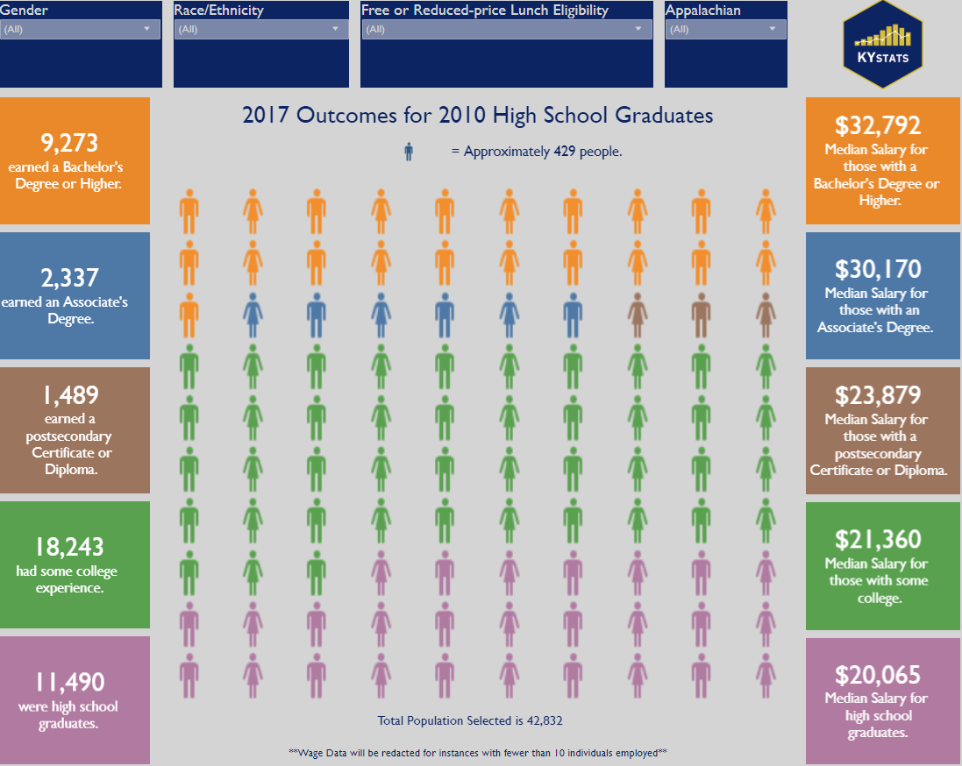

Slide 18
Kentucky’s NSFY Grant Vision
Align Pathways to LMI
Incentivize the Sharing of Resources through Creation of Career Academies
Ensure Industry Recognized Credentials are “of Value”
Improve CTE Teacher Retention
Create “True” Career Pathways (Increase DC)
Increase Employer Engagement

Slide 19
Top Five Industry Sectors for Kentucky
Healthcare and Social Assistance
Business and IT Services
Transportation, Distribution, and Logistics
Construction
Advanced Manufacturing
Notes:
Proposed by Economic Development, Agreed on by State Chamber, Approved by KWIB, Used by K-12, KHEAA, KCTCS, CPE

Slide 20
Top Occupations in Top Sectors
Notes:
This work has to be done both at the state level and at the regional level.

Slide 21
Alignment between Occupations and Career Pathways
Advanced Manufacturing
Welders
Ag Power, Structural, Technical Systems
Welder Entry Level
Welding Engineer
Welding Maintenance Technician
Notes:
Must be completed by experts on the pathways, which is not typically B&I.

Slide 22
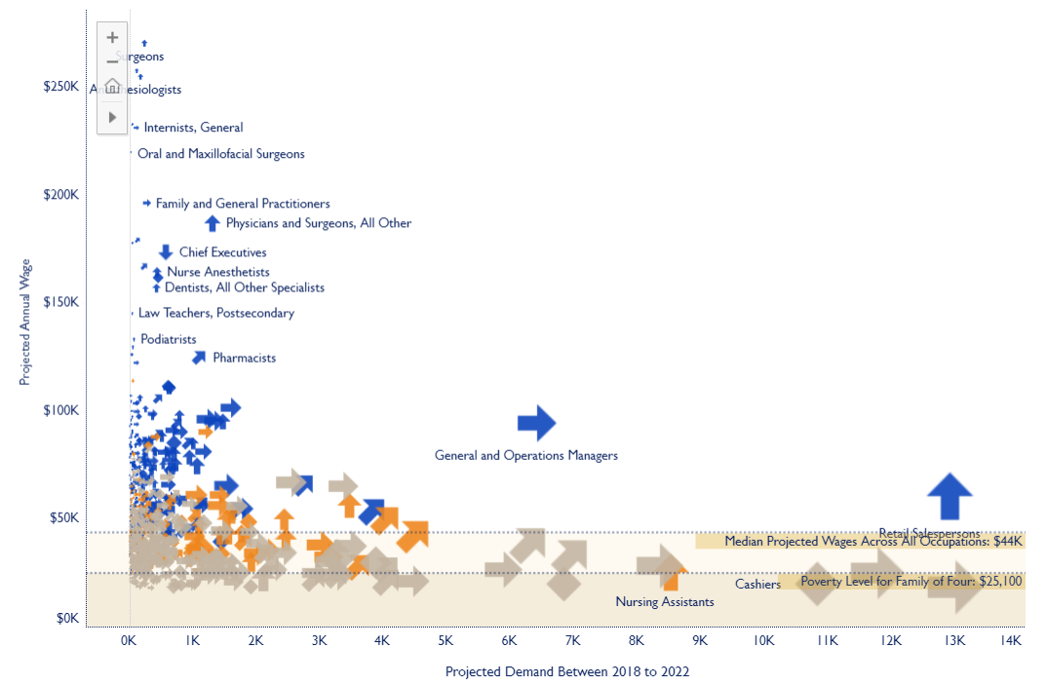

Slide 23
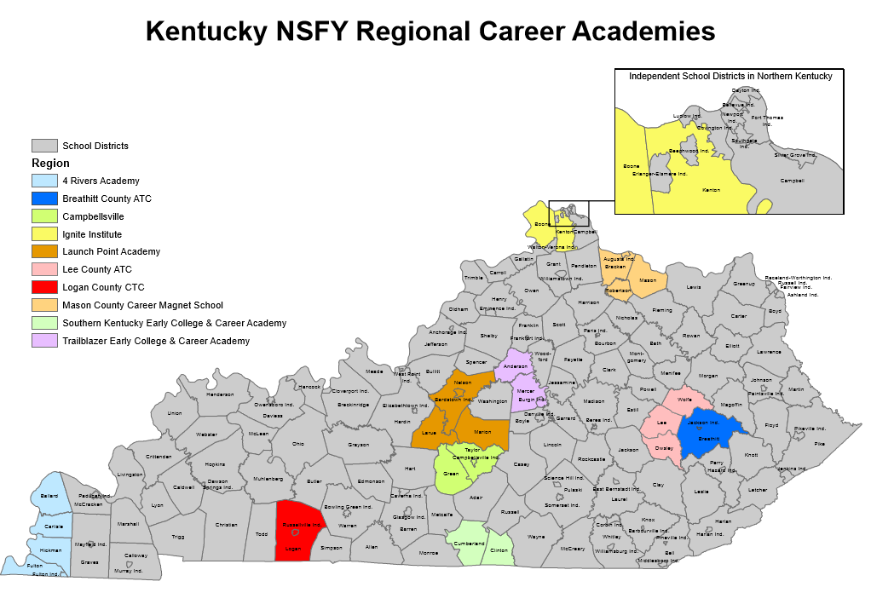

Slide 24
New Skills for Youth
10 Academies
32 School Districts
13 CTC or ATC Centers
200 new B&I Partners
13 Postsecondary Institutions

Slide 25
Regional Asset Mapping: Who Should Be Involved?
K-12
Leaders
Business & Industry Partners
Postsecondary Partners
Community Organizations

Slide 27
Asset Mapping: Career Pathways
Pathway Offerings Aligned to Top 5 Industry Sectors
Overlaps and Duplication?
Support Sector and/or Local Workforce Priorities?
Gaps?
SWOT Analysis

Slide 28
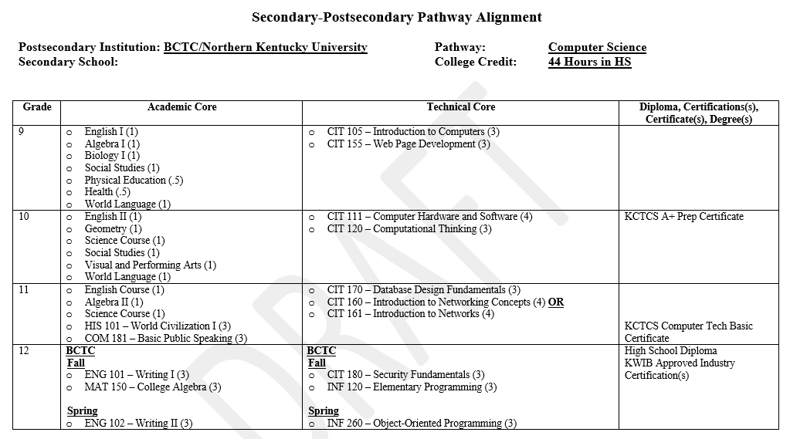

Slide 29
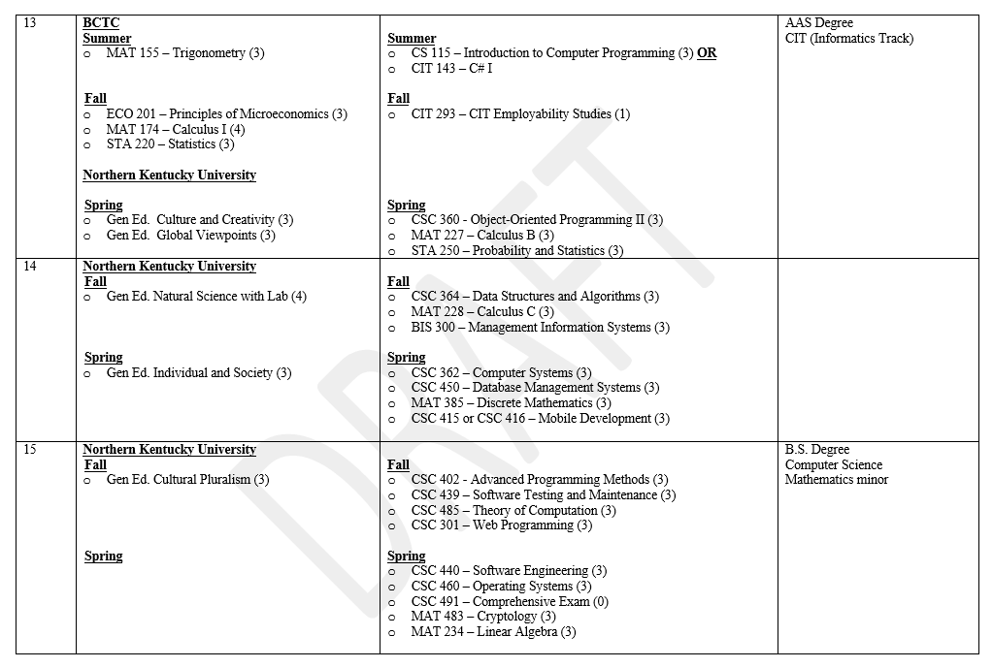

Slide 30
Final Thoughts
Partnership is Key (PS and B&I)
Accountability and Money Matter
Data Makes a Difference
Selling and Marketing is Tough
This work takes a lot of time (Overhauling is not completed overnight)
Perkins Local Needs Assessment

Slide 31
Massachusetts Career Readiness System December 12, 2019
Kerry Akashian, Ph.D.
Career Development Education Lead

Slide 32
Thank You to NSFY
Support
Thought Leadership
Beneficial Outcomes of the Partnership

Slide 33
Key Content Takeaways:
The State Context: Helpful information to better understand the approach that MA takes to deliver High Quality College and Career Readiness Activities
Challenges encountered and solutions
Recommendations/ideas for other states

Slide 34
State Context
Emerging Workforce Shortage
Disengaged High School Students
Notes:
What do we need to know about your state’s career readiness system to understand your approach?
EWS due to decline in high school graduates, drop in college enrollment, stagnant high school performance, disengaged hs students

Slide 35
Challenges
Efforts across agencies were not streamlined
Lack of consistency in what makes a pathway high quality
Underdeveloped strategies for college and career advising
Notes:
What challenges did you encounter while working to transform and expand career pathways under NSFY?

Slide 36
Addressing Challenges/Lessons Learned
Cross-Agency Work
Developing Criteria for High Quality College and Career Pathways
College and Career Advising Framework, MYCAP
Notes:
How did you address challenges as you worked towards transforming and expanding career pathways under NSFY?

Slide 37
Questions?
Kiley Whitaker, kiley.whitaker@education.ky.gov
Kerry Akashian, Kerry.Akashian@doe.mass.edu
Brianna McCain, bmccain@careertech.org
Follow Advance CTE @CTEWorks

