Slide 1
Messaging to Underrepresented Populations:
Aspen CEP’s Findings
Tess Henthorne, Program Manager

Slide 2
Why do student graduation and employment outcomes matter so much for our communities?
For the nation?

Slide 3
There’s a Disconnect Between Available Talent and Employment
Populations remain stranded in low wage work and poverty
Yet employers struggle to find workers for good jobs
83% increase in the number of good jobs for workers with associate‘s degrees between 1991 and 2016
24.9% of children under age 5 in poverty
46% of employers reported difficulty filling positions due to lack of available talent
10.3% of all adults are working poor or unemployed
Higher Education is the Surest Path Out of Poverty
Median weekly earnings increase significantly among workers with education beyond high school:
$712/week with a high school diploma
$836/week with an associate’s degree
$1173/week with a bachelor’s degree
Notes:
Data Sources:
200% of the federal poverty level = approximately $24,000 per year
Source: IPUMS, PolicyLink/PERE National Equity Atlas, www.nationalequityatlas.org
# of opportunity youth = (Aspen Institute Forum for Community Solutions, 2018)

Slide 4
Aspen Research Explores Hard To Reach Populations
Who’s not here?
What did we ask them?
Perspectives on work
How do you think about work currently?
What makes a “good job”? What barriers exist in getting one?
Opportunity Youth
Young adults age 16 – 24, neither in school nor working
4.6M
Perspectives on community college
What do you think about attending a community college program?
What impressions do you have of your local community college?
41M
Underemployed Adults
Adults earning less than $12 an hour
Unemployed Adults
Adults not currently a part of the U.S. workforce
Communication language and channels
Which messages, words, and ideas are the most or least persuasive?
Which people and sources do you trust most for advice in thinking about future job or education opportunities?
6M
Notes:
Data from
https://www.bls.gov/opub/reports/minimum-wage/2017/home.htm
https://www.oyunited.org/

Slide 5
Aspen CEP’s Research Methodology
Qualitative
8 focus groups
Segmented by race/ethnicity, gender, and age
Diverse geographies:
Ft. Lauderdale, FL (suburban)
New Cumberland, PA (rural)
Chicago, IL (urban)
Quantitative
Online survey of 1885 respondents
Included general population and target groups
Across national geography
November – December 2018
January – March 2019

Slide 6
Perception of Careers, Education, and Training

Slide 7
Age and Employment Status Influence Feelings Toward Current Job Situation
Underemployed Adults
Unemployed Adults
Opportunity Youth
General Population
Grateful (30%)
Comfortable (25%)
Stressed (26%)
Frustrated (23%)
Disappointed (17%)
Hopeful (16%)
Grateful (8%)
Comfortable (11%)
Stressed (46%)
Frustrated (42%)
Disappointed (40%)
Hopeful (17%)
Grateful (17%)
Comfortable (18%)
Stressed (39%)
Frustrated (35%)
Disappointed (28%)
Hopeful (20%)
Grateful (22%)
Comfortable (31%)
Stressed (21%)
Frustrated (18%)
Disappointed (15%)
Hopeful (19%)
I'll find myself jumping from job to job to job a lot because of the pay. But, good paying doesn't always mean good work. Because I will get the job and literally be miserable the whole time I'm there. So I end up leaving the job and then I get another job and that's even worse. So, it's just like bouncing from job to job to job. I'm just tired of doing it.
– Underemployed women (Chicago, IL)
Right now I am helping my mom pay her bills, so I can't just quit that job. She’s relying on me.
– Opportunity youth (New Cumberland, PA)

Slide 8
All Audiences Indicate They Face Barriers and Need More Job Training
Underemployed Adults
Unemployed Adults
Opportunity Youth
General Population
Job Search
45% | 50% | 54% | 29%
44% | 44% | 45% | 34%
35% | 30% | 38% | 26%
Want to find a better job, but don’t know how
Accessibility
Do not think there’s a good job market where they live
Interpersonal Bias
Don’t think employers want to hire people like them

Slide 9
Audiences Are Drawn By a Blend of Pragmatism and Passion
Meeting basic needs
“I live with my mom and need to be able to support her if something happens. She’s all I have so I got to make it work.”
— Under/unemployed adults (Chicago, IL)
61%
of unemployed adults
strongly agree with the statement: “I want a reliable job with steady pay”
61%
of underemployed adults
Pragmatism
61%
of opportunity youth
A job they love
“A good job is something you want to do. Not necessarily always the pay, but something you enjoy doing.”
— Under/unemployed adults (Chicago, IL)
46%
of unemployed adults
strongly agree with the statement: “I want to feel inspired / passionate about my work”
45%
of underemployed adults
Passion
51%
of opportunity youth

Slide 10
And Many Have a “Hustle” Spirit That Propels Their Career Interests
I really want to invest in houses and remodel houses. All I watch is HGTV. You can get hired to find a fixer-upper house and make it look nice to invest or just sell it.
— Under-/unemployed women (Chicago, IL)
I drive for Lyft. I can work when I want. Time to take care of my little one. I love the freedom.
— Under-/unemployed adult (Chicago, IL)
You want to be your own boss. So, anything you're looking for should always be in your head. I'm working on this to better myself so I don't have to work for anyone else.
— Opportunity youth (Fort Lauderdale, FL)
I want to play video games and get paid for it. Playing video games for a career, you can make a lot of money, like on YouTube.
— Opportunity youth (New Cumberland, PA)
It's very important to me that I get to manage my own time and make my own money and be in control of all that stuff.
— Under-/unemployed white men (New Cumberland, PA)
6 of 8 focus groups discussed entrepreneurship as an ideal career path.
Notes:
Respondents desire perks like flexibility and the ability to “be your own boss” that come with entrepreneurial and gig work. Many also aim to enter fields that they consider “in-demand” based on media portrayals.
Stereotypes about people not wanting to try. But what we found in FGs was that there was a major drive for entreprenuership based on a need to be self reliant because of bad experiences with employers and work, not because they weren't wanting to try

Slide 11
Community College Experiences and Attitudes

Slide 12
Familiarity with Community College Leads to More Positive Impressions of These Institutions
Factors that Increase Positivity
Familiarity with community college
Attended community college
Work 40+ hours, 1 job
Income greater than $26,000
59% positive
Familiarity with community college
Attended community college
Male
Interest in STEM careers
54% positive
61% positive
Familiarity with community college
Attended community college
68% positive
Familiarity with community college
Attended community college
Employed

Slide 13
But Target Populations Are Less Familiar with Community Colleges Than the General Population
Underemployed
Unemployed
General Population
43%
unfamiliar
45%
unfamiliar
34%
unfamiliar
Opportunity Youth
37%
unfamiliar
Very Familiar
Somewhat Familiar
Unfamiliar

Slide 14
And It’s Clear That Messages Need to Address Skepticism and Pre-Existing Bias
Negative Experiences
Program Costs
Opportunity Costs
One negative experience in someone’s network influences perception of higher education overall
Target audiences are highly skeptical of program costs and generalized outcomes
Opportunity cost is critical when evaluating program options
“I know a lot of people got bachelor’s degrees and they can’t find a job. And if they can’t find a job with their bachelor’s degree, what am I going to do with my little old associate’s?”— African American Opportunity Youth (Chicago, IL)
“It’s a waste of time and money. I didn’t learn anything. Those teachers, they didn’t care about anyone.
— Under/unemployed adults (Fort Lauderdale, FL)
“I have a total of 5 kids […] I’m sure I could do community college if I put my mind to it, but there’s just not enough time.”
— White Males (New Cumberland, PA)
Notes:
. Many indicated that someone in their personal network had a negative experience with college, as a result, were often deterred. Notably, it did not matter which kind of institution (4-year, community college, for-profit college) was responsible for the negative experience – one negative story about any higher education option tainted audiences’ perceptions of all higher education options.
Quotes from focus groups?
Participants typically found costs cheaper than expected but are skeptical about what the advertised amount actually covers.
They are willing to spend longer in a program that with a flexible schedule, rather than a shorter time in a full-time program that forces them to give up current obligations (e.g., 18 months online is good, 18 months full time is not).

Slide 15
What Happens When Messaging to Target Populations

Slide 16
Which Messages and Ideas Work?
PROGRAMS THAT FIT YOUR LIFE
YOU ARE IN-DEMAND
YOU’RE WORTH THE INVESTMENT
Presenting the most appealing aspects of community college programs and training, level of preparation, relevance to the real world.
Highlighting the in-demand industries, employer interest in adults new to the workforce, good jobs available.
Empathizing with the practicalities and putting their dreams in reach, with “guarantees” of job placement.
YOUR PATH TO A GREAT JOB
YOU CAN DO THIS AND YOU’RE NOT ALONE
Positioning programs as the path to build upon existing skills and find a stable career path you will love.
Speaking to family and aspirations, nontraditional student experience and showing it is do-able.

Slide 17
Two Messages Rose to the Top That Made the Pitch to Head and Heart
Programs that Fit Your Life
You’re Worth the Investment
Aims to address busy working adults who don’t believe they can attend school and still work
Speaks to people uncertain about the return on their investment if they decide to go back to school
That means I can learn and I can eat and pay my bills at the same time. That’s important.
– Under-/unemployed adult (Chicago, IL)
Well, right now I am helping my mom pay her bills, so I can’t just quit that job. She’s relying on me.
– Opportunity Youth (New Cumberland, PA)

Slide 18
When Colleges Use the Right Messages, Populations Have a Statistically Significant Increase in Level of Interest in Programs
Interest levels rose across audiences after reading the description.
Unemployed adults shown “new skills training” language were significantly more interested in programs after reading the description.

Slide 19
“Careers” and “Jobs” Are Not Interchangeable
My perception of a career is something that I'm just going to be doing that. I don't think I want any kind of finality, to say: "Yes, I was a train engineer my entire life.” – White Males (New Cumberland, PA)
A career is pursuing a passion that you have, that you can still make money with. – Opportunity Youth (New Cumberland, PA)
I want a career so bad, it seems like it's just right there but I just can't reach it. – African American Under/unemployed Adults (Chicago, IL)
“Careers”
are long-term, secure
A blue collar job is what I have, and a career is what I am looking for. – Under/unemployed adults (Fort Lauderdale, FL)
If it's not something that I see myself wanting to do as a career, getting comfortable if it's just a job is dangerous.
– Opportunity Youth (Fort Lauderdale, FL)
A job is temporary.
– African American Opportunity Youth (Chicago, IL)
“Jobs”
are the here and now

Slide 20
“New Skills” Training is Relatable and In Demand
The term “new skills training” may carry less baggage than “community college,” as indicated by focus group respondents.
Split sampling of this language in the survey reveals nuances between our three audiences: “new skills training” is a better way to get the attention of the unemployed while the underemployed and opportunity youth react similarly regardless of language used.
New Skills Training is something close to me because I think acquiring new skills is beneficial to your job and career. Learning new things is how you advance.
– Opportunity Youth African American (Chicago, IL)
of unemployed respondents indicated interest in a “community college” program.
55%
I'm looking to start a new career, so any kind of new skills training for me would be great.
– White Males (New Cumberland, PA)
66%
of unemployed respondents indicated interest in “new skills” training.

Slide 21
Audiences Want a Guarantee That Community College is Worth the Investment
Audiences want some degree of a “guarantee” of post-graduation outcomes, including earnings and employment metrics. They are skeptical about outcomes data not specific to the program, like general industry data, or data that seems to good to be true, like points from top-earning graduates, but responded to specific language about financial supports in message testing.
Using the highlighter tool, our populations selected:
Unemployed Adults
Underemployed Adults
Opportunity Youth
Grants (23%)
Transportation (22%)
[Opportunities for] work (14%)
[Not getting] rich (3%)
Grants (20%)
Transportation (28%)
[Opportunities for] work (16%)
[Not getting] rich (5%)
Grants (16%)
Transportation (24%)
[Opportunities for] work (10%)
[Not getting] rich (9%)
Lower than average
Higher than average

Slide 22
Overarching Program Messages Work, But Are Strengthened By Tailoring to Audiences
Underemployed
Unemployed
Opportunity Youth
Practical reassurance – Programs are flexible, and your goals are achievable.
Encouragement – Programs help you succeed and get you on the path to a good job.
Aspiring – Programs are flexible, you decide, and you have options for the future.
What Works
Flexibility
Real-world skills
Be marketable
Financial aid
Free tutoring
Good jobs
Flexibility
Real-world skills
Financial aid
Free tutoring
Job placement
Flexibility
Financial aid
Free tutoring
Opportunities
Your work matters
Key Language

Slide 23
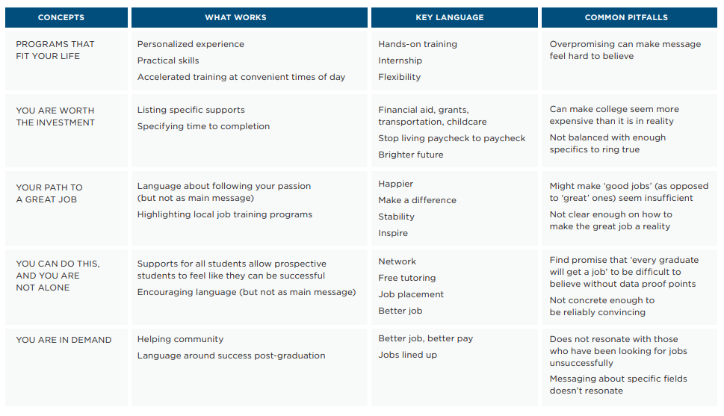

Slide 24
Messengers and Communication Channels

Slide 25
Messengers Also Matter in Gaining Trust: The Most Trusted Sources are Not Always the Most Used, and the Most Used are Not Necessarily the Most Trusted
Used and Trusted
Used, Not Trusted
Trusted, Not Used
Friends/co-workers
Family members
Career services and
job placement centers
31%
Online job board postings
Classifieds/other advertising
Social media
37%
Church/religious organization
School counselor
Nonprofit organization
4%
27%
28%
6%
16%
6%
25%
Career services and job placement centers used extensively by unemployed adults but not other target populations
Most used source by opportunity youth, but the least trusted
Highly trusted source for underemployed and unemployed adults, but not trusted by opportunity youth

Slide 26
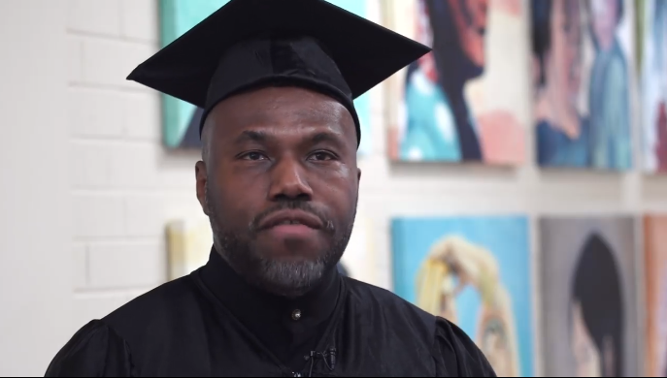
In the Field: The Right Messages with the Right Messengers
Strategy 1: Increasing Use of Highly Trusted Sources
Strategy 2: Increasing Trust in Highly Used Sources
Generation USA offers short-term skills training based on regional demand
Accelerated Skills Training Program provides short-term, niche skills training for low-income adults
Messages focus on the program’s free cost and success stories from recent completers
Message is affirming, but addresses barriers low-income adults face
Social media not trusted as a channel, but testimonials from real students from diverse backgrounds serve as “digital peers”
Partnerships with Goodwill help to spread the word
Partnerships with employers help to reach low-income incumbent workers
Approach has allowed Generation USA to source 50% - 60% of participants from these ad campaigns

Slide 27
Final Takeaways

Slide 28
Our Research Revealed Key Insights Around Messages That Work
Balance Pragmatism and Passion
Reinvigorate Perspectives
Pragmatism should lead in messages, but showing passion and providing encouragement should also be incorporated. Emphasize the how (e.g., flexibility, financial aid, and childcare) and the what (ROI, guarantees) alongside encouragement.
Messages should reinvigorate the picture of today’s new experiences and encourage audiences to revisit their perspectives. Personal experiences (that are often dated) and word of mouth impact impressions and interest levels for community colleges.
Focus on Student Success
Provide Concrete Examples
STEM “categories” do not resonate as intended, and audiences often misinterpret what jobs fall within each category or hold stereotypes, impacting levels of interest. Instead, focus on about how the program can enable students’ success.
Many approached messaging with a veil of cynicism based on their current employment situations. As a result, some positive, well-intentioned messaging came across as inauthentic and untrue. Messaging should provide concrete examples and mobilize word of mouth.

Slide 29
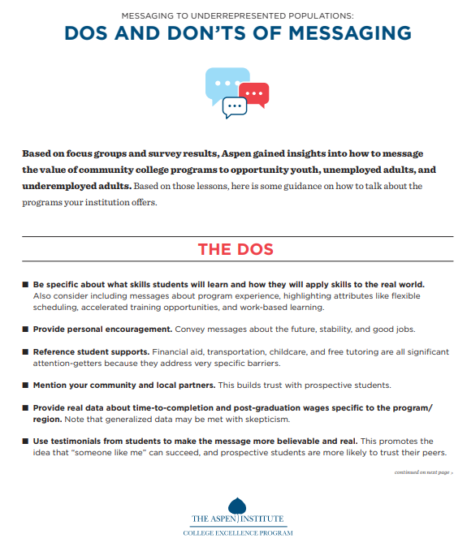
Messaging Dos and Don’ts
Be specific about skills students will learn and how they apply to the “real world.”
Provide personal encouragement.
Highlight student supports.
Mention your community and local partners.
Provide real data about time-to-completion and post-graduation wages.
Use testimonials from students to make the message more believable and real.

Slide 30
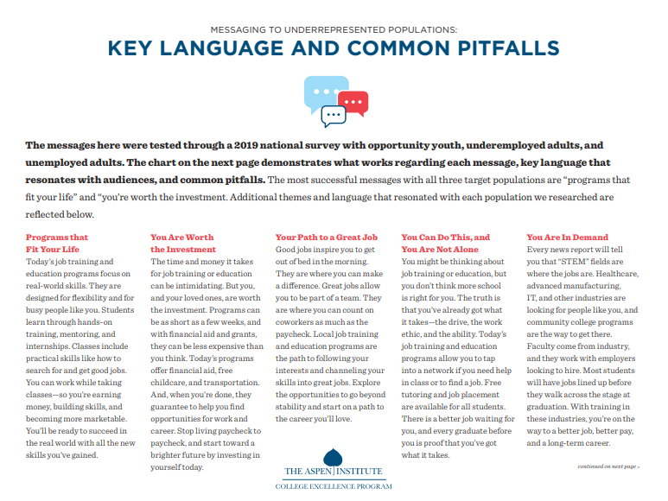
Programs that fit your life
Key Messages
What works:
Personalized experience
Practical skills
Opportunity for mentorship
Key language:
Hands-on training
Internship
Flexibility
You’re worth the investment
What works:
Calling out specific supports
Timing/specifying time to completion
Key language:
Financial aid, grants, transportation, childcare
Stop living paycheck-to-paycheck
Brighter future

Slide 31
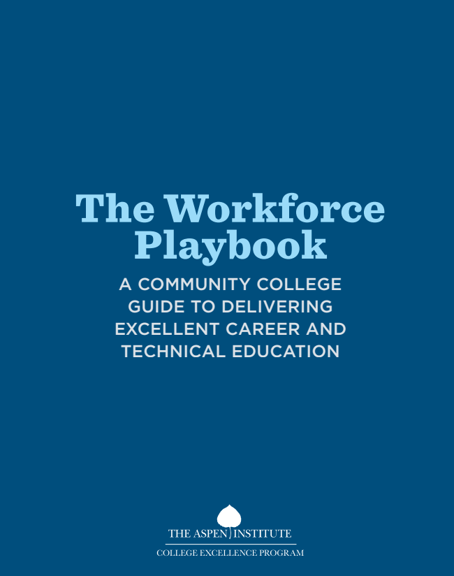
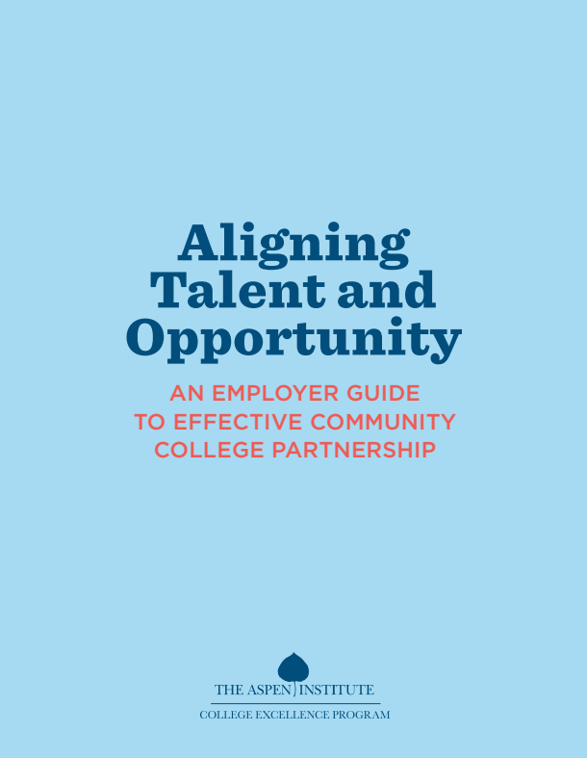
To Access Aspen CEP’s Materials
Visit our website at highered.aspeninstitute.org/research/

Slide 32
Connect With Aspen
Aspen CEP: linkedin.com/showcase/aspenhighered/
Tess Henthorne: linkedin.com/in/tess-henthorne/
Follow along for updates on the Excellence and Equity in Community College STEM Award
@AspenHigherEd
Tess.Henthorne@aspeninstitute.org

Slide 33
Thank You!

