Slide 1
Strategies for Communicating CTE and Connecting with Historically Marginalized Populations
Stacy Whitehouse, Senior Associate for Communications and State Engagement

Slide 2
Presentation Areas of Focus
Research background
Key findings
Considerations for historically marginalized populations
Putting research into action

Slide 3
Poll Question
What is your biggest challenge recruiting secondary learners into CTE programs?

Slide 4
Research Background

Slide 5
Background
Partnership with Siemens Foundation to address stagnant recruitment into Career Technical Education (CTE) programs that are vital to a skilled workforce.
Goals: Develop effective, equitable recruitment practices that frame CTE as meeting the needs and goals of families and empower stakeholder to put research into action.
2 rounds of research: 2017 and 2020
Notes:
Principle 1: Cohesive systems that families can easily understand and navigate to match their education aspirations and find path to college and career success
Principle 2: Learner-centered systems that close equity gaps with programs designed on the margins and messages that align and listen to intended audiences
Principle 3: Empower learners through informed trusted sources, integrated advising, and equitable access to information

Slide 6
Content
Test resilience of 2017 research findings in current environment
Confirm what families want in their education
and satisfaction level in and outside of CTE
Test timely messages on what is most compelling to families about CTE and who should communicate it
Focus on findings by race/ethnicity and income to identify equity barriers to CTE and message tailoring
Notes:
Identify key sources and communication channels for CTE

Slide 7
Advancing CTE Without Limits
Principle 1: Each learner engages in a cohesive, flexible and responsive career preparation ecosystem
Principle 2: Each learner feels welcome in, is supported by and has the means to succeed in the career preparation ecosystem
Principle 3: Each learner skillfully navigates their own career journey
Notes:
Principle 1: Cohesive systems that families can easily understand and navigate to match their education aspirations and find path to college and career success
Principle 2: Learner-centered systems that close equity gaps with programs designed on the margins and messages that align and listen to intended audiences
Principle 3: Empower learners through informed trusted sources, integrated advising, and equitable access to information

Slide 8
Research Methodology
This research explored what middle and high school families are looking for in their education and what messages resonates with them about CTE.
Prospective Families: Learners and parents/guardians interested in but not currently participating in CTE
Current Families: Learners and parents/guardians who’s learner is participating in one or more classes in a CTE program of study
Families: Encompasses findings from both learners and parents/guardians
Notes:
NOTE: Some attendees got confused with what families meant, so it’s helpful to emphasize that term.

Slide 9
Research Methodology
Qualitative
Quantitative
10 Virtual Focus Groups
2 Current Learners & Parents/Guardians
8 Prospective Learners & Parents/Guardians
1 Universal Prospective group, 7 disaggregated by income, race and ethnicity
Oversample of Black, Latinx, and low-income families
National Online Survey
1,098 parents/guardians
255 Current adults
843 Prospective adults
1,058 learners
256 current learners (9-12th)
802 prospective learners (6-11th)
Oversample of Black, Latinx, and low-income families
Notes:
The key takeaway from this slide is the difference in this research from 2017 - we focused on exploring how messages resonated with historically marginalized

Slide 10
Findings

Slide 11
Key Findings
CTE Still Delivers for Families
‘Preparing for the Real World’ a Proven Message for Recruitment
CTE Priorities vary on exposure, but finding passion is consistent priority
CTE Prepares Learners for College and Career Success
Informed and Diverse school leaders are critical for CTE Recruitment and Retention

Slide 12
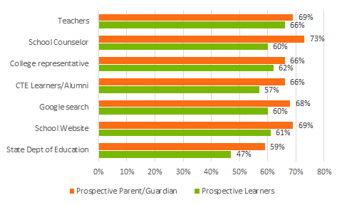
YOU Matter in Communicating CTE
Sources named by families as Top 2 Sources for information about CTE
Notes:
Our last finding focuses on Messengers where we asked “Which of the following are you likely to utilize to receive more information about CTE?”
The great news is you don’t need a big ad campaign to get to CTE to families effectively - our findings from 2017 continued with teachers and counselors as the go-tos
Learner voice continues to be important - CTE learners and alumni are a top 5 source for P and C families
Not surprisingly, parents are more likely than learners to consult non-school sources (employers, community orgs)
How to Use: Equipping sources closest to families particularly important. Mention advisor curriculum. Also reinforces importance of message consistency across all platforms
You may see that online sources were popular, reinforcing the importance of learners seeing themselves in recruitment materials as these sources were popular among black and low-income families. Online sources of information about CTE should be up-to-date, use digestible terminology, and be available in the language(s) of your target audience
Black and Latinx parents/guardians were significantly more likely to consult school counselors than Black and Latinx learners

Slide 13
CTE Still Delivers for Families
53% of Current CTE Parents/Students Very Satisfied
with overall school experience
(88% satisfied)
28% Prospective Parents/Students Very Satisfied with overall school experience
(75% satisfied)

Slide 14
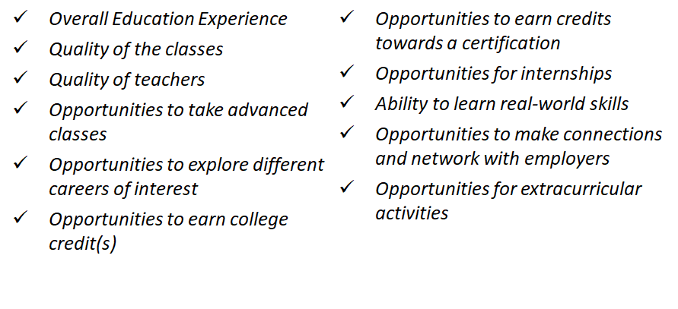
CTE Families More Satisfied with Education Quality and Opportunities
Those participating in CTE and their parent/guardian are more satisfied than those not involved in CTE in regards to:

Slide 15
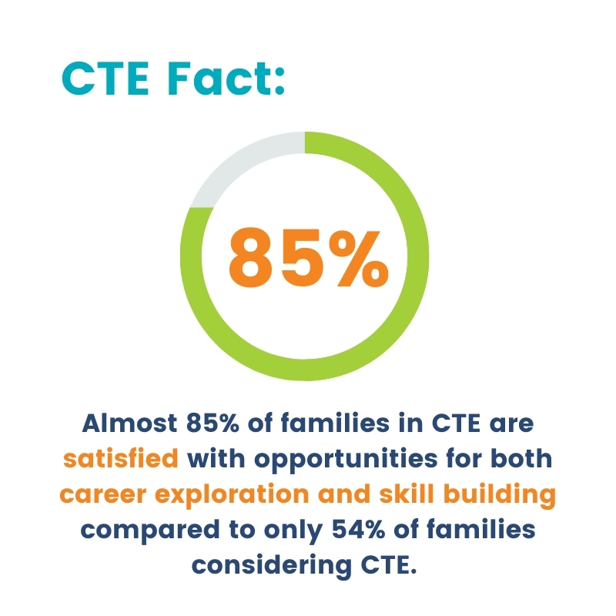
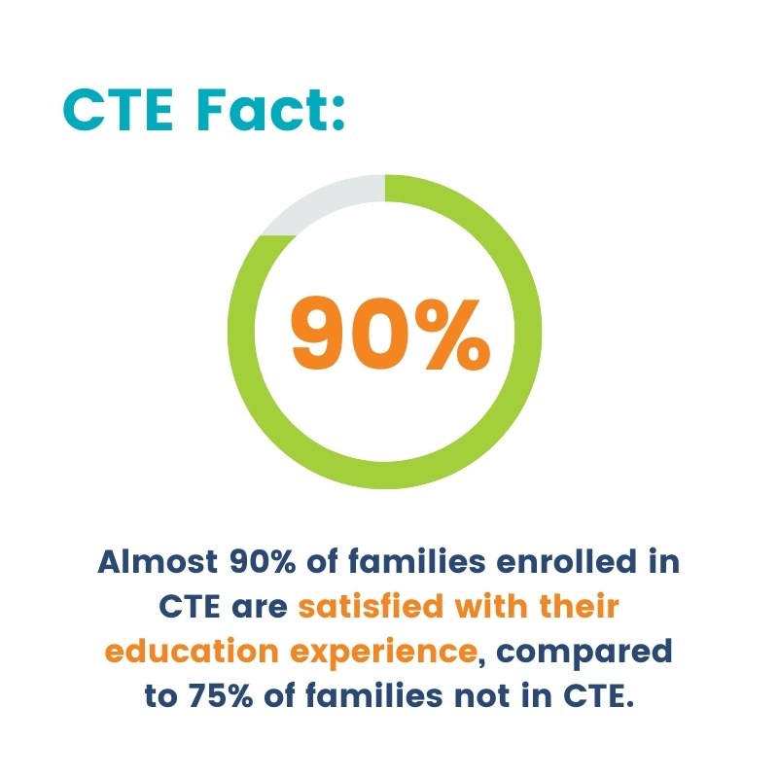
CTE Still Delivers for Families

Slide 16
Families Desire Key Aspects of CTE in Education
Top Aspect | % Ranked Top 2 CURRENT | % Ranked Top 2 PROSPECTIVE
Opportunities to take classes that focus on gaining skills in a specific field | 51% | 46%
2. Opportunities to take classes for career exploration | 40% | 50%
3. Opportunities to take AP, IB, & other advanced classes | 36% | 36%
4. Opportunities for an internship | 28% | 20%
5. Opportunities to participate on clubs and extracurriculars | 16% | 16%
6. Opportunities to take classes in the arts (visual, performance, etc.) | 15% | 17%
7. Opportunities to participate in sports | 15% | 15%
Notes:
This slide highlights one of our messaging focuses- what parts of education are families most attracted to to ‘Prepare to the Real World?’
Answer is that families are looking for career exploration and skillbuilding in their education
Chart is all the options families chose as their top two most important aspect of education
Career Exploration and Skill Building are the top choices at 40-50% compared to four other choices at 15-20%
Prospective families favored career exploration over skillbuilding, whereas current families favored skillbuilding (this is not surprising)
State should consider this nuance when messaging to families - prospective families may not know what CTE has to offer or what career path to follow
Famlies want key aspects of CTE in their education, and CTE is one of the few path currently to have those opportunities

Slide 17
Families are Attracted to the Real-World Benefits of CTE
“Preparing for the Real World” was still the top message chosen by both prospective and current families on the value and benefit of CTE.
“Preparing for the real world” was also chosen as the top desired benefit/outcome for CTE by both prospective and current families.
Families viewed career exploration and skillbuilding as key aspects to preparing learners for the ‘real world’
Notes:
This message was especially effective for prospective families, and most effective among prospective Latinx families.

Slide 18
CTE Benefits and Outcomes:
Finding Passion A Top Priority
Prospective and current parent/guardians and learner placed finding a career passion in their top two outcomes and benefits of CTE out of 22 options.
Finding a career passion was ranked above finding a well-paying job, earning college credit, and having experiences that stand out on college and job applications
Top CTE Benefits
and Outcomes for Prospective Families
Preparing for the Real World | Finding career passion
Getting hands-on experience | Learning life skills
Discovering “right fit” for career
Notes:
The next layer is exploring what families want to get out of career exploration and skill building, and this slide looks at the benefits and outcomes families are looking for from CTE.
Earlier we mentioned Preparing for the Real World was universally #1. Finding a career passion was universally #2.
Talking point #2 especially important because what employers and policymakers see as benefits from CTE are not necessarily the top priority for families
Families want to marry opportunity with passion to help their learner find a career that aligns with their interests
2020 vs. 2017: We found passion to be important in 2017, but felt it had to be elevated because it was so prominent even consider all the upheaval that has occurred.
In our focus groups, we had families where parents/guardians had lost their jobs due to COVID. Even still, they wanted their learner to have a job they love and makes a difference
Table: Lists the top benefits found in the research that aligns with everything else already previous discussed
How to Use: Drive home this message when talking with ALL stakeholders how families want to hear about CTE.

Slide 19
CTE Helps Each Learner Prepare for and Complete College
Preparation
Plan to Complete Postsecondary Education
Families’ Satisfaction with opportunities to earn college credits and take advanced classes:
Current = Over 80% Prospective = 60%
Latinx
Families
Families Experiencing Low Income
60%
55%
42%
36%
Prospect Current
Prospect Current
Notes:
Pushes back on potential stigma and lingering perception of CTE as not as advanced; important for closing equity gaps
This slide revisits the positive finding that CTE learners feel more prepared for college but highlights how it closes equity gaps along racial lines
Latinx parent/guardians stood out as the highest percentage of those saying learners would only complete “some college”
Encouragingly, the percentage of those saying they will complete college significant rises when you participate in CTE (to 60% among Latinx families and 55% among Families experiencing low income)
NOTE: Black Families were actually higher than whites on their confidence in completing college for both prospective and current, so that is why they are not highlighted here
How You Use: Extremely important that messengers are specific about how secondary CTE connects to postsecondayr opportunities. We know historically marginalized populations face significant barriers to college access and completion, and these findings showing CTE can overcome some of those barriers is something to be celebrated.

Slide 20
Fedex Ad

Slide 21
Discussion
What finding do you most want to act on in your school?
Did anything surprise you?

Slide 22
Effective Messaging
Notes:
BREAK: Any questions about findings?
This next section will go a little more in depth in what messages are tested, which is what makes Advance CTE’s research unique.

Slide 23
Message Testing
Tested three messages for:
Believability
Personal connection,
Relation to current education experience
Likelihood to enroll in CTE
Messages: Prepare for the Real World, Safe Bet in this Economy, and Making Connections
Force choice of the message that makes CTE sound like a good options
Notes:
Three messages were tested across four categories (1st bullet point), and all three had positive results
However, when asked to do forced ranking 1 stood out
Our message testing choices were different than 2017, which tested 6 messages such as Smart Investment, Get a leg Up, Get More form HS. We found out that these messages of ‘difference’ did not resonate and Prepare for the Real World did
Our 2020 messages are overarching themes that any stakeholder could use

Slide 24
Messages
Preparing for the Real World: Effective message in 2017 focused on CTE’s value in cultivating real-world skills and practical knowledge through hands-on experiences and career exploration to prepare learners for the real world.
Safe Bet in this Economy: Selected due to traction on messaging for CTE’s role in the economic recovery and concerns about significant sector-based job loss. Focused on CTE’s value in cultivating in-demand, transferable skills with input from employers that are evergreen in the rapidly changing world of work.
Making Connections: Inspired by focus group responses on current CTE experiences. Focused on CTE’s value in building relationships with like-minded peers, instructors, and employers through mentorship, internships, and other hands-on experiences.
Notes:
Mostly read off of the slide
Safe Bet: Regardless of good or bad economy, CTE provides skills for a sustainable career.

Slide 25
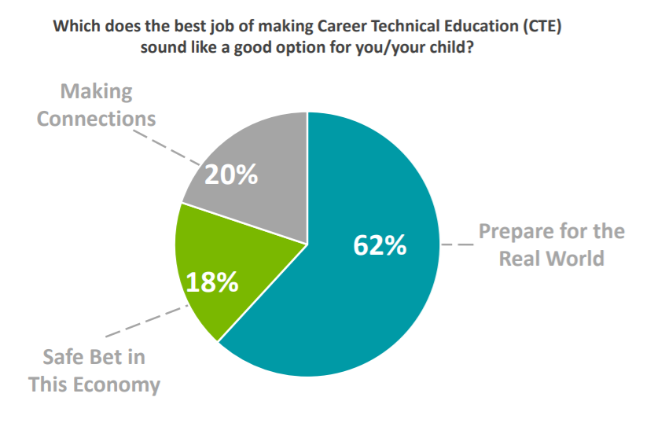
Message Testing Choice
Notes:
Talk more about what was emphasized in each message in the description
64% Prospective Families, 56% Current Families, 69% Prospective Latinx Families (Highest)

Slide 26
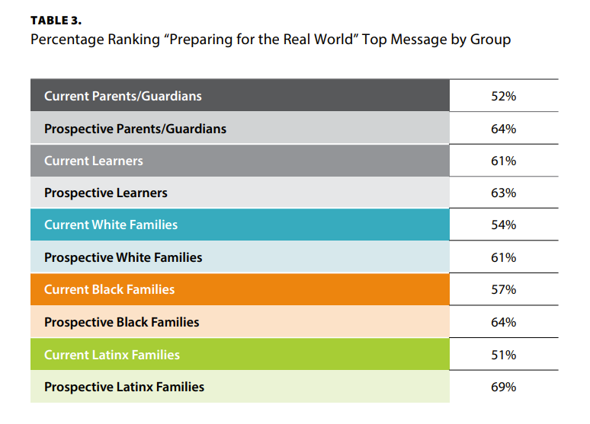
Equitable Message Impact
Notes:
Talk more about what was emphasized in each message in the description
64% Prospective Families, 56% Current Families, 69% Prospective Latinx Families (Highest)

Slide 27
Most Effective Message:
Preparing for the Real World
Continues top message from 2017 research
Top message across participation, race, and income
Reinforces top outcomes/benefits desired from CTE
Gives purpose to learning by emphasizing real‐world skills and practical knowledge
Students receive hands‐on training, mentoring, and internships from employers in their community.
help students explore different options before they start college or a career, and get them ready for the real world.

Slide 28
Chat Storm
What message resonated with you the most that you want to include in your marketing materials?

Slide 29
Equity Considerations for Historically Marginalized Populations
Notes:
BREAK: Any questions? We know it’s a lot to digest
This last section will cover equity considerations that we found.
This is not meant to change the messages we just gave
Rather, its to offer message tailoring to ensure messages resonate with each family and learner and address historical barriers to participation
This is one of the key changes to this round of research compared to 2017

Slide 30
Real World Skillbuilding, Hands-on Experiences Face Satisfaction Gaps
Career exploration and gaining skills in a specific field had equitable difference in satisfaction among race/ethnicity and income between prospective and current learners
However, White learners had significant higher differences in satisfaction between prospective and current groups for internships and networking with employers than Black, and Latinx learners
Quality, equity and access for CTE programs matters for effective communication to families
Notes:
Have to start on not such a great note but what is one of the most important findings from the presentation
Why Important: This has a lot of program and policy impacts because program quality is not equitable. If the program quality is not equitable, communications about progrrams are not going to be effective and learners will either not enroll or won’t stay in programs.

Slide 31
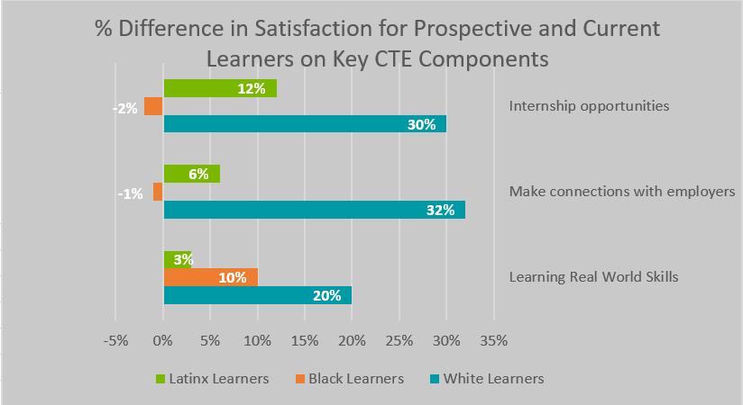
Real World Skillbuilding, Hands-on Experiences Face Satisfaction Gaps
Notes:
Black prospective statistically just as satisfied as current CTE learners, which is not good
Note: Findings were found in learners but not parents. This is not too surprising as learners are the ones on the ground in these experiences.
Why this matters: Social capital and the potential of these programs to close equity gaps in building networks. Many people try to say you get networks through luck or being a ‘social butterfly’, but that is not the case in reality. Systems can facilitate or purpeate access to social capital.

Slide 32
Source Trust and Information Accessibility Matters
It is important that your intended audience sees themselves in information sources about CTE
Black and Latinx parents/guardians were significantly more likely to consult school counselors than Black and Latinx learners
Google searches
Top 2 Source
Black prospective families
Current learners
School website
Top 2 Source
Low income prospective families
Black prospective parents/guardians

Slide 33
Effective Secondary Message:
Making Connections
CTE’s unique opportunities to build social capital with peers, instructors and employers with similar interests resonated with Black, Latinx and low income learners
Effective Retention Message: The percentage difference of Making Connections over the economic message was even more significant among current learners.
Preference of ‘Making Connections’ over Economic Messaging
Category | Prospective | Current
White | +1 | +7
Low-Income | +6 | +18
Latinx | +9 | +15
Black | +8 | +19
Notes:
Our final consideration focuses on messaging
The two tables show the percentage points that learner categories chose ‘Making Connection’ over ‘Safe Bet in This Economy’
The even higher percentages among Current Learners show how impactful CTE can be in building social capital, but connecting back to the first finding, that is only possible if program quality allows those opportunities.
The findings also show this can be a powerful retention message.
Again, this isn’t suggesting to not use Prepare for the Real World, but this is an impactful secondary message for historically marginalized populations
NOTE: Again, this finding was not found among parents, not too surprising because they aren’t ‘on the ground’

Slide 34
Chat Storm
What equity consideration do you most need to consider when marketing your programs?
What message tailoring was most helpful for you?

Slide 35
Putting Research Into Action
Notes:
BREAK: Any questions? We know it’s a lot to digest
This last section will cover equity considerations that we found.
This is not meant to change the messages we just gave
Rather, its to offer message tailoring to ensure messages resonate with each family and learner and address historical barriers to participation
This is one of the key changes to this round of research compared to 2017

Slide 36
Putting Research Into Action
Message triangle
Message tailoring
Resources
Sharing with stakeholders

Slide 37
Language that Works
Explore careers to find their passion
Have more options for career and college success
CTE Learners...
Gain real- world skills

Slide 38
Core Messages and Message Tailoring Tool
https://cte.careertech.org/sites/default/files/Message_Triangle_2021.pdf

Slide 39
Key Dos and Donts
Do....
Be consistent and reinforce key messages
Utilize learners to tell CTE success stories
Be specific about how CTE works, particularly hands-on experiences
Engage and inform educators closest to learners about CTE
Emphasize CTE learners are more satisfied with their education
Emphasize CTE’s value in preparing for college and career success
Don’t...
Position CTE and college as an “either/or”
Position CTE as a ‘different’ high school experience
Push financial benefits of CTE career pathways over finding passion
Do all the talking - elevate the learner voice
Neglect message tailoring
Forget about retention messages

Slide 40
Language that Works
Gain real-world skills
Explore careers for a path you are passionate about
Get hands-on experience
Leads to fulfilling, reward careers
Be prepared for college
Enhance your high school experience
Make valuable connections
Be prepared for the real world

Slide 41
Resources https://careertech.org/recruitmentstrategies
Core Messages resource with the messaging triangle and key supporting messages for historically marginalized populations
Dos and Don’ts which detail how to use the messages and how not to use them
Fact Sheet with key statistics that reinforce CTE’s value and benefits
Updated message card and other printed material templates,
Updated social media guide with tips and example on how to reach audiences effectively and equitably
CTE 101 Video - effective at improving perceptions of CTE

Slide 42
Implement in Your Work
Share with stakeholders who communicate with families about work-based learning and career pathways
Elevate equity in evaluation of recruitment and satisfaction for work-based learning opportunities
Review and refresh your communication materials and recruitment processes, and leverage regional and state resources where possible
Consider ways to receive feedback from families and elevate the learner voice in your recruitment process
Create recruitment communications strategy
Notes:
NOTE: This slide often changes depending on the audience

Slide 43
Poll Question
What messaging resource do you believe will be most useful to you in your work?

Slide 44
2 Minute Brainstorm- Next Steps
What are your current recruitment materials, and what is one step that you can take to refresh those materials?
What barriers exist for families to access information about CTE? What is one step you can take to remove those barriers?
Who else in your school/district/community needs to know about these messages? How can you share the information with them?

Slide 45
Thank you!
For questions or more information, please contact:
Stacy Whitehouse
swhitehouse@careertech.org

