Slide 1
The Career Clusters Leadership Pilot
Agriculture, Food & Natural Resources

Slide 2
Welcome!
On today’s call:
  Kate Blosveren, Associate Executive Director, NASDCTEc
  Jean Massey, Associate Superintendent, Office of Vocational and Workforce Development, Mississippi Department of Education
  Scott Stump, NASDCTEc President and Associate Provost for Career & Technical Education, Colorado Community College System
  Andrea Zimmermann, State Policy Associate, NASDCTEc

Slide 3
Webinar Outline
Why are we doing this?
How’d we get here? (History/background on the Career Clusters)
Overview of Career Clusters Leadership Pilot
  Timeline
  Action Template
  Kickoff meeting
Q&A

Slide 4
Who is participating?
Colorado
Nebraska
Mississippi

Slide 5

  Jean Massey, Associate Superintendent, Office of Vocational and Workforce Development, Mississippi Department of Education

Slide 6
How the CCLP Came to Be
Career Clusters ubiquitous, but not always a driver of improvement and quality
No longer a framework for change
Not necessarily a mechanism for engaging business/industry as co-investors
Notes:
NASDCTEc Board of Directors

Slide 7
CCLP Structure
Two pilots (selected by states)
  Manufacturing
  Agriculture, Food & Natural Resources
MOU
State Team Structure
Notes:
These leadership teams will be tasked with coordinating efforts among key stakeholders to deliver high-quality CTE; ensuring the Career Clusters are well-aligned with industry needs; and providing a space for ongoing discussions to help keep the Career Clusters and related resources relevant and meaningful for students and industry.

Slide 8



Where Can We Add Value?

Slide 9

Career Clusters:
An Introduction to a Framework for Impacting Students, Communities and the Economy

Slide 10
What are Career Clusters®?
Career Clusters are groupings of occupations and industries
Represent knowledge and skills demanded by those industries
Used as an organizing tool for curriculum design
Used for career counseling and guidance
Connect to business and industry expectations and priorities
Notes:
Career Clusters are a framework for Career Technical Education
At the most basic level, they are grouping of the knowledge and skills demanded by industries and occupations – which are then used at the secondary and postsecondary level to organize CTE curriculum
They can also serve as a framework for career counseling and guidance
And provide an avenue to connect business and industry expectations and priorities to CTE instruction

Slide 11

Definitions
  Career Cluster– organizer of knowledge and skills needed by a broad industry
  Career Pathway – organizer of knowledge and skills statements shared by professions
  Program of Study – sequence of instruction that prepares individuals for careers of their choice
Notes:
Let’s make sure everyone has a clear understanding of the terms we’ll be using:
Career Clusters: “An organizing tool defining CTE using 16 broad clusters of occupations and 79 pathways with validated standards that ensure opportunities for all students regardless of their career goals and interests.”
Career Pathways: Formulated by grouping professions that require similar talents, knowledge and skills.
A program of study is the actual sequence of courses . .

Slide 12

Career Clusters Development
First started in 1970’s
  Education Focused
Revisited in 1994 part of School to Work Act
  Industry Sector Focused
Building Linkages project
  U.S. Department of Education
  in 1996 that led to 16 Career Clusters
Notes:
The Career Clusters were first conceptualized in the 1970s, with education topics as the organizing principle
During the 1994 School to Work Act, Career Clusters revisited and reorganized around industry sectors under the auspice of the U.S. Department of Education (USED)
The Building Linkages project, funded by the USED in 1996, ultimately led TO VERSIONS OF THE 16 Career Clusters we know today
This project began with three pilots: manufacturing, health, and retail and banking.

Slide 13

2002 States’ Career Clusters Initiative
Movement led by states to develop a set of supportive tools and resources around the Career Clusters
Led to States’ Career Clusters Initiative
Goals:
    Consistency and uniformity
    Take control of CTE’s future
    And build new partnerships with business and industry
Notes:
Around this time, the State CTE Directors came together around a new vision for what CTE could be, and began to see how the Career Clusters were the vehicle to move toward this new vision.
States were eager to take control of CTE’s fate and provide much needed consistency across the Career Clusters.
And with this, the Career Clusters effort moved to the National Association of State Directors of Career Technical Education Consortium and out of the Department of Ed – and became OWNED by the states
This was also used as an opportunity to build new partnerships with business and industry.
To do this,

Slide 14
States’ Career Clusters Initiative
Each Career Cluster had a “leader” organization and lead states
  National Council on Agriculture Education
  Iowa, Idaho (initially)
And a National Advisory Committee
  Business/industry, postsecondary, secondary, labor representatives
Notes:
So how was the States’ Career Clusters Initiative organized? Each Career Cluster had a “leader organization” and at least one lead state
In Ag, it was the National Council on Agriculture Education, and the states were Iowa and Idaho (at least initially)
The Initiative had a National Advisory Committee that advised on a wide variety of issues initially. However, over time, the primary functions were largely validating and revising standards

Slide 15
2002 and Beyond
Career Clusters’ Knowledge and Skills
  Developed by working groups of state leaders, K-12, postsecondary and business/industry representatives to support teaching and learning to industry expectations.
  Aligned Plans of Study
Revised/revalidated in 2008 and 2012
Foundation of Common Career Technical Core (CCTC)
Notes:
One of the results was the development and (and later revision) of the Knowledge and Skills Statements to support teaching/learning of those industry-led expectations
Revised in 2008
And again in 2012, where they became part of the process to develop the CCTC

Slide 16
16 Career Clusters
Agriculture, Food & Natural Resources
Architecture & Construction
Arts, A/V Technology & Communications
Business Management & Administration
Education & Training
Finance
Government & Public Administration
Health Science
Hospitality & Tourism
Human Services
Information Technology
Law, Public Safety, Corrections & Security
Manufacturing
Marketing
Science, Technology, Engineering & Mathematics
Transportation, Distribution & Logistics
Notes:
Here are the 16 Career Clusters, covering the full range of the world of work

Slide 17
79 Career Pathways
  Seven within AFNR
    Agribusiness Systems
    Animal Systems
    Environmental Science Systems
    Food Products & Processing Systems
    Natural Resources Systems
    Plant Systems
    Power, Structural & Technical Systems
Notes:
Here is an example of a set of pathways under the Ag Career Cluster that demonstrate how unique and focused pathways can be– although importantly they are not focused on a particular JOB but rather a field or specialty within the industry Career Cluster.

Slide 18
An Example
Career Cluster
Agriculture, Food & Natural Resources
Career Pathway
Plant Systems
Food Products & Processing Systems
Environmental Science Systems
Animal Systems
Power, Structural & Technical Systems
Natural Resources Systems
Agribusiness Systems
Career Options
Food Science Technicians
Aquaculture Managers
Veterinary Technicians
Agricultural Technicians
Farmers/Ranchers
Notes:
In this example, we see that the Ag Career Cluster® has seven Career Pathways. Manufacturing Production Process Development is one of those pathways.
Within Animal systems, for example, there are hundreds of career specialties and occupations. Five examples are shown on the screen. This slide is a reminder of how diverse and varied the career options are with each of the 79 Career Pathways and 16 Career Clusters.

Slide 19
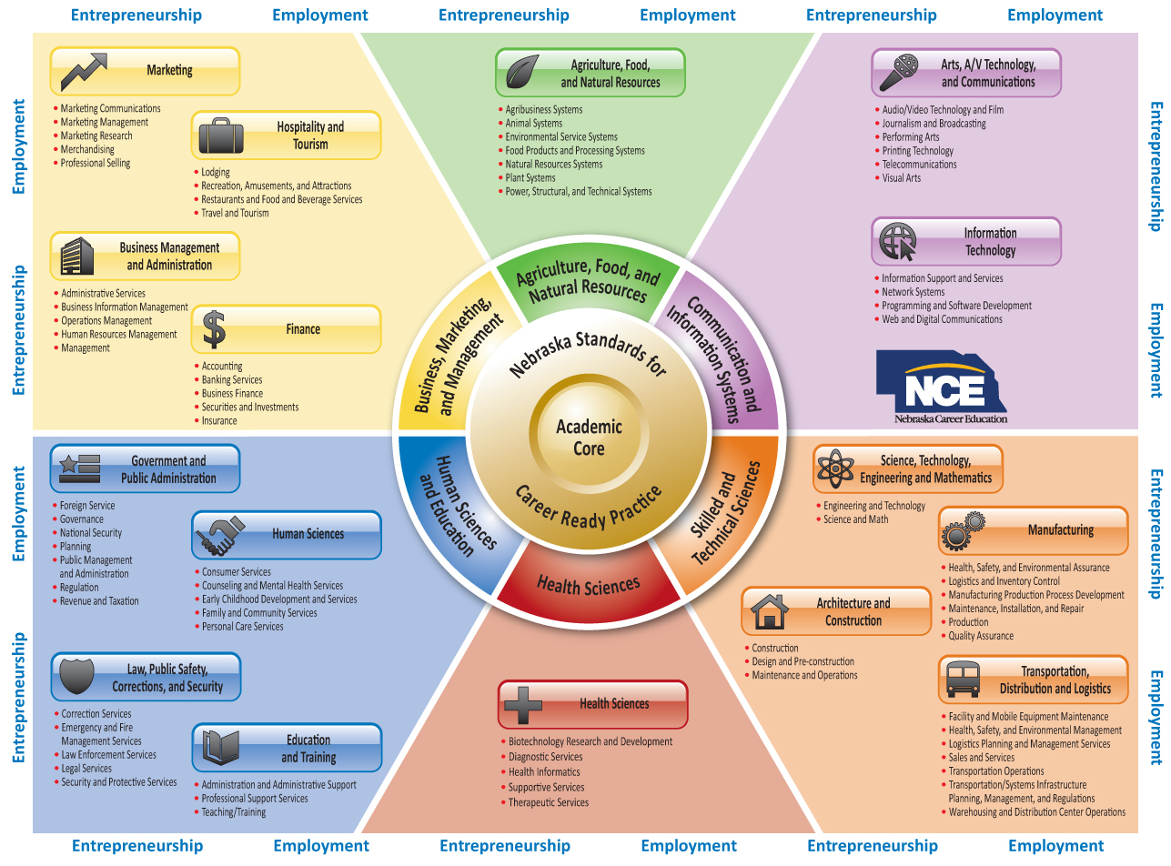
Adaptability of Framework
Notes:
Critical to the Career Clusters framework is that is can be adaptable based on states’ industry priorities and delivery of CTE. Underscore importance of data/linking state/region’s economy to CC framework
Here is an example of grouping the Career Clusters® into larger fields.
Nebraska is an example of a state that organized the 16 Career Clusters® into six fields to better serve the needs of rural schools in the state.

Slide 20
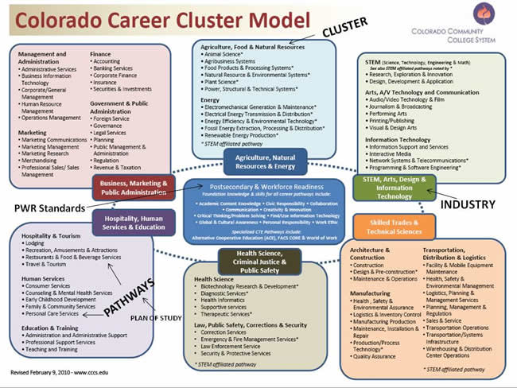
Colorado Adaptation
Notes:
Colorado is an example of a state that added a new career cluster - “Energy” in this case – due to its unique importance to the state’s economy and the number of careers specifically related to it.
**Mississippi – uses the full 16 Career Clusters

Slide 21
So… How are we approaching the Career Clusters this time?
Notes:
Now that we’ve laid out the history of the Career Clusters and past efforts to revise and update them… Let’s talk about how we are going to approach the work this time around.

Slide 22
CCLP Timeline
Month | Proposed Activity
August- September 2014 | Laying the foundation: August calls with State CTE Directors for each Career Cluster Building state team; preparing for Fall Meeting
October | Getting started: Kick-off planning meeting in Baltimore, MD on October 20 Lay out objectives for pilot work; division of labor
November-December | Digging in: ­Monthly progress calls begin; work begins
January- February 2015 | In progress: Major work/research under way; deliverables start to take shape Monthly calls continue; work continues

Slide 23
CCLP Timeline
Month | Proposed Activity
March-April 2015 | In progress: Begin to prepare for April’s in-person meeting; presentation to membership Deliverables continue to form Monthly calls continue; work continues
April 2015 | Progress report: Second in-person meeting to be held in Washington, DC Provide status report at Spring Meeting (some early deliverables potentially prepared in time for this meeting)
May-July 2015 | In progress: Deliverables enter final stages Monthly calls continue; work finishes

Slide 24
CCLP Timeline
Month | Proposed Activity
August 2015 | Wrapping up: Present deliverables across cluster pilots Monthly calls continue; recommendations for future work discussed
September-October 2015 | Looking to the future: Recommendations finalized in report to membership Final deliverables and recommendations presented at 2015 Fall Meeting

Slide 25
CCLP Action Template
Step 1: Read through the entire document
Step 2: Focus on those topics most important to you based on your role and/or your state’s needs
Step 3: Fill in the “Existing Strategies/New Ideas” column with questions, existing resources, potential deliverables, etc.

Slide 26
CCLP Action Template
Step 4: Identify the level of priority of this issue for yourself (high, medium, low)
Step 5: List your top five priorities (in order of preference) on page 2. Your priorities can come from any category, including multiple from the same category
  Will create a baseline of priorities for the October 20 kickoff meeting

Slide 27
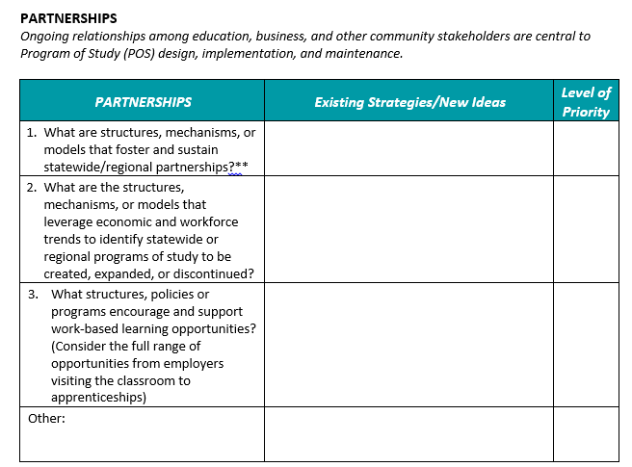
CCLP Action Template

Slide 28
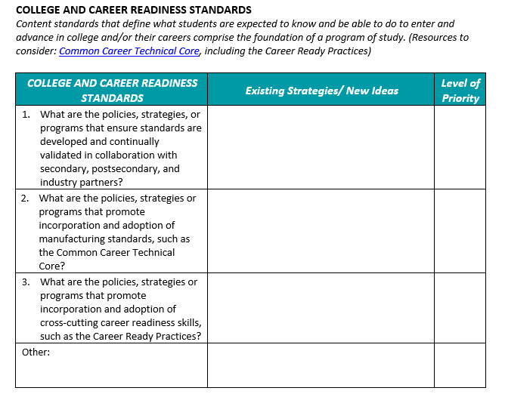
CCLP Action Template

Slide 29
October 20th Kickoff Meeting
OBJECTIVE: States will lay critical groundwork for the Manufacturing Career Cluster Pilot by engaging in cross-state sharing, gathering consensus and prioritizing the issues, deliverables, and activities that will be undertaken during the yearlong pilot.
Setting the Stage – and the Priorities
Small-group Discussion
Small-group Report Out
Consensus Building
Cross-Pilot Sharing

Slide 30
Questions?
Type any questions into the “Chat” box at the bottom right-hand corner of your screen.

Slide 31
Housekeeping
Upcoming deadlines
  Submit your completed state teams to Andrea by October 1
  Submit your completed Action Template to Andrea by October 8 (early submissions are welcome!)

Slide 32
Thank you!
We will see you in Baltimore!
Andrea Zimmermann
azimmermann@careertech.org
Kate Blosveren
kblosveren@careertech.org
Jean Massey
jmassey@mde.k12.ms.us

