Slide 1
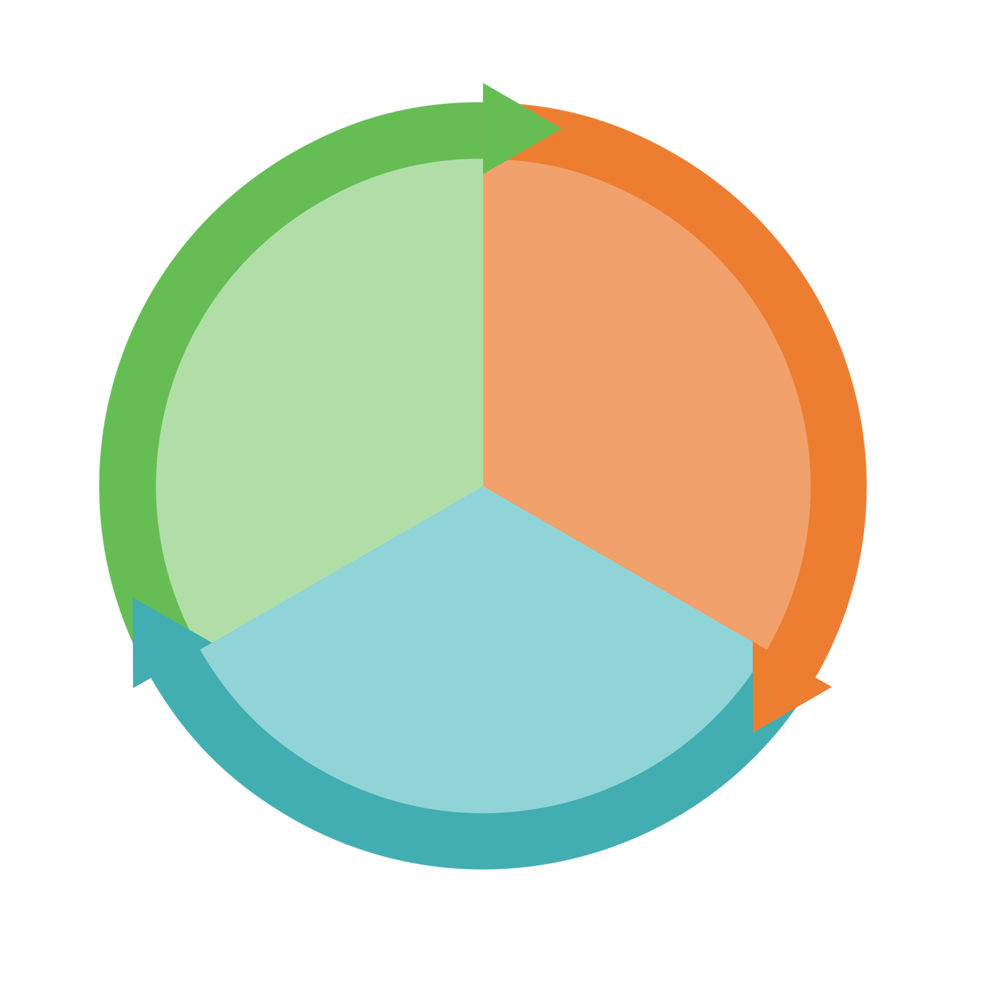

Work-Based Learning: Workplace experiences designed to help students gain work experience, build employability & technical skills, and explore career options. These experiences are for four or more weeks and often a full semester or summer. They are paid, for credit, or both.
Career Immersion
Career Awareness
  Internships
  Cooperative education
  Apprenticeships
  CTE capstones and simulated work experiences
  Clinical experiences
  School-year and summer employment
College, career and academic planning (MyCAP)
Work readiness workshops
Career panels
Preparation:
Engage students in college and career planning and in work readiness activities that prepare them for career exploration and work-based learning.
Career Exploration
  Job shadowing
  Company tours
  Mentoring
  Networking
  Projects/ design sprints
  Embedded courses
Workplace Exposure:
Connect students with the workplace for career exploration activities.

