Slide 1


An Update from the U.S. Department of Labor
Advance CTE 2016 Fall Meeting
Baltimore, Maryland
October 19, 2016
Office of Apprenticeship
US Department of Labor | Employment and Training Administration

Slide 2
Today’s presentation
Updates
ApprenticeshipUSA
Registered Apprenticeship College Consortium (RACC)
RACC Sponsor Initiative
Youth Apprenticeship
Q&A

Slide 3
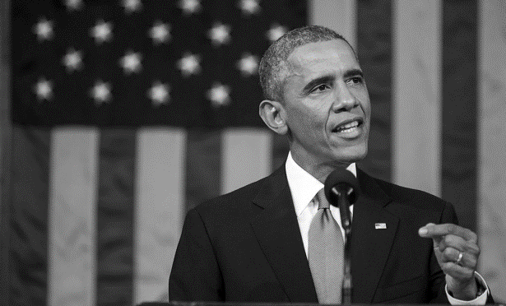
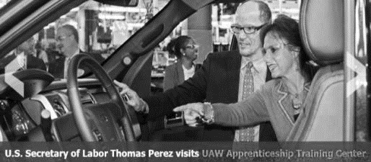
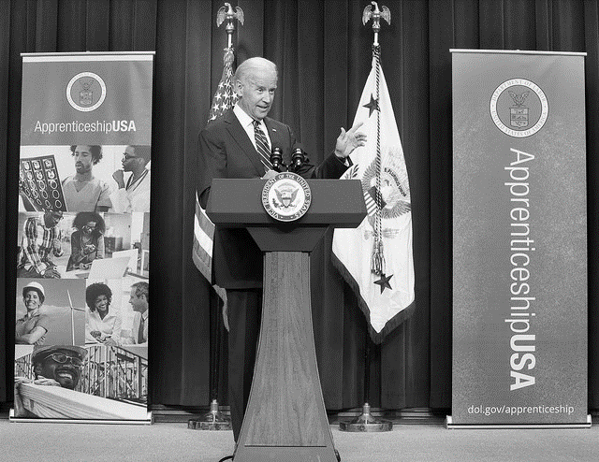
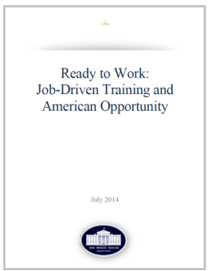


ApprenticeshipUSA has been a growing part of workforce development in the United States
Tonight, I'm also asking more businesses to follow the lead of companies like CVS and UPS, and offer more educational benefits and paid apprenticeships -- opportunities that give workers the chance to earn higher-paying jobs even if they don't have a higher education.
– President Obama
State of the Union Address, January 20, 2015
FY 2016
Congress
Invests $90 Million
in Apprenticeships
American Apprenticeship Grants
$175 Million
Notes:
Diversify RA: people with disabilities
Reinforce RA as a workforce system-integrated
Emphasize partnerships

Slide 4

ApprenticeshipUSA continues to grow
750,000
500,000
FY 16
375,000

Slide 5
ApprenticeshipUSA Funding Opportunity Update
$10.4 million in ApprenticeshipUSA State Accelerator Grants – Awards announced June 2.
$50.5m Apprenticeship Expansion Grant FOA announced June 22 - closed September 7.
National Industry Partners RFP ($14.5m)– Awards announced September 21.
National Equity Partners Contract ($6.5m)– Awards announced September 21.

Slide 6
SEAs Established In Key Industry Sectors
Healthcare
Boston, MA
Information and Communication Technologies (ICT)
San Francisco, CA
Construction
Philadelphia, PA
Advanced Manufacturing
Chicago, IL
Public Service
Washington, DC
Energy
Dallas, TX
Transportation and Logistics
Atlanta, GA

Slide 7
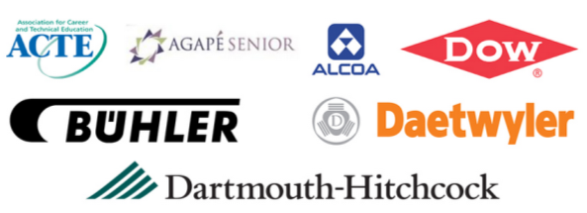



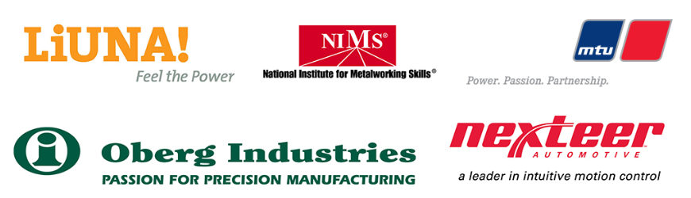

Leader of Excellence in Apprenticeship Development, Education and Research
183
Companies and organizations advocating and supporting the growth of Registered Apprenticeship
Notes:
ApprenticeshipUSA LEADER Campaign:
The ApprenticeshipUSA LEADERs campaign brings together businesses, workforce organizations, labor unions, industry associations, education providers, and other organization like CVS, UPS, Ford, Alcoa, and Siemens, to promote apprenticeship nationwide, and has grown to 171 members.

Slide 8

ApprenticeshipUSA Accelerator Sessions
Opportunity for businesses and other industry stakeholders to rapidly develop and register apprenticeship programs.
Focus on Advanced Manufacturing, Energy, Healthcare,
IT, Transportation and Logistics, and others TBD
Notes:
ApprenticeshipUSA Accelerator Meetings – In 2016, OA will hold a series of ApprenticeshipUSA Accelerator meetings in targeted industries from. While the specific objectives of these meetings will vary by industry, the overall goal is to simplify and streamline the process of building and registering apprenticeship programs in order to rapidly grow the number of apprentices across the United States.

Slide 9
Expanding ApprenticeshipUSA across Both Traditional and Non-traditional Industries
Sectors of Excellence
in Apprenticeship
LEADERs
Industry partnerships working toward apprenticeship growth in targeted sectors.
Leaders in advocating and supporting growth of apprenticeship across the US.
ApprenticeshipUSA Accelerators
Events designed to accelerate the development and registration of apprenticeship programs.

Slide 10
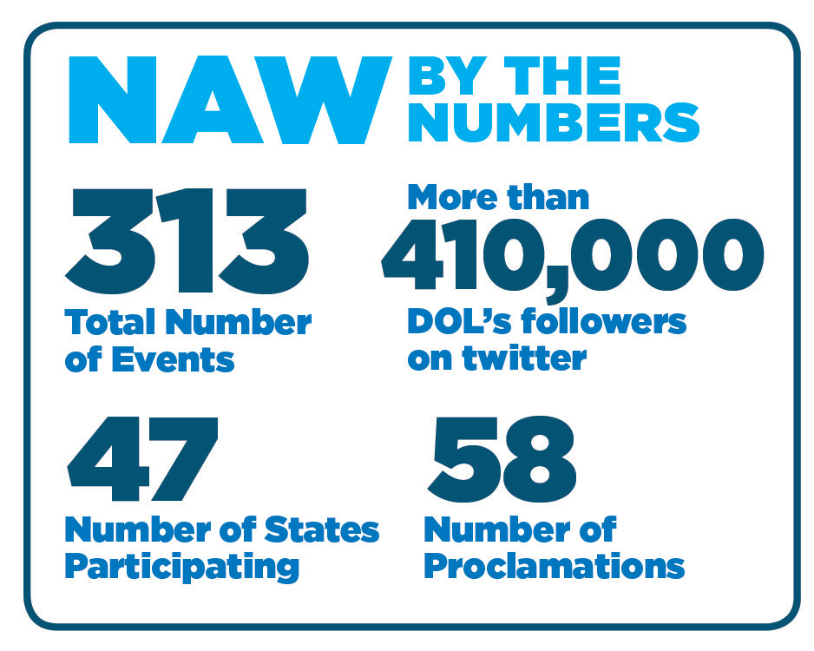
National Apprenticeship Week (NAW)
NAW offers Registered Apprenticeship Sponsors the opportunity to showcase their programs, facilities and apprentices, and gives Employers, Education, Industry Associations, Labor, Elected officials and other critical partners the opportunity to highlight how Registered Apprenticeship meets their needs for a skilled workforce.
National Apprenticeship Week 2016 will take place November 14-20, 2016. The goal is to double the success of our inaugural year which sparked 300 events across 47 states.
NAW 2015 events were diverse and creative – ranging from
  Apprentice Graduations
  Business open houses
  High school Career Fairs
  Apprenticeship Signing days
  Skills competitions
  Industry Roundtable Events
NAW 2015 Highlights
Notes:
President Barack Obama proclaimed the week of November 2nd as the first Annual National Apprenticeship Week and this year we’re excited to announce that the second Annual National Apprenticeship Week will take place during the week of November 14th.
NAW offers Registered Apprenticeship Sponsors the opportunity to showcase their programs, facilities and apprentices, and gives Employers, Education, Industry Associations, Labor, Elected officials and other critical partners the opportunity to highlight how Registered Apprenticeship meets their needs for a skilled workforce.
Last year’s Inaugural National Apprenticeship Week was highly successful, spurring over 300 events in 47 States across the Country. President Obama kicked off the week with a Presidential Proclamation, which started a movement that generated 57 additional State and Local proclamations.
NAW 2015 events were diverse and creative – ranging from
Apprentice Graduations
Business open houses
High school Career Fairs
Apprenticeship Signing days
Skills competitions
Industry Roundtable Events
As you can see there are many ways to participate in the NAW movement. For example, last year, Secretary Perez participated in a roundtable event at Cuyahoga Community College about 21st-century apprenticeship in other high-growth industries like health care, and IT during National Apprenticeship Week.
We plan to launch a new NAW website over the next few weeks where you will be able to register an event or find an event near you. Please visit our website for more information about this exciting opportunity to showcase and highlight your Registered Apprenticeship program or learn about other programs near you!

Slide 11
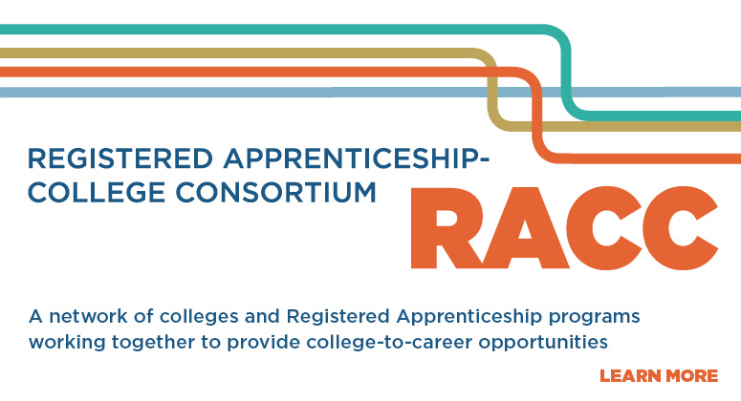
Office of Apprenticeship
US Department of Labor | Employment and Training Administration

Slide 12

289 colleges joined the RACC
957 Apprenticeship Training Centers
Electrical Training ALLIANCE
Finishing Trades Institute
Heat & Frost Insulators & Allied Workers
Sheet Metal and Air Conditioning Industry
National Elevator Industry Educational Program
United Association of Plumbing & Pipefitting
16 National, Regional, State Organizations
Achieving the Dream
American Association of Community Colleges
AFL-CIO Building and Construction Trades
Council on Adult and Experiential Learning (CAEL)
Colorado Community College System
North Carolina Community College System
Ohio Association of Community Colleges
Ohio Board of Regents
Oregon Department of Community Colleges
and Workforce Development
Collegiate Consortium for Workforce and Economic Development
South Carolina Technical College System
Southeast Maritime & Transportation Center (SMART)
Technical College System of Georgia (TCSG)
University of Alaska System
VA Tidewater Consortium for Higher Education
Wisconsin Technical College System
Notes:
Grantee membership: Essentially, grantees are expected to join the RACC as a condition of their grant award according to the FOA:
P. 4: Promoting Career Pathways and Aligning Apprenticeships with Institutions of Higher Education (IHEs) and Workforce Investment Systems: Engaging states, regions, and local areas to align, at a minimum, education and training systems (e.g., Workforce Investment Boards/State Workforce Agencies; and career technical education, community college, and university systems) behind apprenticeship as an area for cooperation and co-investment and linking apprenticeship to credit and industry-recognized credentials that allow for further advancement (e.g., college credit, portable industry-recognized credentials; also see the Registered Apprenticeship College Consortium at http://www.doleta.gov/oa/racc.cfm);
P. 57 (Innovations to Create a Supportive Ecosystem): Create incentives for community colleges to support the development and provision of apprenticeship training by a) articulating apprenticeships to community college credit (visit the RACC website: http://www.doleta.gov/oa/racc.cfm), b) creating financial incentives through FTEs or other mechanisms for community colleges to support apprenticeship, or c) create capacity within the community college system to support employers in setting up or expanding apprenticeship programs
The link to the FOA is here if you’d like to get additional context. Let me know if you need anything else.

Slide 13
Becoming a Registered Apprenticeship Sponsor
Office of Apprenticeship
US Department of Labor | Employment and Training Administration

Slide 14
Key Roles within Registered Apprenticeships
Employers (OJT)
Must have employer(s)
Must Drive Program Design / RTI
Provider of OJT/Work-Based Learning
Sponsors (Intermediaries)
Responsible for Administering the Program
Can be Employer, Consortia of Employers, Industry Associations, Joint Labor-Management Organizations, Educational or Training Providers, CBOs, or Other Workforce Intermediaries!
4
Supportive Services
Can bring together a range of other entities to complement program design and to support apprentices and industry partners.
Educational (RTI) Provider
Can be employer/industry based
Can be Joint Labor-Mgmt Orgs
Community Colleges
Others

Slide 15


Who operates Registered Apprenticeship programs?
Traditional Sponsors
Employers
Industry Associations
Joint Labor-Management Organizations
Other Types of Sponsors
Institutions of Higher Education
Community-based Organizations (CBOs)
Community Service Organizations
Multiple Employers

Slide 16

Innovations: Colleges as RA Sponsors
Colleges can also be sponsors
Benefits:
Qualify for state-based tax credits related to apprenticeship programs.
Registered Apprenticeship sponsors are automatically eligible for the Eligible Training Provider List under WIOA
Access resources from federal programs to help reduce costs and support your apprentices including Pell Grants, Work Study Funding and GI Bill benefits.
Join the apprenticeship system and leverage a nationwide network of expertise and support at no cost.
Office of Apprenticeship
US Department of Labor | Employment and Training Administration

Slide 17

Colleges as Registered
Apprenticeship Sponsors
BULLETIN 2016-26--Guidance on Organizations that can serve as Registered Apprenticeship Sponsors
“Any person, association, committee, or organization operating a Registered Apprenticeship program.”
Institutions of Higher Education as defined in Sections 101 and 102 of the Higher Education Act (e.g., Community Colleges and 4-year Colleges
Notes:
Sponsor as “any person, association, committee, or organization operating an apprenticeship program and in whose name the program is (or is to be) registered or approved.” Sponsorship requires that the program comply with the applicable provisions of Title 29 CFR §§ 29 and 30, which may be achieved through partnerships between Sponsors and employers who are actively training apprentices.

Slide 18
Duties of Sponsors
Must abide by the apprenticeship regulations and work with USDOL or the designated SAA, where applicable, to develop Standards and administer the program
Work with employers
Work with students/apprentices
Keep records and make sure employers are in compliance

Slide 19

Benefits for colleges
Fulfill colleges’ missions
Increase enrollment
Enhance retention rates
Increase completion rates
Expand relationships with many companies
(Could lead to equipment donations for programs, becoming a College Foundation member, serve on advisory groups, etc.)

Slide 20
Examples of college sponsors
Northeast Alabama Community College
(Advanced manufacturing)
Harper College, Illinois
(Advanced manufacturing)
Gaston College, NC
(Advanced manufacturing)

Slide 21
October 27: College Accelerator
At Harper College in IL
Over 60 colleges will attend from 15+ states
Employer and college panels
Rapid registration for colleges

Slide 22
Youth Apprenticeship
Office of Apprenticeship
US Department of Labor | Employment and Training Administration

Slide 23



Youth apprenticeship
Classroom instruction
On-the-job learning
Paid Work Experience
Dual enrollment/ earn college credits towards 2- and 4-year degrees
National Occupational Credential

Slide 24
State Youth Apprenticeship Models
South Carolina
90+ Youth Apprenticeship programs
North Carolina
(Charlotte)
Long-standing program with manufacturers (mechatronics)
AS degree paid by employers
Kentucky TRACK
Wisconsin
1-2 year prgm. for 2,500 juniors and seniors
24 counties
High Schools to carry liability
Tax Credit
Juniors and Seniors
Employers select courses
Leads to apprenticeship
450 to 900 hrs.
Aligns to apprenticeship

Slide 25

USDOL’s Youth Apprenticeship Ad-Hoc Working Group
Purpose:
Make suggestions and recommendations on how to strengthen alignment between CTE and Registered Apprenticeship systems on the secondary level
Members:
Part of the USDOL Advisory Committee on Apprenticeship (ACA); includes representatives from the ACA, the U.S. Department of Education and select Subject-Matter Experts (SMEs) including CTE state directors, employers, and other experts.

Slide 26
Registered Apprenticeship
Provisions in WIOA
POTENTIAL OPPORTUNITY | SECTION OF WIOA
RA as recognized post-secondary credential | Section 3(52)
RA on State Workforce Board | Section 101(b)(1)(C)(ii)(II)
RA on Local Workforce Board | Section 107(b)(2)(B)(ii)
RA on Eligible Training Provider List | Section 122(a)(2)(B) and (3)
Pre-apprenticeship as Youth program service | Section 129(c)(2)(C)(ii)
RA as career pathway for Job Corps | Section 141(1)(A)(ii) and Section 148(a)(2)(B)
Pre-apprenticeship/RA for YouthBuild | Section 171(c)(2)(A)(i)
Notes:
Out-of-school youth
YouthBuild

Slide 27
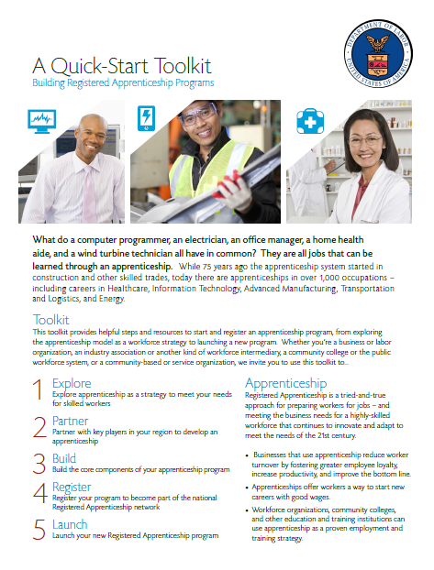
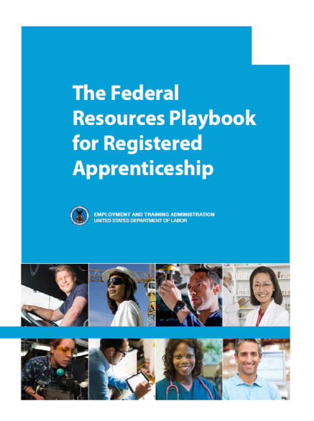
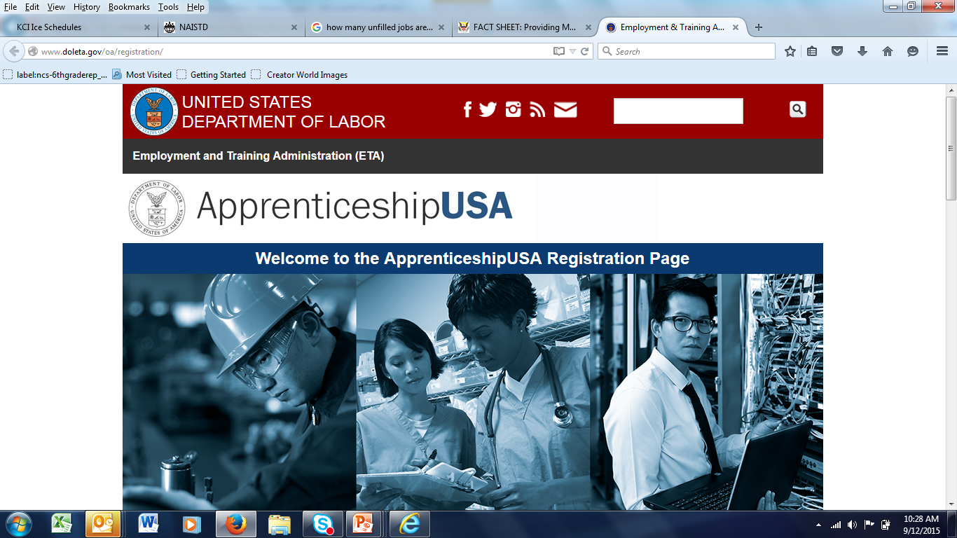

DOL.GOV/Apprenticeship: New Resources
Quick-Start Toolkit
5 Step Format to take you from “exploring” to “launching” a Registered Apprenticeship Program.
http://www.doleta.gov/oa/employers/apprenticeship_toolkit.pdf
Federal Resources Playbook for Registered Apprenticeship
Guide to resources from the Departments of Labor, Education, Veterans Affairs, Agriculture, Transportation, and Housing and Urban Development to support Registered Apprenticeship
http://www.doleta.gov/oa/federalresources/playbook.pdf
DOL Registration Site
An electronic apprenticeship standards builder that allows potential new sponsors to build and register their program online.
http://www.doleta.gov/oa/registration/
RACC Site
Find information on becoming a RACC member and a database of college members and sponsors.
https://www.doleta.gov/oa/racc.cfm

Slide 28







ApprenticeshipUSA
a proven Work Based Learning approach
Amy Firestone, Ph.D.
Program Analyst
Office of Apprenticeship
US Department of Labor
Phone: 202-693-3998
Firestone.amy@dol.gov

