Slide 2


How We Got Here

Slide 3
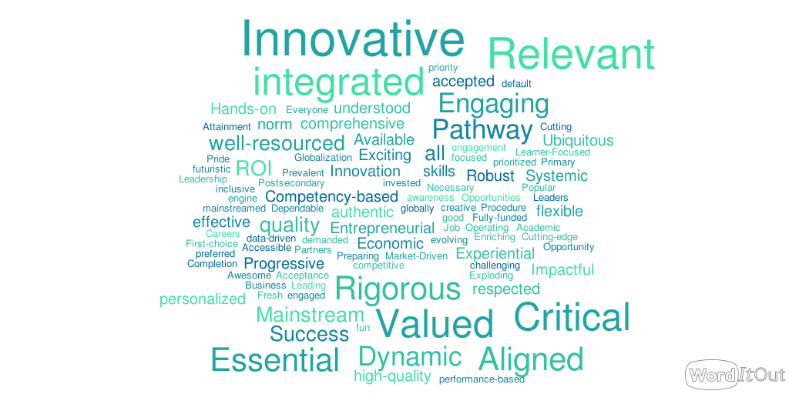
Summit Participants’ Views on How CTE Should be Viewed in the Future

Slide 5
The Shared Vision
Focuses on supporting ALL learners over the course of their career journeys
Aims to transform all education – with CTE as a driver of this transformation
Demands full commitment from all stakeholders

Slide 6











Vision Supporters

Slide 8
All CTE Programs Are Held to the Highest Standards of Excellence

Slide 9

All CTE Programs Are Held to the Highest Standards of Excellence
To accomplish this, we will:
Develop and implement rigorous review and approval processes and policies to ensure only high-quality programs of study exist
Align funding to high-quality programs of study
Develop and implement sustainable processes for employers to inform, validate and
participate in the implementation
of programs of study

Slide 10
All Learners Are Empowered to Choose a Meaningful Education and Career

Slide 11

All learners are empowered to choose a meaningful education and career
To accomplish this, we will:
Develop and implement a career advisement system that allows all learners to be successful in a career pathway of interest
Provide all learners with authentic, real-world experiences linked to a career interest of their choice

Slide 12
All Learning is Personalized and Flexible

Slide 13

ALL Learning is personalized and flexible
To accomplish this, we will:
Identify, build and scale policies and models that fully integrate academic and technical expectations and experiences
Identify, build and scale models of K-12 and postsecondary competency-based systems
Fully align secondary and postsecondary programs of study to ensure seamless transitions

Slide 14
All Learning Is Facilitated by Knowledgeable Experts

Slide 15
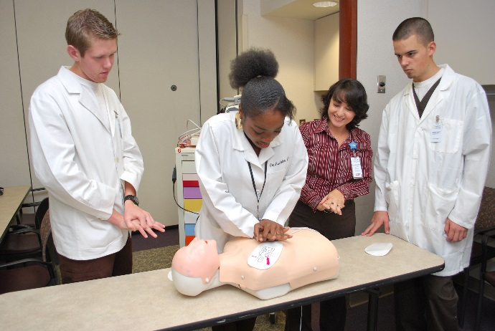
All learning is facilitated by knowledgeable experts
To accomplish this, we will:
Modernize K-12 certification programs to
ensure all learners have access to educators
who are able to facilitate learning that
prepares them for both college and careers
Prioritize professional learning opportunities that focus on retention of quality instructors, contextualized teaching and learning, and learner engagement
Build and support a pool of experts that instructors may draw upon to supplement learning

Slide 16
All Systems Work Together to Put Learner Success First

Slide 17

All systems work together to put learner success first
To accomplish this, we will:
Establish a common statewide vision and commitment to providing all learners with meaningful career pathways
Coordinate federal and state policies, programs and funding to maximize investments and reduce inefficiencies
Develop and support sustainable partnerships and intermediaries to accelerate learner success
Build indicators of career readiness – for all learners – into federal and state accountability systems

Slide 18
Call to Action
Making this vision a reality requires an unwavering, steadfast commitment from all sectors and stakeholders.
We must hold ourselves accountable to do the work even when funding gets tight, political winds shift, or questions arise of whether we really need to set the bar so high.
We must join together to demand change where and when it is needed, to support reform that is already underway and to applaud those who have made it.
It is only through a shared commitment to action that this new vision will become a reality for learners across the nation.

Slide 19
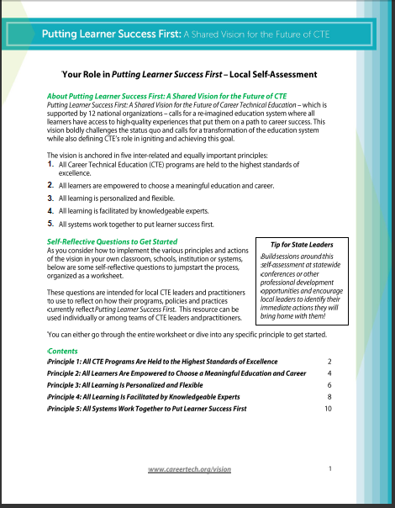
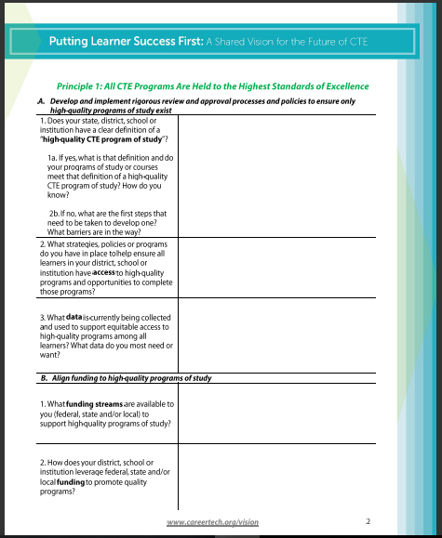
www.careertech.org/vision-resources

Slide 20
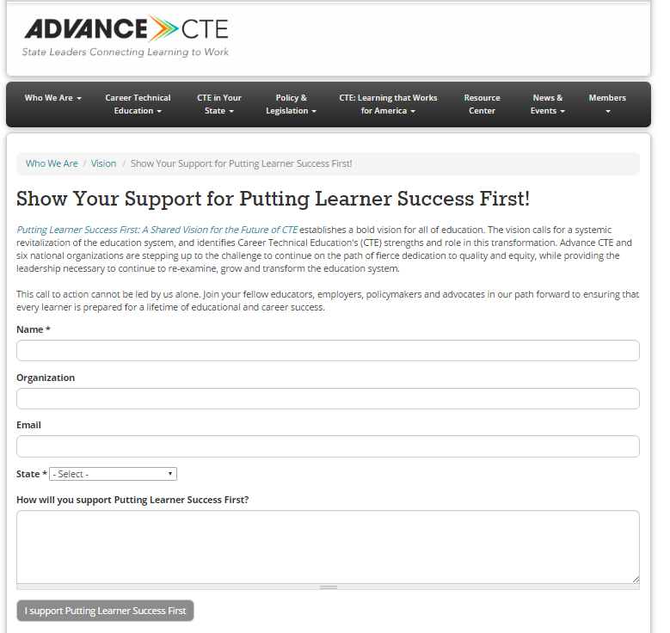
www.careertech.org/ shared-vision-sign-on

