Slide 1
Communicating Career Technical Education: Learner-centered Messages for Effective Program Recruitment

Slide 2
Agenda
Key findings
Considerations for historically marginalized populations
Putting research into action

Slide 3
Advance CTE Report
April 2020 Research Report: Communicating Career Technical Education: Learner-centered Messages for Effective Program Recruitment
Report and Related Tools:
https://careertech.org/recruitmentstrategies

Slide 4
Research Goals
Test resilience of 2017 research findings in current environment
Confirm what families want in their education
and satisfaction level in and outside of CTE
Test timely messages on what is most compelling to families about CTE and who should communicate it
Focus on findings by race/ethnicity and income to identify equity barriers to CTE and message tailoring

Slide 5
Research Methodology
Qualitative
Quantitative
10 Virtual Focus Groups
2 Current Learners & Parents/Guardians
8 Prospective Learners & Parents/Guardians
1 Universal Prospective group, 7 disaggregated by income, race and ethnicity
Oversample of Black, Latinx, and low-income families
National Online Survey
1,098 parents/guardians
255 Current adults
843 Prospective adults
1,058 learners
256 current learners (9-12th)
802 prospective learners (6-11th)
Oversample of Black, Latinx, and low-income families

Slide 6

Advancing CTE Without Limits
Principle 1: Each learner engages in a cohesive, flexible and responsive career preparation ecosystem
Principle 2: Each learner feels welcome in, is supported by and has the means to succeed in the career preparation ecosystem
Principle 3: Each learner skillfully navigates their own career journey

Slide 7
Findings

Slide 8
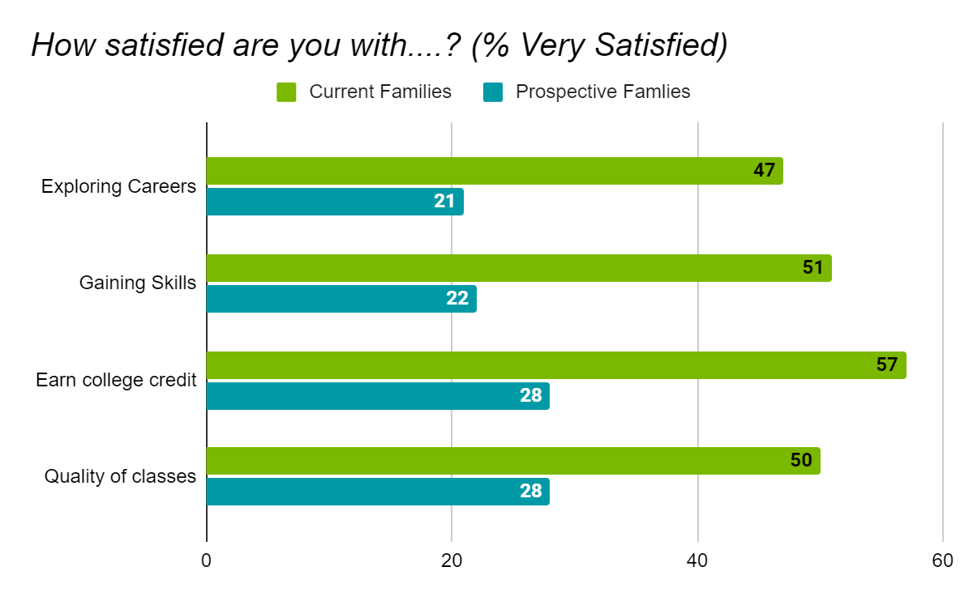
CTE Still Delivers for Families
53% of Current CTE Parents/Students Very Satisfied with overall school experience
(88% satisfied)
28% of Prospective Parents/Students Very Satisfied with overall school experience
(75% satisfied)

Slide 9
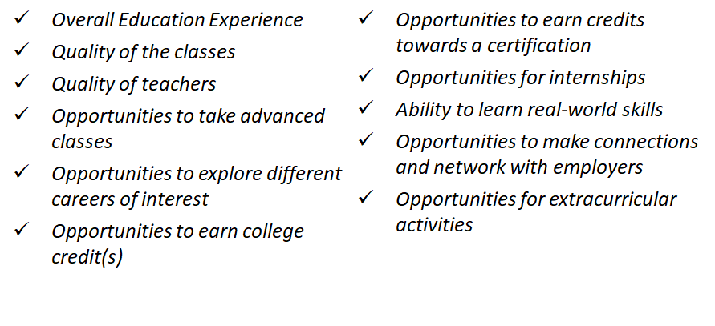
CTE Families More Satisfied with Education Quality and Opportunities
Those participating in CTE and their parent/guardian are more satisfied than those not involved in CTE in regards to:

Slide 10
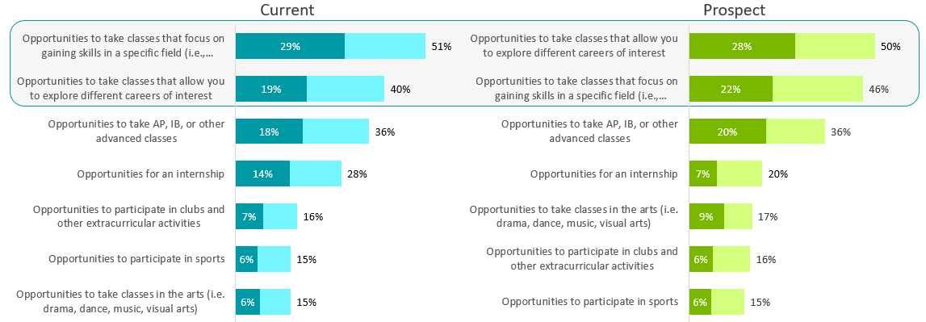
Key Aspects of CTE Priorities for Families in their Education
Exploring careers and gaining skills were ranked in the top 2 most important aspects of education by over 45 percent of prospective families compared to less than 20 percent for extracurricular activities and sports
Participants rated items from most important to least important. Dark shading shows % most important; bar shows % top 2 in importance

Slide 11
Families are Attracted to the Real-World Benefits of CTE
“Preparing for the Real World” was still the top message chosen by over 60 percent both prospective and current families on the value and benefit of CTE.
This message was especially effective for prospective families, and most effective among prospective Latinx families.
“Preparing for the real world” was also chosen as the top desired benefit/outcome for CTE by both prospective and current families.

Slide 12
CTE Benefits and Outcomes:
Finding Passion A Top Priority
Prospective and current parent/guardians and learner placed finding a career passion in their top two outcomes and benefits of CTE out of 22 options.
Finding a career passion was ranked above finding a well-paying job, earning college credit, and having experiences that stand out on college and job applications
Exploring careers and gaining real-world skills should be communicated as an effective path to finding a career learners are passionate about
Top CTE Benefits
and Outcomes for Prospective Families
Preparing for the Real World | Finding career passion
Getting hands-on experience | Learning life skills
Discovering “right fit” for career

Slide 13
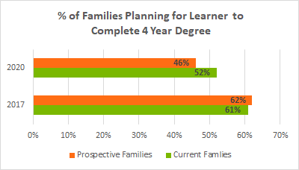
College and Career Success Matter to Families
78 percent of prospective families and 85 percent families currently participating in CTE expect to pursue some level of postsecondary education
Families in CTE are more certain about their postsecondary plans - only 3% were unsure vs. 13% of prospective families
Families are more open to paths other than a four-year degree compared to our 2017 research.

Slide 14
CTE Learners Prepared for College
CTE Learners and their parents/guardians are more satisfied with opportunities to prepare for college through opportunities for advanced classes and college credit.
CTE Learners and their parents/guardians are more confident about completing a postsecondary degree.
Over 80% of families currently in CTE are satisfied with opportunities to earn college credit and take advanced classes compared to only 60% of prospective families

Slide 15
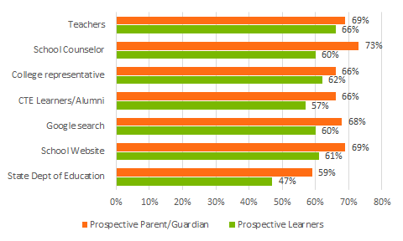
Teachers and School Counselors are Go-To Sources
Sources named by families as Top 2 Sources for information about CTE
Teachers and school counselors top sources across, participation, race and income
CTE learners and alumni
are a top 5 source
for both prospective
and current families
Parents more likely than learners to consult non-school sources (employers, community orgs)

Slide 16
Effective Messaging

Slide 17
Message Testing
Tested three messages for:
Believability
Personal connection,
Relation to current education experience
Likelihood to enroll in CTE
Messages: Prepare for the Real World, Safe Bet in this Economy, and Making Connections
Force choice of the message that makes CTE sound like a good options

Slide 18
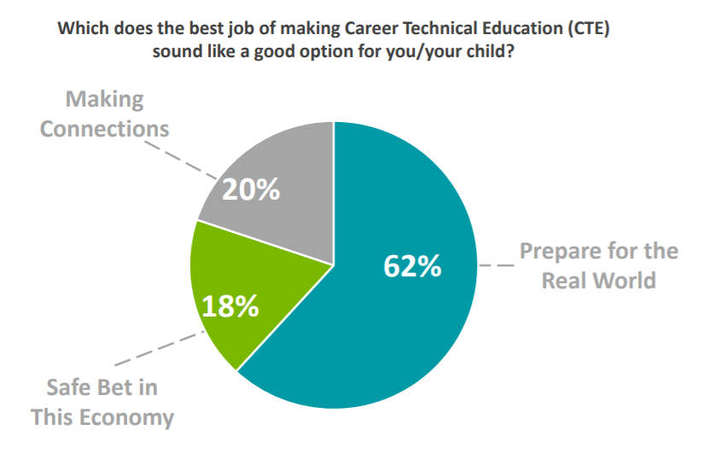
Most Effective Message:
Preparing for the Real World
Preparing for the
Real World
64% Prospective Families
56%
Current Families
69%
Highest: prospective Latinx families

Slide 19
Language that Works
Gain real-world skills
Explore careers for a path you are passionate about
Get hands-on experience
Leads to fulfilling, reward careers
Be prepared for college
Enhance your high school experience
Make valuable connections
Be prepared for the real world

Slide 20

Language that Works
Explore careers to find their passion
Have more options for career and college success
CTE Learners...
Gain real- world skills

Slide 21
Equity Considerations for Historically Marginalized Populations

Slide 22
Real World Skillbuilding, Hands-on Experiences Face Satisfaction Gaps
Career exploration and gaining skills in a specific field had equitable difference in satisfaction among race/ethnicity and income between prospective and current learners
However, White learners had significant higher differences in satisfaction between prospective and current groups for internships and networking with employers than Black, and Latinx learners
Quality, equity and access for CTE programs matters for effective communication to families

Slide 23
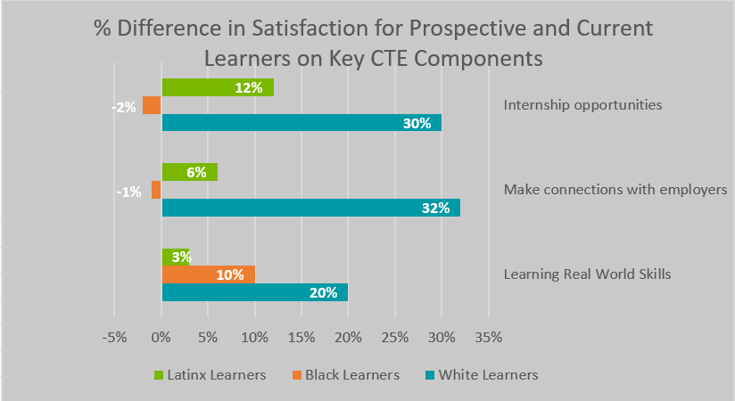
Real World Skillbuilding, Hands-on Experiences Face Satisfaction Gaps

Slide 24
CTE Helps Each Learner Prepare for and Complete College
Latinx and low income prospective parents/guardians had significantly lower percentages choosing a two or four year degree outcome after high school than White and Black parents/guardians
The findings indicate CTE helped to close this gap for both parents/guardians and learners
Plans to earn a two or four year degree immediately following high school
Latinx Families
Families Experiencing Low Income
60%
55%
42%
36%
Prospect Current
Prospect Current

Slide 25
Source Trust and Information Accessibility Matters
It is important that your intended audience sees themselves in information sources about CTE
Black and Latinx parents/guardians were significantly more likely to consult school counselors than Black and Latinx learners
Online sources of information about CTE should be up-to-date, use digestible terminology, and be available in the language(s) of your target audience
Google searches
Top 2 Source
Black prospective families
Current learners
School website
Top 2 Source
Low income prospective families
Black prospective parents/guardians

Slide 26
Effective Secondary Messaging:
Making Connections
While Preparing for the Real World was the universal top choice, CTE’s unique opportunities to build social capital with peers, instructors and employers with similar interests resonated with Black, Latinx and low income learners
Effective Retention Message: The percentage difference of Making Connections over the economic message was even more significant among current learners.
Prospective Learners
+9 Black
+8 Latinx
+6 Low Income
+1 White
Percentage Point Difference ‘Making Connections’ Chosen Over An Economic Message
Current Learners
+19 Black
+18 Low Income +15 Latinx
+7 White

Slide 27
Putting Research Into Action

Slide 28
Key Dos and Donts
Do....
Be consistent and reinforce key messages
Utilize learners to tell CTE success stories
Be specific about how CTE works, particularly hands-on experiences
Engage and inform educators closest to learners about CTE
Emphasize CTE learners are more satisfied with their education
Emphasize CTE’s value in preparing for college and career success
Don’t...
Position CTE and college as an “either/or”
Position CTE as a ‘different’ high school experience
Push financial benefits of CTE career pathways over finding passion
Do all the talking - elevate the learner voice
Neglect message tailoring
Forget about retention messages

Slide 29
Resources You Can Use https://careertech.org/recruitmentstrategies
Core Messages resource with the messaging triangle and key supporting messages for historically marginalized populations
Dos and Don’ts which detail how to use the messages and how not to use them
Fact Sheet with key statistics that reinforce the value and benefits of CTE
Message card, social media graphics, and printed material templates,
Social media guide with tips and examples on how to reach audiences effectively and equitably

