Slide 1
An Overview of The New Federal CTE Law:
Perkins V

Slide 2
Agenda
What is Perkins?
Perkins V Reauthorization Process & Timeline
Major Tenets of Perkins V
Resources & Next Steps

Slide 3
WHAT IS PERKINS?

Slide 4
What Does perkins do?
Perkins is a federal education program that invests in secondary, postsecondary and adult Career Technical Education (CTE) programs in all 50 states, the District of Columbia and the territories
Perkins is:
  dedicated to the continuous improvement of and relevancy of CTE to meet the ever-changing needs of learners and employers
  increasing learner access to high-quality CTE programs of study

Slide 5
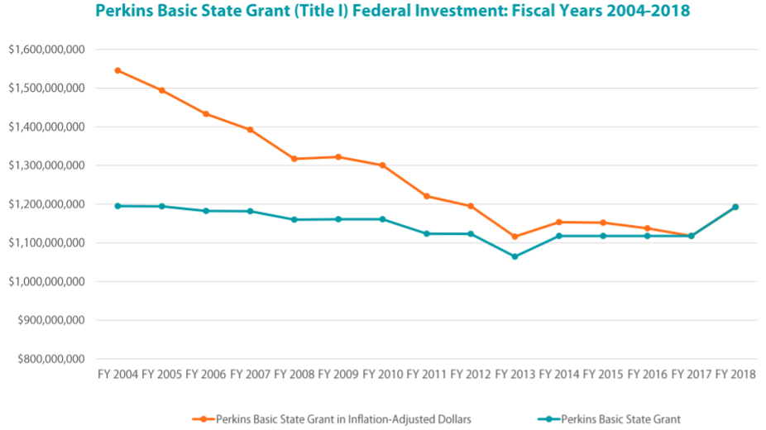
How much is the federal investment in perkins?

Slide 6
How does perkins funding work?
Congress appropriates funds to Perkins on an annual basis
States designate an eligible agency to administer Perkins and must submit a plan to the U.S. Department of Education to receive funds
Locals submit an application to the eligible agency to receive funds, local recipients of Perkins funds often include:
  Local school districts
  Area technical centers
  Community and technical colleges
  Pre-apprenticeship/youth apprenticeship programs

Slide 7
What do perkins funds support?
A variety of activities, including:
Programs of Study
Professional development
Technical assistance
Career exploration, guidance and advisement
Data collection and analysis, including program and plan evaluation and monitoring

Slide 8
PERKINS REAUTHORIZATION
& TIMELINE

Slide 9
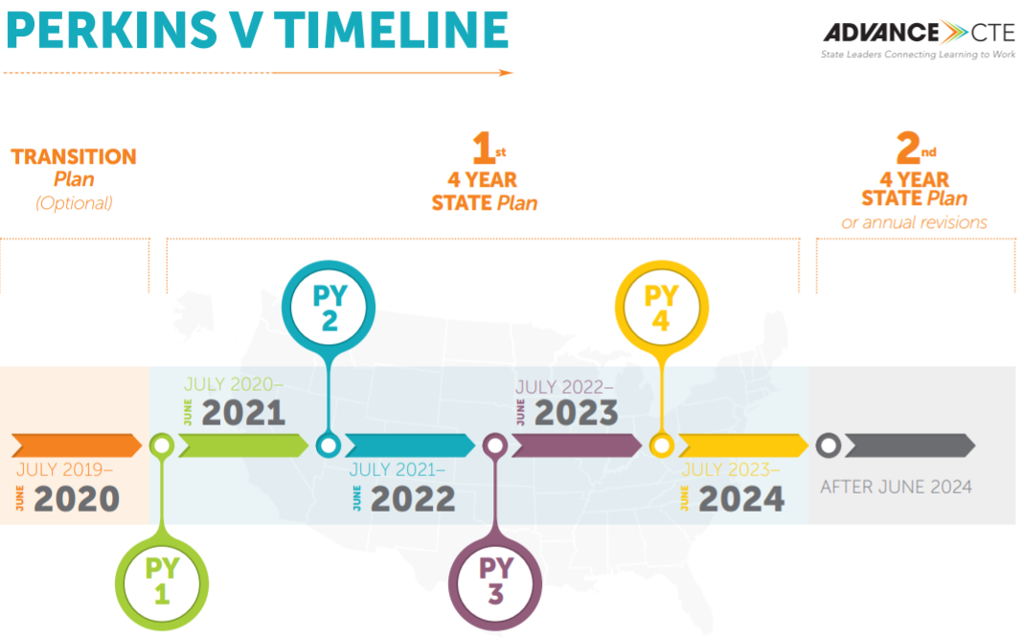
What does reauthorization mean for the state plan timeline?

Slide 10
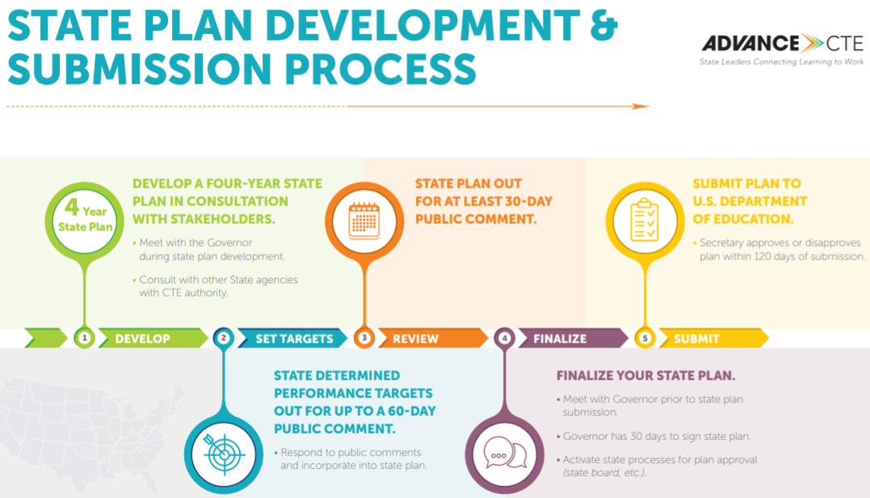
What does reauthorization mean for the state plan DEVELOPMENT?

Slide 11
What does reauthorization mean for the governance of perkins?
Perkins V largely retains the governance structure of Perkins IV, whereby the eligible agency maintains the ability to make key decisions about:
  Administration of funds from the Perkins Basic State Grant
  Split of funds between secondary and postsecondary CTE
  State plan development
  Local grantee oversight and technical assistance

Slide 12
MAJOR TENETS OF PERKINS V

Slide 13
Major tenet 1: program improvement
Maintains commitment to programs of study
Introduces comprehensive local needs assessment
Increases reserve fund to spur local innovation and implement programs of study
Adds new national, competitive grant program that focuses on innovation and modernization
Increased focus on alignment to labor market needs
Stronger focus on equity, including a new purpose on increasing opportunities for special populations

Slide 14
Major tenet 2: flexibility
Retains governance structure and flexibility of eligible agency to determine:
  Secondary and postsecondary split
  How to leverage funds
  Elements of local application
Expands support for career exploration to go as low as grade 5
Alignment to the Every Student Succeeds Act (ESSA) and Workforce Innovation and Opportunity Act (WIOA)

Slide 15
USES of State leadership funds
Required (5 total)
Preparation for non-traditional fields, programs for special populations
Individuals in state institutions
Recruiting, preparing or retaining CTE teachers/faculty
Technical assistance
Reporting on effectiveness of funds
Permissible (25 total)
Vary greatly in scope and feasibility
Many retained from Perkins IV (e.g., awarding incentive grants, enhancing data systems, partnering with intermediaries, etc.)
Some new uses (e.g., adoption/integration of recognized postsecondary credentials and work-based learning into programs of study, support for the integration of employability skills into CTE programs, supporting eligible recipients in eliminating inequities in student access to high-quality programs of study and effective teachers, etc.)

Slide 16
Major tenet 3: data & accountability
Defines who is included in the accountability system
Changes the process for setting performance targets
  Includes strengthened stakeholder engagement process
Focuses on disaggregation of data
Shifts the accountability indicators

Slide 17
Secondary accountability indicators
Graduation rates
Academic proficiency
Student placement
A measure of “CTE program quality”:
  student attainment of recognized postsecondary credentials;
  student attainment of postsecondary credits in their CTE program/program of study; or
  percentage of students participating in work-based learning.
The percentage of CTE concentrators in CTE programs that lead to nontraditional fields

Slide 18
postSecondary accountability indicators
The percentage of CTE concentrators who, during the second quarter after program completion, remain enrolled in postsecondary education, are in advanced training, military service, a service program, the Peace Corps or are placed or retained in employment.
The percentage of CTE concentrators who receive a recognized postsecondary credential during participation in or within 1 year of program completion.
The percentage of CTE concentrators in CTE programs that lead to nontraditional fields.

Slide 19
Resources & Next steps
Find resources at: www.careertech.org/Perkins

