Slide 2



OUR VISION
The zip code you’re born into should not determine your chances in life. If the ability to move up the ladder of opportunity grinds to a halt, we are in grave danger of losing the best of America.
Opportunity Days at Opportunity Nation Higher Education Council member University of Texas-El Paso
Young Leaders Town Hall, 2011 Opportunity Nation Summit
November 2011, TIME Magazine cover story featuring Opportunity Nation

Slide 3
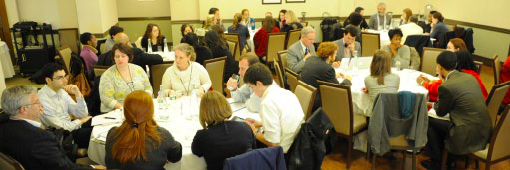
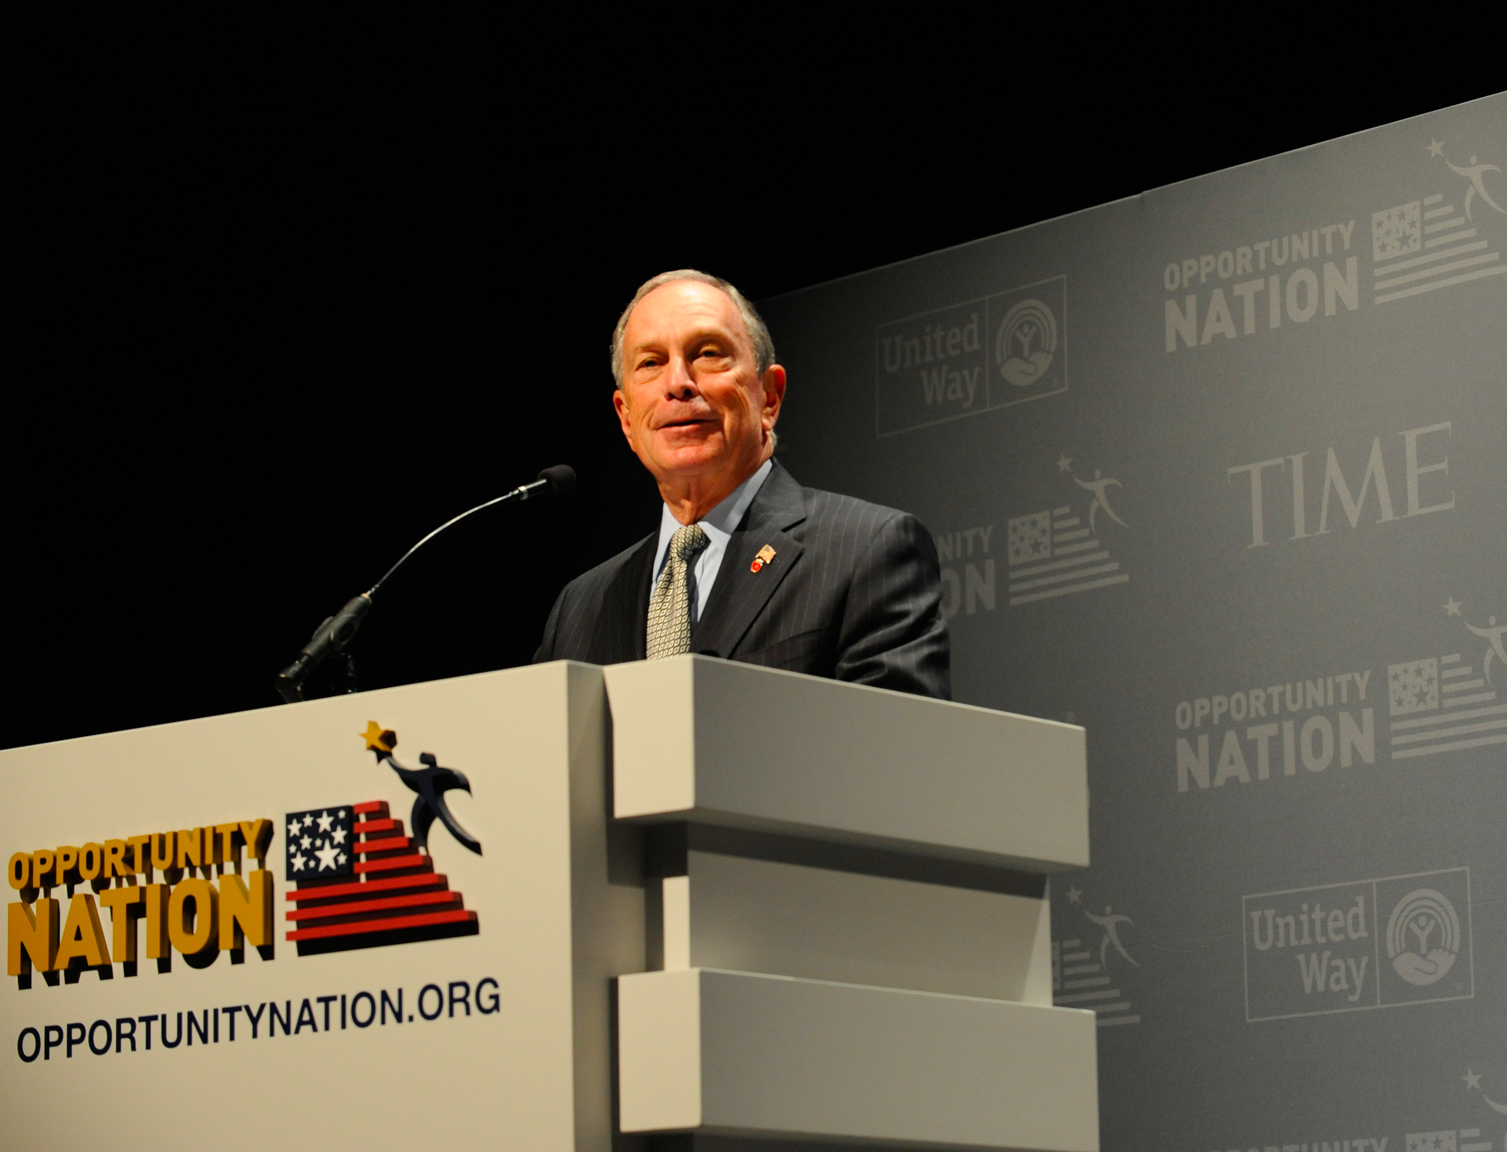
PARTNERS AND ALLIES
The Opportunity Nation Leadership Council: Over 100 diverse, iconic leaders support the Opportunity Nation campaign.
Opportunity Nation Coalition Meeting
Leadership Council Co-Chair, Mayor Michael Bloomberg
The Opportunity Nation Coalition: Over 250 organizations including United Way, Year Up, Points of Light, America’s Promise Alliance, Jumpstart, CFED, Boys & Girls Clubs of America, Higher ed institutions and businesses and over 150 Opportunity Leaders and Scholars
Coalition Meeting at 2011 Opportunity Nation Summit

Slide 4

MEASURING OPPORTUNITY:
THE OPPORTUNITY INDEX
DIMENSIONS & INDICATORS
Developed in partnership with
The Opportunity Index takes a comprehensive approach to measuring access to opportunity by including 16 economic and non-economic indicators across education, workforce, and community.
The result is a measure designed to help local communities connect economic, academic, civic, and other factors together to identify concrete solutions to complex problems.
In 2012, Opportunity Nation re-released the Opportunity Index with state and county scores across all dimensions.
JOBS AND LOCAL ECONOMY
EDUCATION
COMMUNITY HEALTH AND CIVIC LIFE
Jobs
Preschool enrollment
Community Engagement
(state only)
Wages
On-time school graduation
Volunteerism
(state only)
Poverty
Postsecondary completion
Youth Economic and Academic Inclusion
Inequality
Assets
Community Safety
Affordable Housing
Access to Health Care
Internet Access
Access to Healthy Food
SCORE
ECONOMY SCORE
EDUCATION SCORE
COMMUNITY SCORE
SCORE SCALED AVERAGED
State
Opportunity Score
(out of 100)
Counties
Opportunity Grade
(from A+ to F)

Slide 5
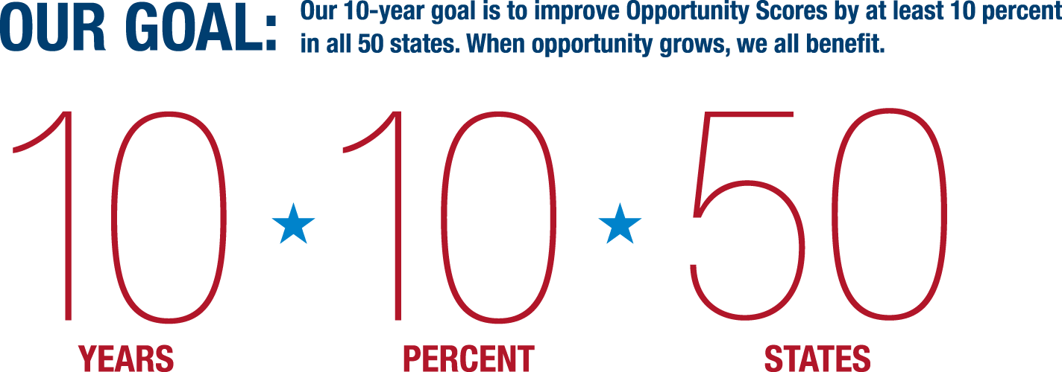

The Opportunity Index is the nation’s first measure of opportunity in communities

Slide 6


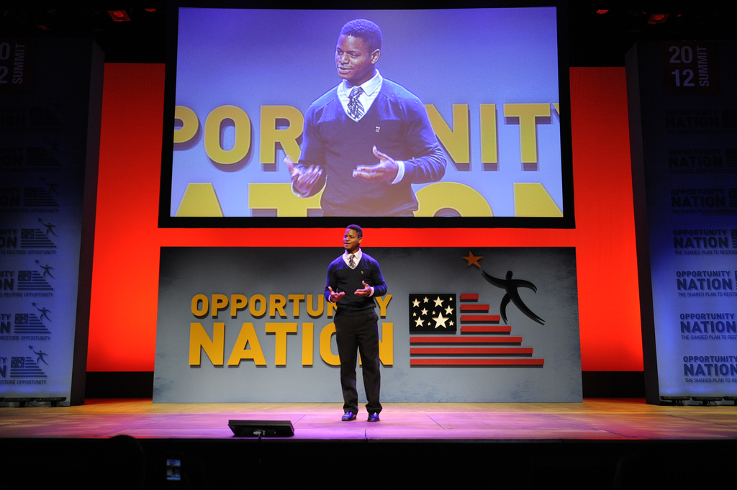
Our Shared Plan focuses on repairing the opportunity ladder one rung at a time by advancing policy changes that will create more robust education and career pathways for young adults such as updating and reauthorizing the Career and Technical Education Act.
University of San Francisco student, Chris Hill, discuss the career and post-secondary pathways provided to him by Opportunity Nation Coalition member, Summer Search

Slide 7
ON CTE RECOMMENDATIONS
Opportunity Nation Coalition Meeting
Ensure increased collaboration and coordination between secondary and postsecondary institutions.
Ensure increased collaboration between CTE and the private sector.
Align CTE programs with regional and State workforce needs.
Expose students to career and work-based learning opportunities.
Leadership Council Co-Chair, Mayor Michael Bloomberg
Coalition Meeting at 2011 Opportunity Nation Summit

Slide 8

Thank You
OpportunityNation.org
OpportunityIndex.org
Melanie Anderson
manderson@opportunitynation.org

