Slide 1
WV Career Technical Initiatives
Simulated Workplaces & in|site (an easy button)
Dr. Kathy D’Antoni
Assistant State Superintendent of Schools
West Virginia Department of Education

Slide 2



REALITY CHECK
Employers comments on preparing students for success in the workplace.

Slide 3

DECISION MADE
CHANGE THE CULTURE OF CAREER TECHNICAL EDUCATION

Slide 4



SIMULATED WORKPLACES

Slide 5




BUSINESS PROCESSES
AND
ENVIRONMENT

Slide 6


ADDITIONAL COMPONENT
TECHNICAL TEAMS

Slide 7
ANNOUNCING in|site

Slide 8


Slide 9
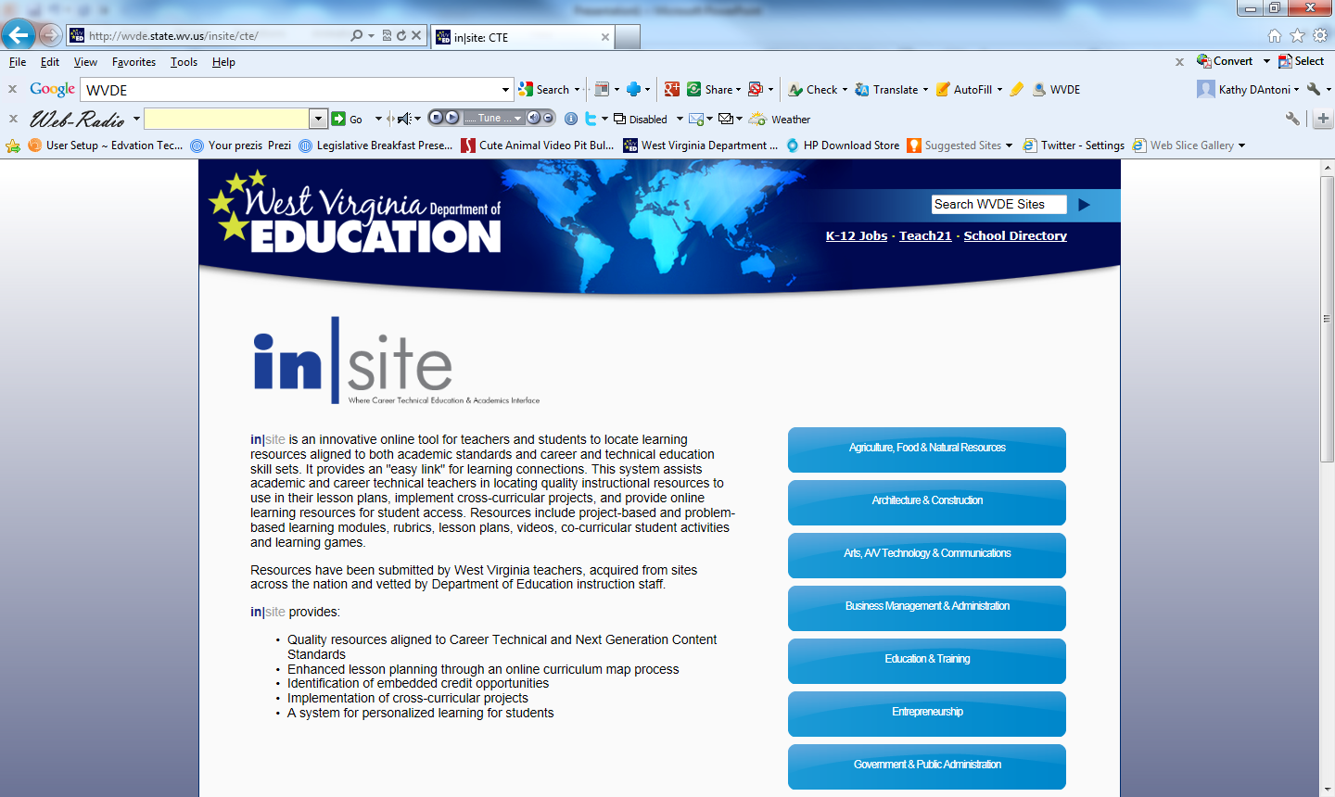

Slide 10
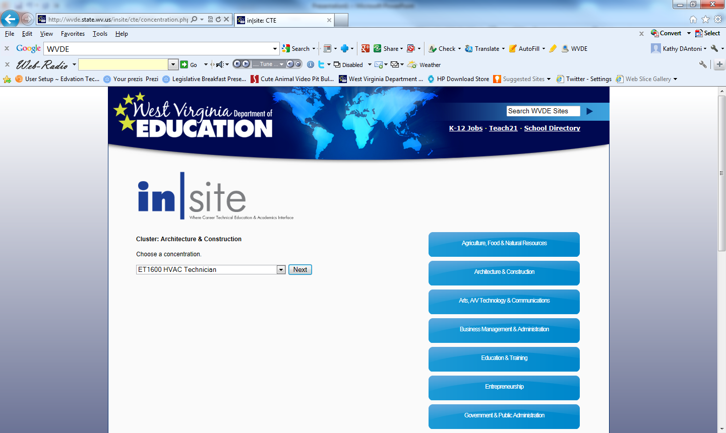

Slide 11
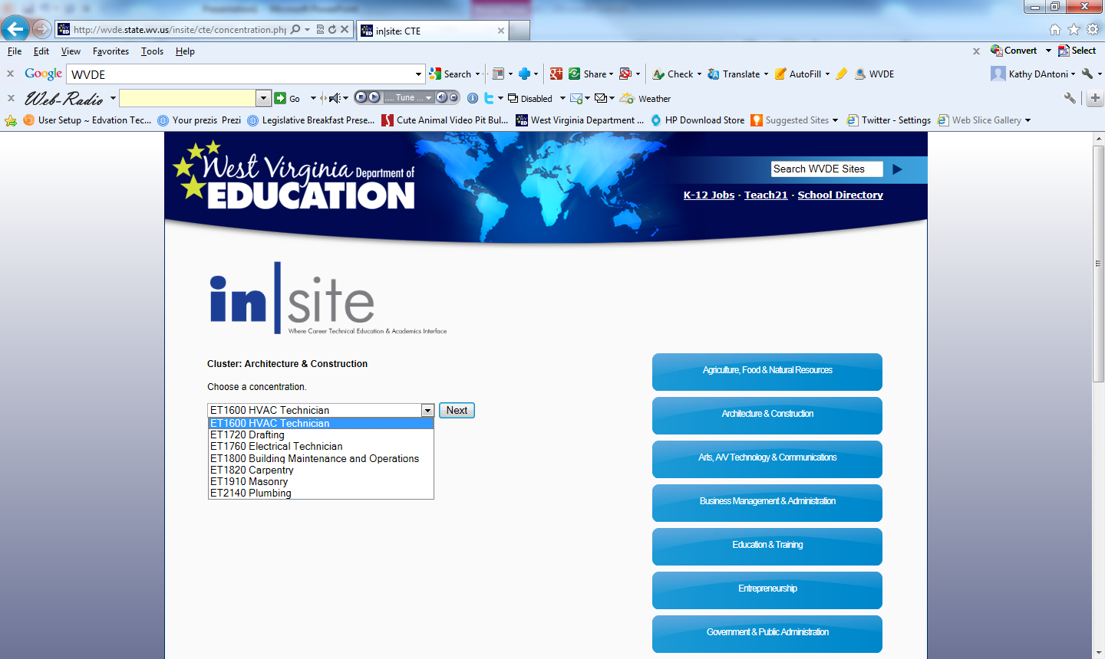

Slide 12
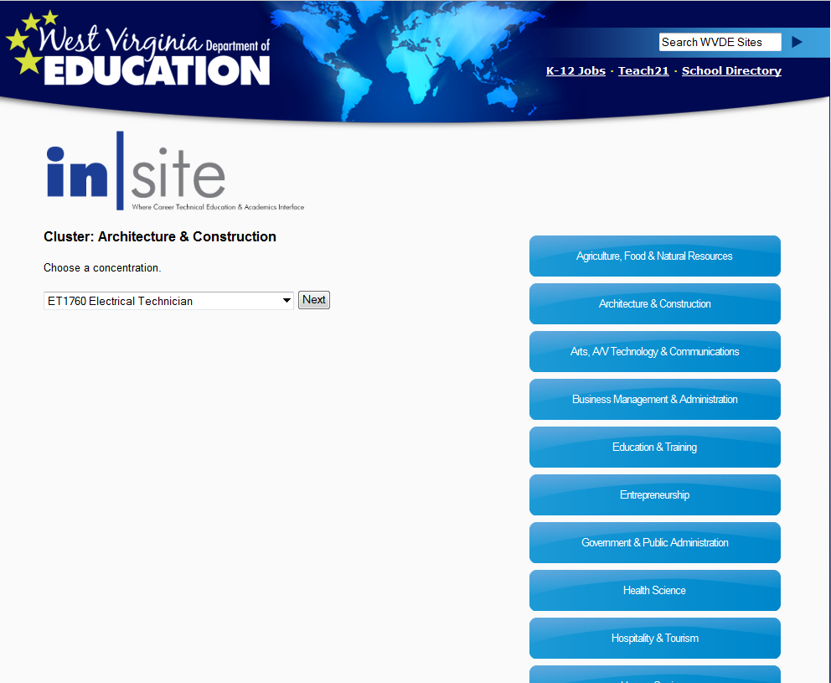

Slide 13
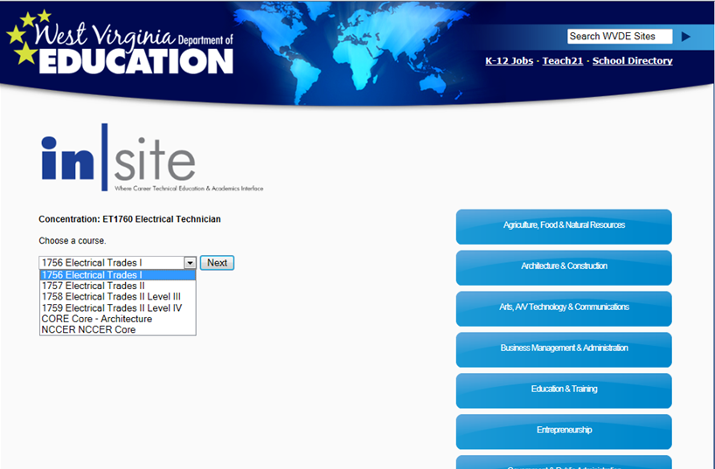

Slide 14
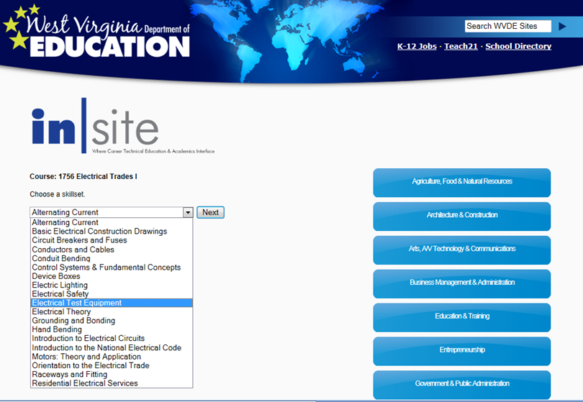

Slide 15
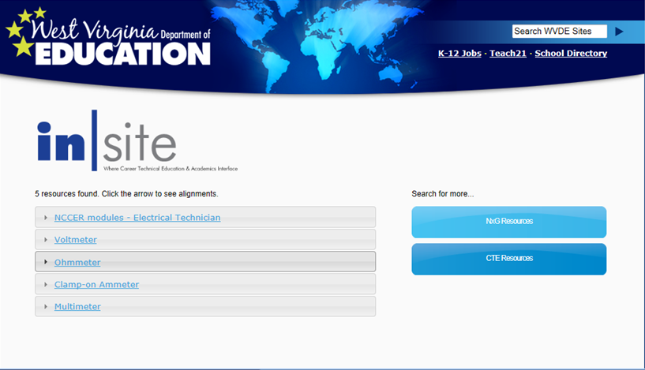

Slide 16
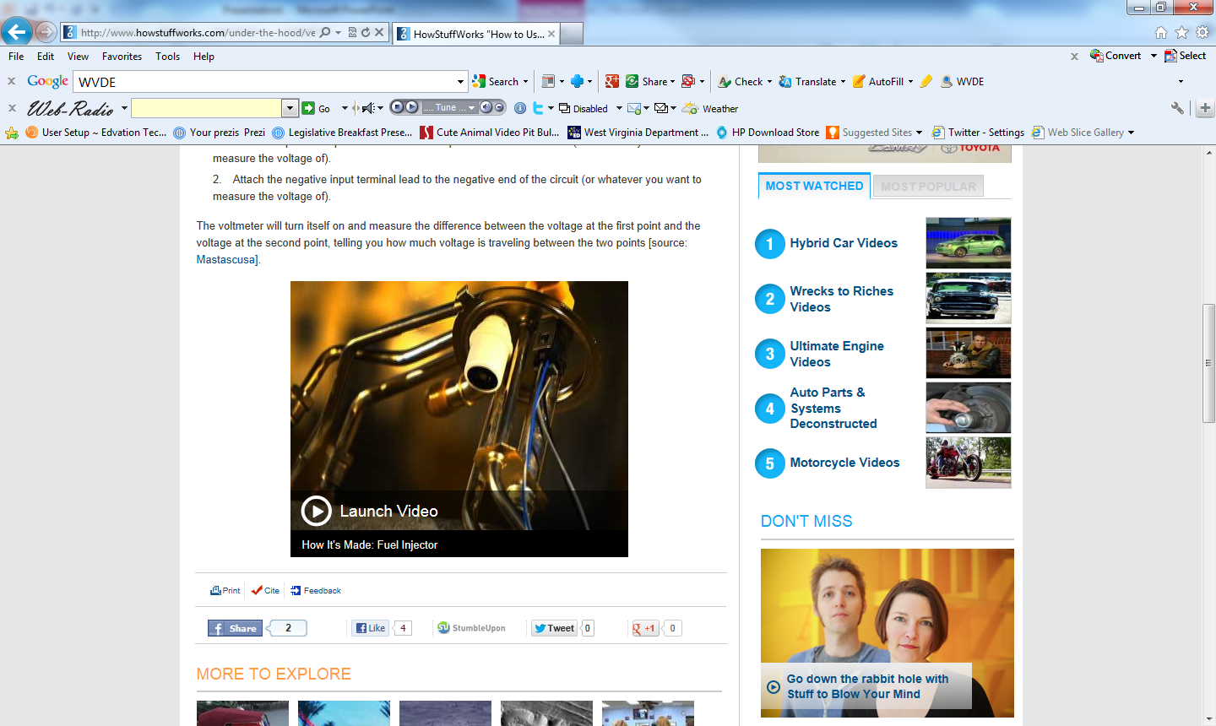

Slide 18
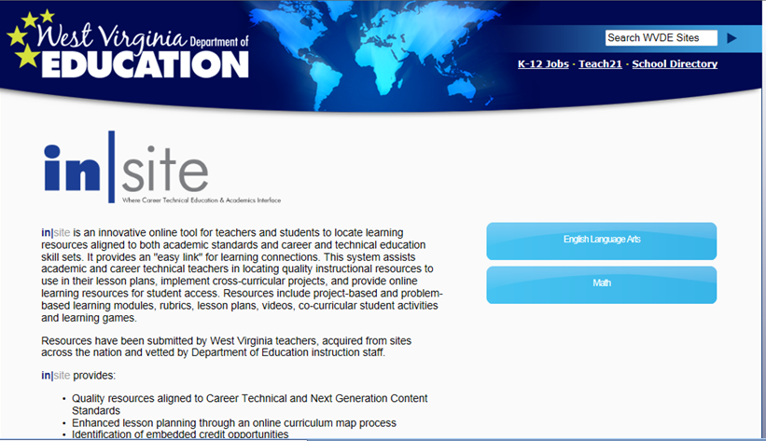

Slide 19
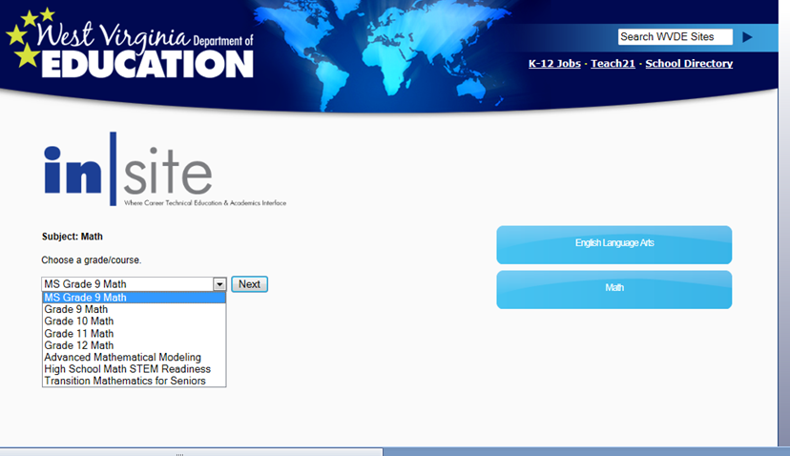

Slide 20
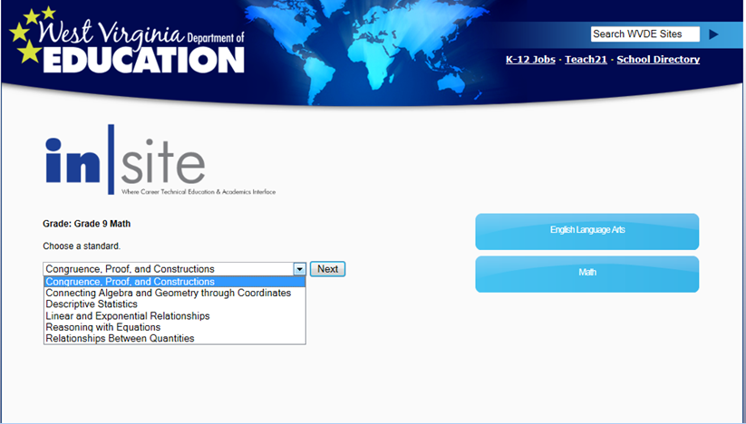

Slide 21
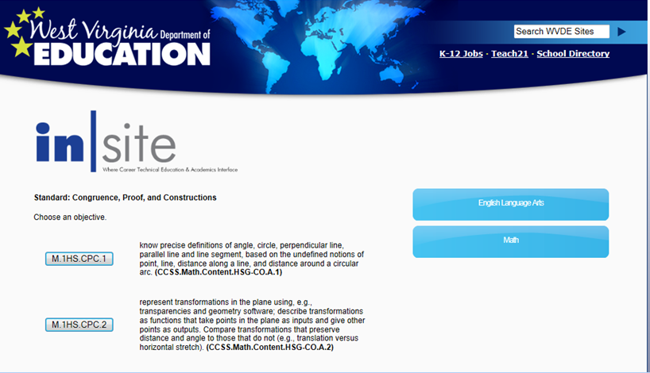

Slide 22


QUESTIONS

