Slide 1
Employer Engagement Initiative
Connie Beene, Director
Federal Initiatives for Technical Education cbeene@ksbor.org

Slide 2
A Brief History......
April, 2013 – Technical Education Authority members posed questions as to when employers were engaging with students
May 2013 – Surveyed institutions and results from survey presented to TEA
July 2013 – Pilot group convened to gain input in development of process to recognize employers
Fall, 2013 – Three tier system developed and continued gathering input to determine recruiting strategies, diversification, and employer rewards

Slide 3
Current status……..
Institutions:
submit names of business partners to KSBOR
receive framed certificate of appreciation signed by President Tompkins and Commerce Secretary George
will begin to collect data validating success of initiative
What does success look like?
Employers and faculty encouraged to engage further and diversity in strategies to create opportunities for students

Slide 4
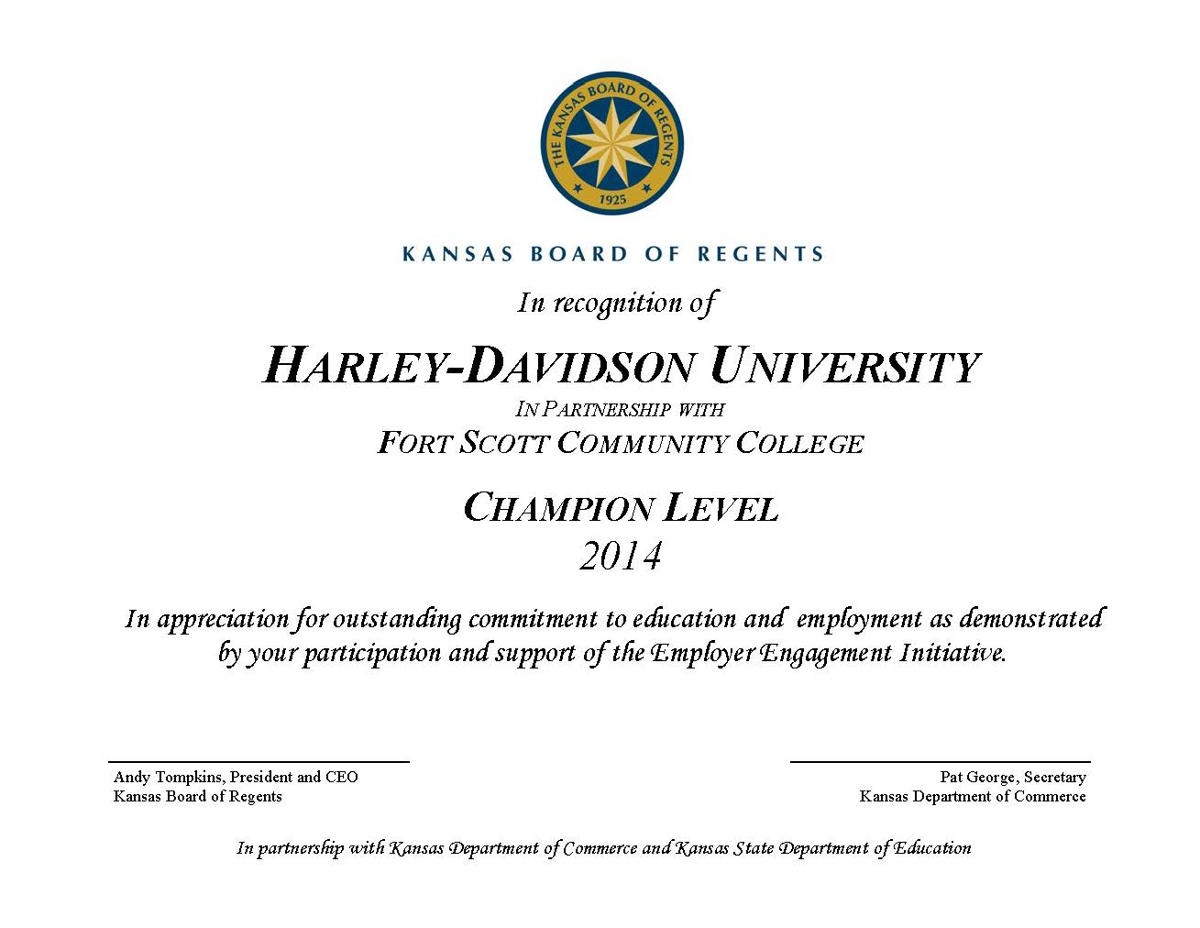

Slide 5
Current status……..
Approximately 120 employers recognized
17 of out 26 institutions participating
KBOR staff attending ceremony to recognize 100th employer
Opportunity for statewide press
Distribution of 2015 stickers to show continuous involvement

Slide 6
What’s next??
Continued expansion of initiative throughout the state
Recognition of business partners at the state level
Addressing issues with data collection
Goal: all technical and community colleges participate
Recognition of continuous involvement (sticker)
Sustainability
Showcased in CTE and B & I newsletter
Continuous development and sharing of best practices
Adds momentum to Programs of Study…….

Slide 7
POS Initiatives
Joint position with KS Department of Education
Development of web tool to facilitate Programs of Study
Streamline efforts with joint advisory committees
Continuation of RPOS model and initiatives
Funding sources?

