Slide 1
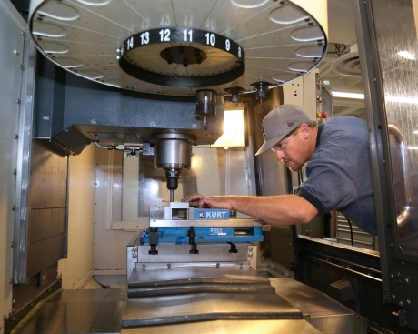

Hope Cotner, Vice President, CORD Mapping Upward Project Director

Slide 2
Today’s Session
You’ll learn about:
Project Focus
Participating Colleges and Their Goals
Technical Assistance
What We’re Learning
Deliverables On the Way

Slide 3
Project Overview
U.S. Department of Education –
Office of Career, Technical, and Adult Education (OCTAE)
Purpose:
Build capacity of community and technical colleges to improve CTE credential attainment rates by offering stackable credentials, a series of shorter pathways to associate degree completion.
Help students progress along the education continuum; earn a postsecondary credential with labor market value.
Deepen employer engagement and partnerships.

Slide 4
Key Activities
Environmental scan of existing practices
Delivery of technical assistance to college networks in support of local expansion of stackable credentials
Creation of community of practice for collaboration, resource sharing, development of processes that
will advance the field
Development and dissemination of stackable credentials toolkit and tutorials to support colleges across the country

Slide 5
Stackable Credentials Characteristics
Responsive to labor market/talent development
needs of region
Educational certificates linked to industry credentials
Active employer engagement
Support diverse groups of learners
Multiple entry and exit points
Flexible scheduling to supports work-and-learn models
Incremental milestones yield credentials with labor market value on the path to degree attainment

Slide 6
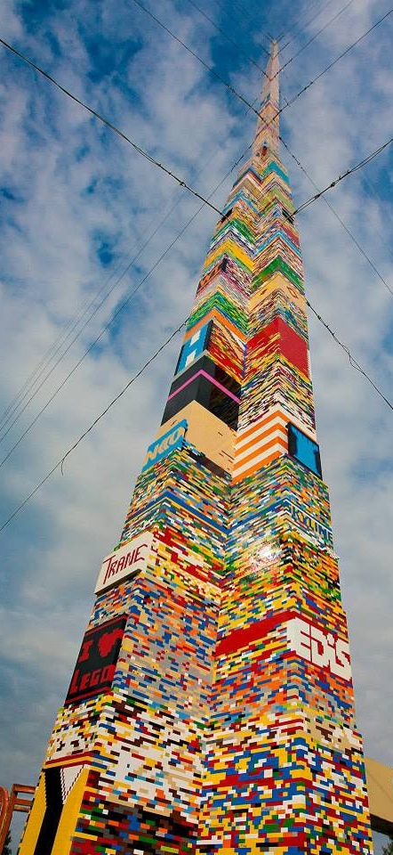



Slide 7
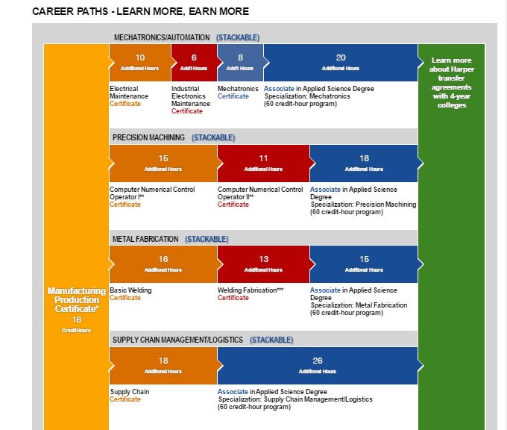

Stackable Credentials in Manufacturing

Slide 8
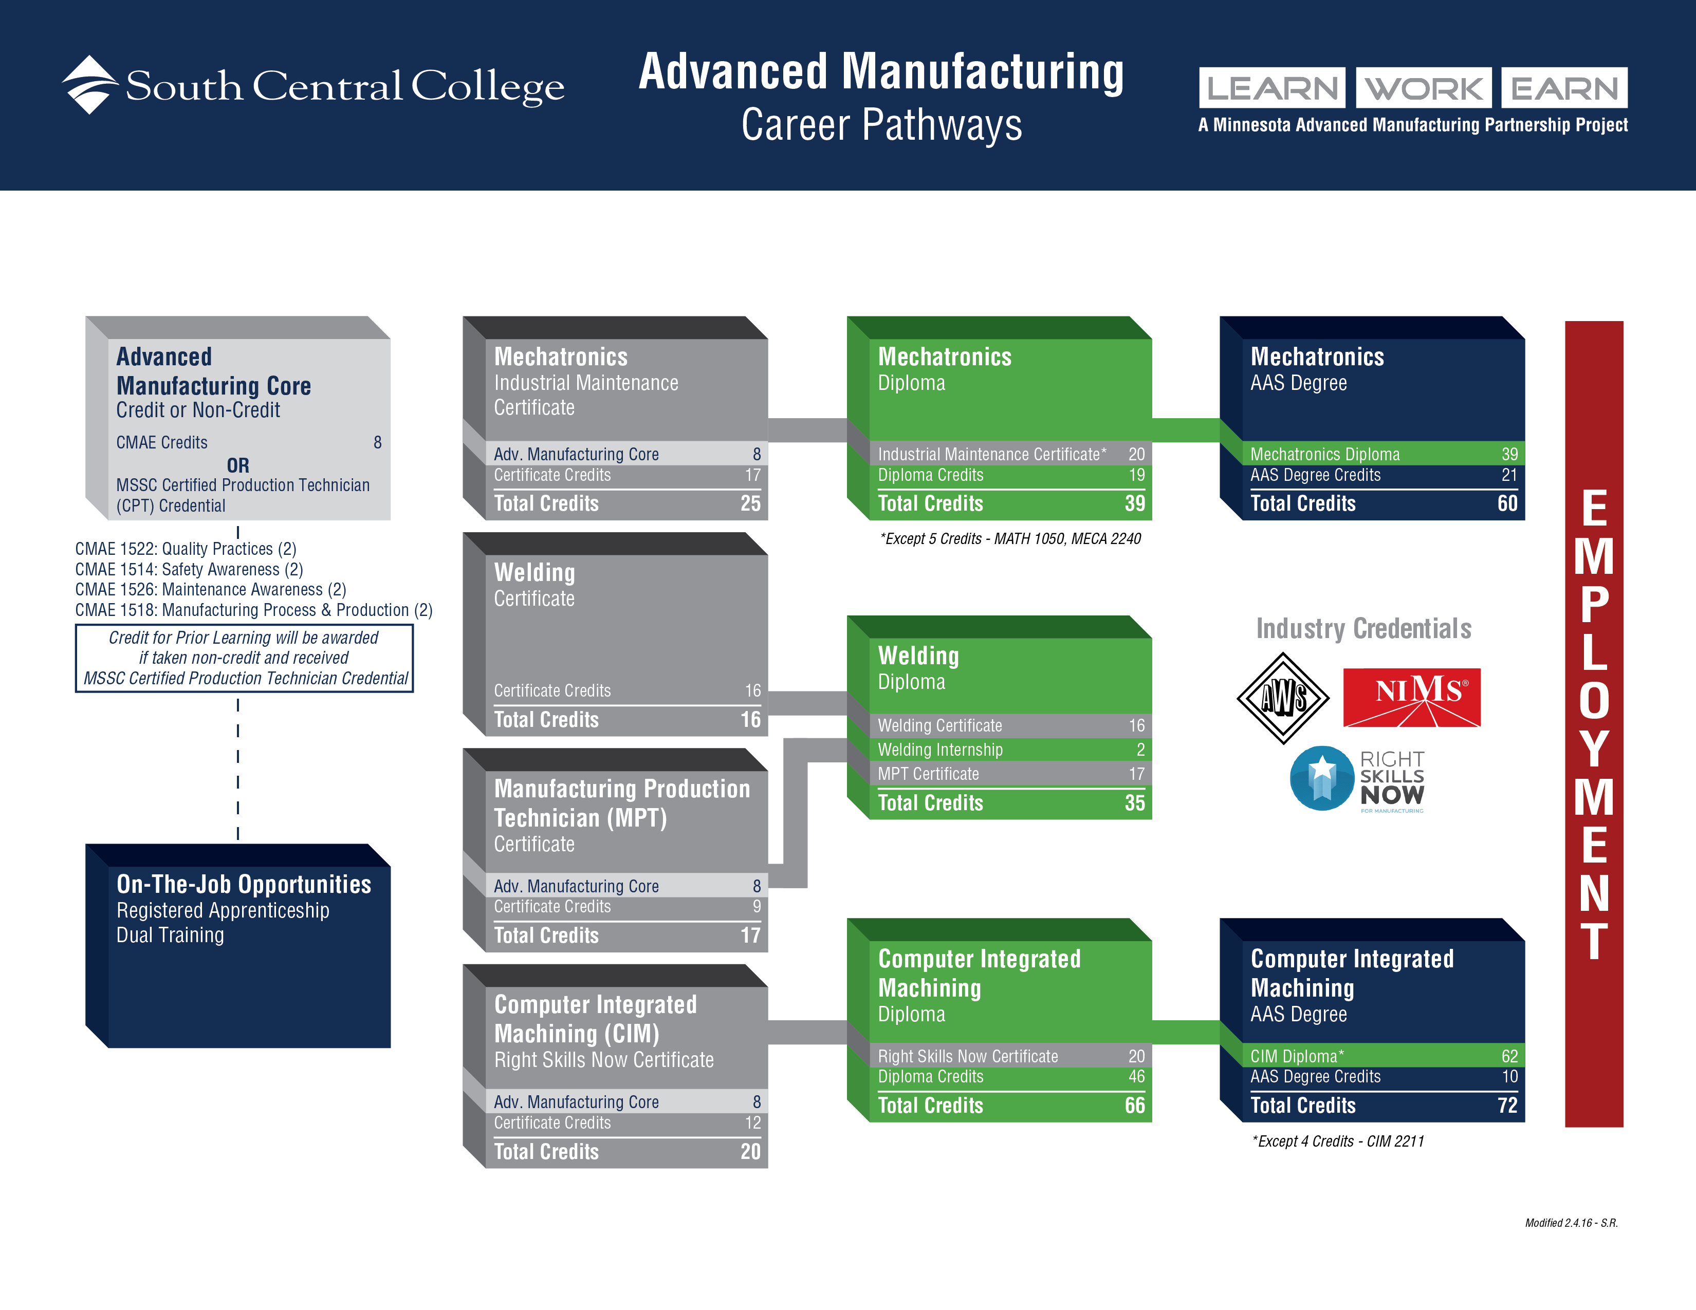

Slide 9
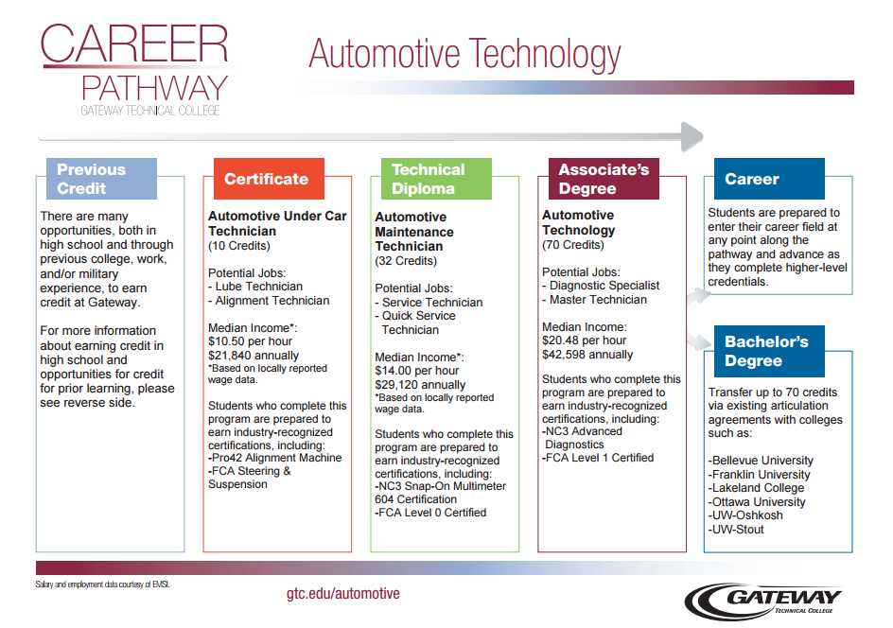

Slide 10
Networks Challenged to Build Their Vision
Groups of 2 – 4 colleges collaborate to:
  create a new series of stackable credentials
  replicate a statewide program or process from one sector to another
  collaborate to convert noncredit certificates to credit-bearing stackable credentials
  scale a successful single-institution model across a network
  form a sector-based network to work with regional employers on stackables
  And so on…
Notes:
Concept of the network – rather than a single college model
Why there’s no prescriptive framework
Meet you where you are…

Slide 11
Participating Networks
Horticulture:
  Bakersfield College, Shasta College, and
  Reedley College (CA)
Advanced Manufacturing:
  Forsyth Technical Community College, Catawba Valley Community College, Isothermal Community College, Piedmont Community College (NC)
  Luzerne County Community College, Lehigh Carbon Community College, Northampton Community College (PA)
  Rowan-Cabarrus Community College and Mitchell Community College (NC)

Slide 12







Environmental Horticulture Certificates
California Association of
Nurseries and Garden Centers
Notes:
A stackable horticulture certificate recognized by industry is our goal.
We hope that we will be able to prepare students for the industry’s labor needs. We are working with three horticultural associations; the CLCA, the ISA and the CANGC. Each of these associations have asked if there is a way to get more entry level employees. We are creating this certificate to 1) give a clear road map to the courses students need to complete. 2) Show the career opportunities available. 3) Develop stronger industry partnerships. 4) Give the student the skills to compete and have the ability to pass the industry certifications. And 5) Get this adopted by the state Chancellor’s Office.

Slide 13

Advanced Manufacturing Credentials Network
Led by Forsyth Technical College, Winston-Salem, NC
Network goals:
Increase awareness of and support for stackable, industry-recognized credentials in the ecosystem for advanced manufacturing including employers, workers, economic developers, educators and potential students.
Establish and/or improve advanced manufacturing career pathways from North Carolina’s secondary schools through its community colleges to embed stackable, industry-recognized credentials such as MSSC that could be earned at the high school level.

Slide 14
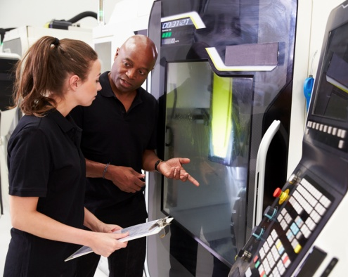
Advanced Manufacturing Credentials Network
Streamline and promote the translation of competencies that can be demonstrated through attainment of stackable, industry-recognized credentials into curriculum credit that will satisfy requirements toward completion of associate in applied science technical degree programs.
Increase industry participation in Work-Based Learning by promoting new opportunities for students who have earned or are working to attain one or more stackable, industry-recognized credentials that have been embedded into their programs of study in advanced manufacturing.

Slide 15
Technical Assistance Delivery
July 2016-August 2017
Tailored to local/regional needs; guided by action plan
Dedicated TA coaches; SMEs support targeted issues
Institute immersed networks in key issues; team planning; program tours
Coaching calls monthly; two site visits (workshops/ meetings/support sessions)
Online community of practice
Webinars, conference calls, podcasts
Identification of cross-cutting issues and
opportunities for partnerships

Slide 16
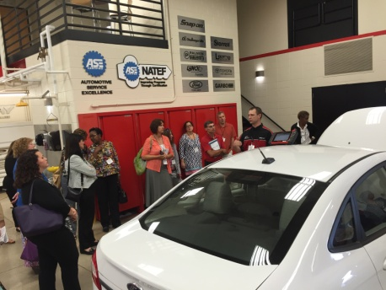
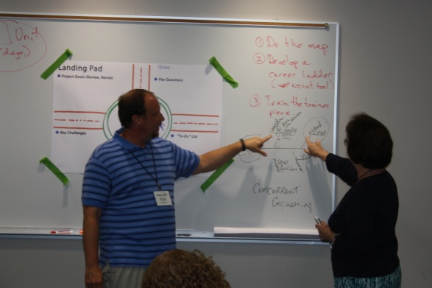
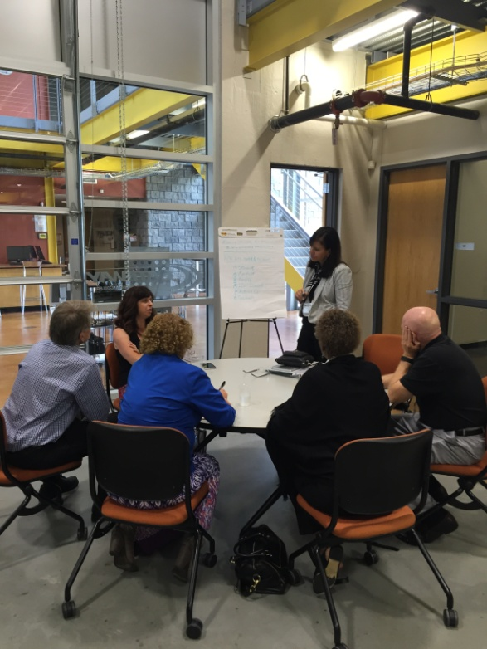
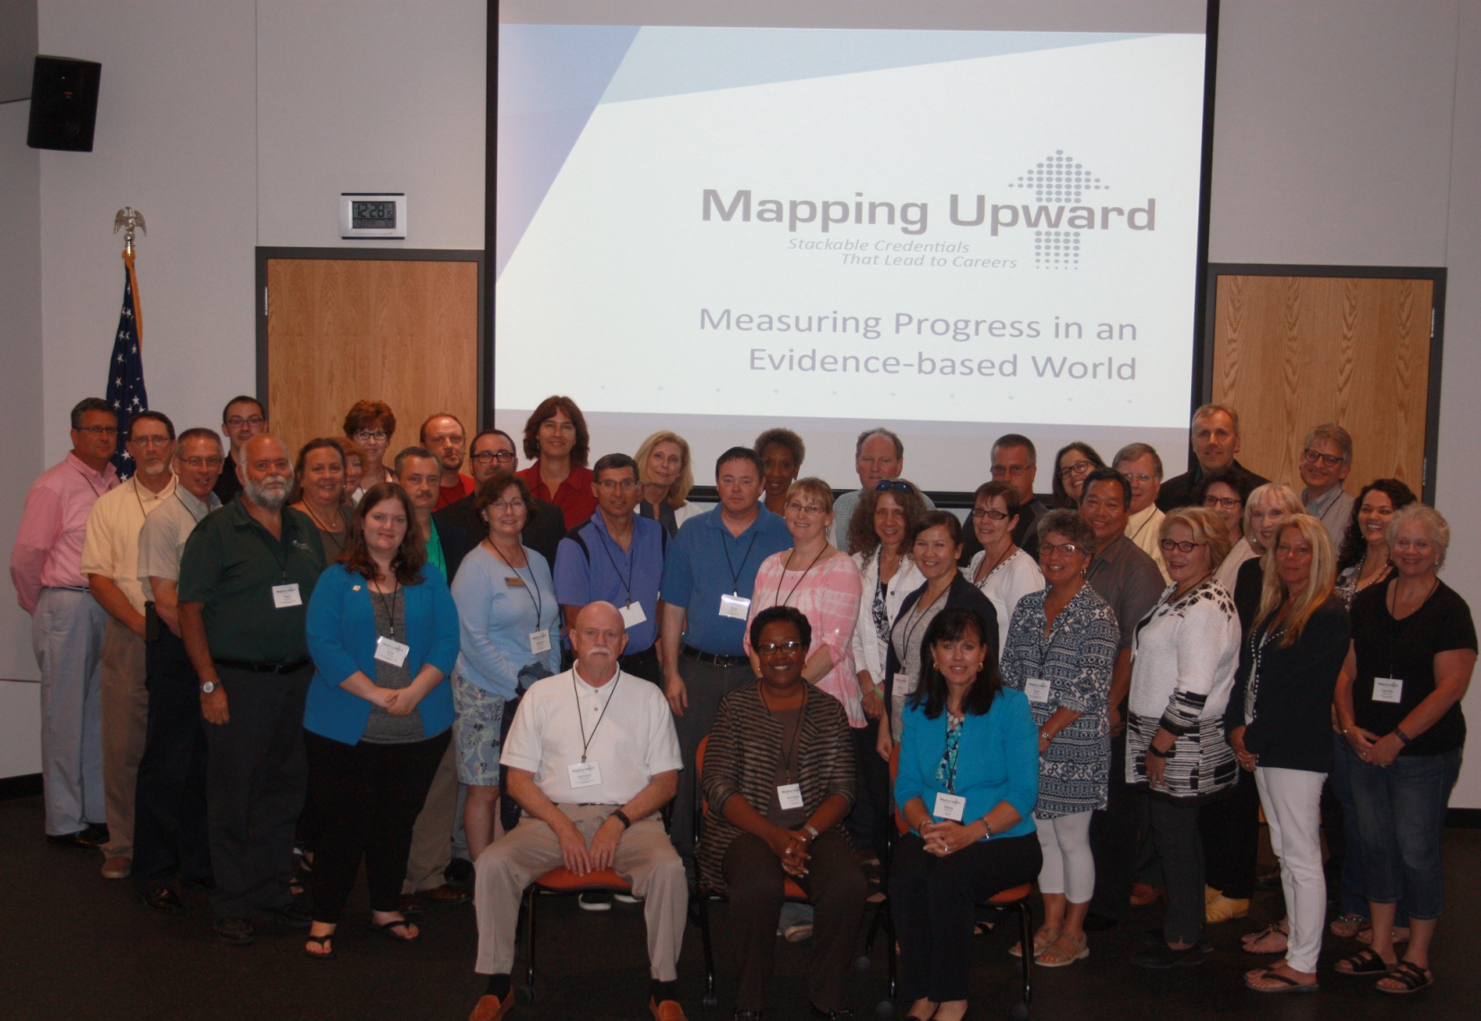
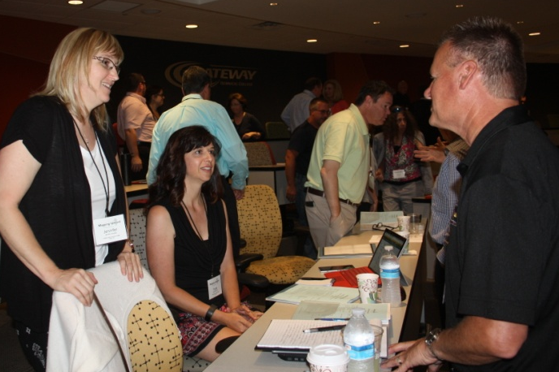
Summer Institute

Slide 17

Key Issues Colleges Are Tackling
Non-credit to credit conversion
Engaging/re-engaging employers through a business-industry leadership team model
Getting employer buy-in for industry certifications
Developing a process for designing stackables from scratch, regardless of the starting point
Communicating benefits of stackable credentials to students and communities
Maintaining, updating, and sustaining industry-responsive stackable credentials

Slide 18

Deliverables to Come
Stackable Credentials Toolkit
Tutorials and Podcasts
Webinar
Replicable Ideas
from the Field
Notes:
Customized TA to advance efforts in stackable credential design such as employer engagement, support services, faculty collaboration, awarding of credit, and industry certification alignment.
Refine approaches to better meet needs of students and employers.
Participate in webinars with other colleges for resource sharing; learn from other sectors.
Receive support sessions from SMEs on specialized topics.
Have access to resources from across the project as well as other federal projects.

Slide 19
Learn More
To learn more about the project’s TA activities and deliverables, contact:
Hope Cotner
Project Director
Vice President – U.S. Projects
Center for Occupational Research and Development
hcotner@cord.org
254.741.8309
Erin G. Berg
Community College
Program Specialist
U.S. Department of Education
Office of Career, Technical, and Adult Education
erin.berg@ed.gov
202.245.6792
Project Email:
mappingupward@cord.org
Download Slides:
cordonline.net/mappingupward
The work reported herein was supported under the Community College Career and Technical Education (CTE) Stackable Certificates Initiative; award number
ED-VAE-15-D-0007, as administered by the U.S. Dept. of Education, Office of Career, Technical, and Adult Education. The contents do not necessarily represent the positions or policies of OCTAE or the U.S. Dept. of Education and you should not assume endorsement by the Federal Government.

