Slide 1
Leading through a Time of Change
Ellyn Artis
Advance CTE Fall Meeting • October 18, 2016

Slide 2



What we do
Hobsons helps students identify their strengths, explore careers, create academic plans, match to best-fit educational opportunities, and reach their education and life goals. Through our solutions, we enable thousands of educational institutions to improve college and career planning, admissions and enrollment management, student success and advising for millions of students around the globe.
College and Career Readiness
Admissions and Enrollment
Student Success
and Advising

Slide 3



In this session, we’ll explore:
A Framework
Tools to Support Change
Action

Slide 4

“Change is the only constant in life.”
Resist change.
Be acted on by change.
Lead change.

Slide 5


A Framework

Slide 6
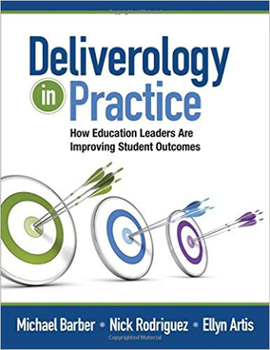
The delivery approach provides a set of flexible tools for K12 and postsecondary educators to implement at scale

Slide 7

Four fundamental questions are at the heart of this change management approach
“delivery” (n.) is a systematic process through which system leaders can drive progress and deliver results.
It involves asking the following questions consistently and rigorously:
1
What are we trying to do?
2
How are we planning to do it?
3
At any given moment, how will we know whether we are on track?
4
If not, what are we going to do about it?

Slide 8
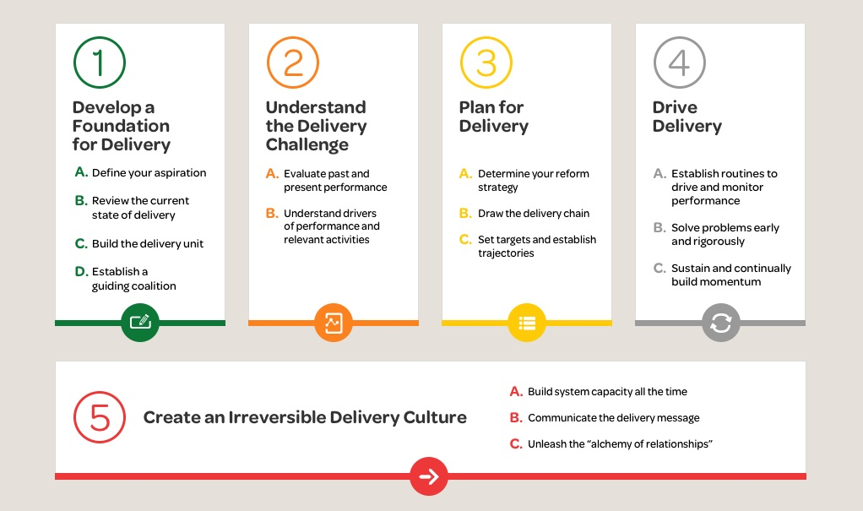
The approach breaks out implementation steps that are necessary for success
Data
Planning
Goal Setting
Focus
Sticking with it

Slide 9




Leaders and advocates have set out a comprehensive vision for the future of CTE
All CTE programs are held to the highest standards of excellence
All learners are empowered to choose a meaningful education and career
All learning is personalized and flexible
All learning is facilitated by knowledgeable experts
All systems work together to put learner success first
Source for vision and photos: Putting Learner Success First: A Shared Vision for the Future of CTE; https://www.careertech.org/vision

Slide 10

Tools

Slide 11

If you have a goal
then you
must
have a plan to deliver

Slide 12

The only plans worth writing are those that actually drive your work
The only plans worth writing are those that actually drive your work
“When asked for a plan, [the bureaucracy’s] traditional response is to write some thoughtful prose…the hope being that the recipients will be so impressed by the prose that, after reading it, they will leave you alone. That of course was not what we wanted. We wanted real, messy practical plans, with folds and creases, scribbled notes in the margins and coffee stains.”
– Deliverology in Practice

Slide 13
Good planning requires a team to collectively answer several implementation questions
?
Is there a clear definition of success?
Who is accountable at the top … and all along the delivery chain?
What’s our theory about why and how our strategies will help us to achieve the desired outcome?
What milestones should we anticipate?
What data do you need? Will it be early enough to act if progress is off track?
What are the major risks? How will they be managed?
Are we clear about the resources needed to implement?
What impact will the actions have on the key outcomes?

Slide 14
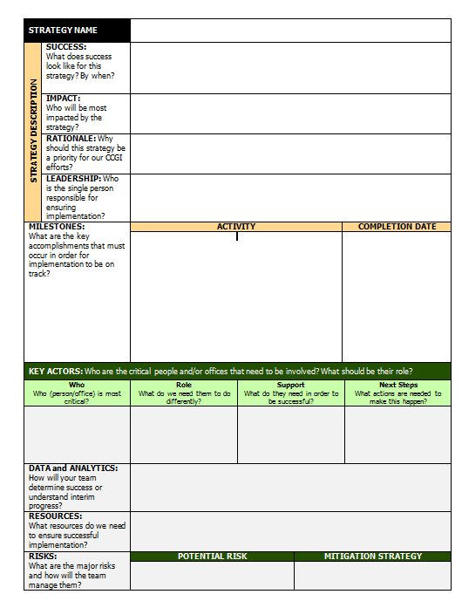
Thin “strategy profile” planning allows for a shared view of what the team will do and how it will be done
Component | What to Capture?
Description | Describe the strategy and purpose in a sentence or two.
Desired success | What would success look like for this specific strategy? By when?
Impact | Who will be most impacted by the strategy? At what scale (number of students, colleges, faculty, etc.) will it be implemented?
Rationale | Why should this strategy be a priority for our CCGI efforts?
Leadership | Who are the critical people and/or offices that need to be involved in the effort? What should be their role?
Workflow and Milestones | What significant events will have happened in the roll out of this strategy?
Key Actors | Who are the critical people and/or offices that need to be involved? What should be their role?
Data and Analytics | What data could you use to understand progress?
Risks | What are the major risks and they be managed?
Resources required | What people, agencies, time, or other resources will be needed?

Slide 15
These profiles become an implementation plan that you can test with your stakeholders

Slide 16

Action
Notes:
NO SUBHEAD

Slide 17
Once the plan is clear, there are a number of stakeholders to consider and engage
K-12
Higher Ed
Workforce
Community

Slide 18
When identifying stakeholders to prioritize, consider their level of interest and influence
High
Power to influence outcome
Low
Low
High
Level of interest for your effort

Slide 19
Based on where stakeholders fall on the 2x2 matrix, you can determine the best way to approach them
Messengers/ champions
activate them
Opponents
watch them
High
Power to influence outcome
Not a priority
minimize engagement with them
Fan club
inform them – proportionate to their influence
Low
Low
High
Level of interest for your effort

Slide 20
And choose to target those with the most potential for impact
Messengers/ champions
activate them
Opponents
watch them
Targets
High
Power to influence outcome
Not a priority
minimize engagement with them
Fan club
inform them – proportionate to their influence
Low
Low
High
Level of interest for your effort

Slide 21



When developing messages, it helps to start by thinking through the questions the core messages should answer
The Why
The What
The How

Slide 22

When developing your messages consider several principles
  Keep it simple
  Let the objectives drive the message
  Remember interests and values
  Think about what your audience:
    Already knows
    Wants
    Needs to know
    Is already doing
  Seek input and feedback from the audience (or somebody who understand them well)

Slide 23
…but we know that setting goals is only the beginning – next comes the even tougher part
“You don’t just sign up for the goal;
you sign up for the suffering too.”
Sir David Brailsford
Team Sky
“
Notes:
How will you implement these reforms at scale, with fidelity?
Your goal for students is important. But setting it, and even selecting your reforms, is the easy part. How are you actually going to get there? (Reveal).

Slide 24
“Change is the only constant in life.”
Resist change.
Be acted on by change.
Lead change.

Slide 25
Thank You!
Ellyn Artis
ellyn.artis@hobsons.com
@EllynArtis

