Slide 1

Better Connecting Education to Careers
Report to Idaho Senate Education Committee
Dwight Johnson, State Administrator
Wednesday, Jan. 31, 2018
Notes:
Thank you for the opportunity to make my annual report for Idaho Career Technical Education to your committee today. We are very excited about the progress and momentum CTE is making nationally and in Idaho.

Slide 2
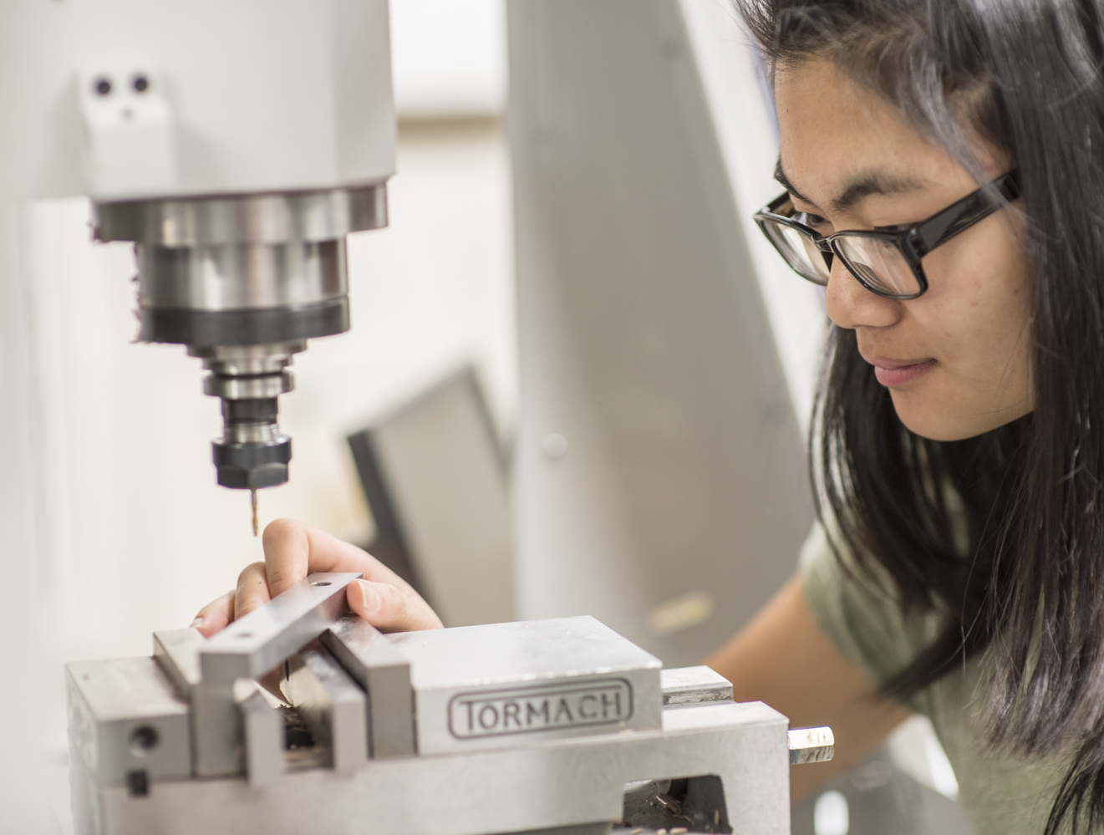
Our Mission
We prepare Idaho’s youth and adults
for high-skill, in-demand careers.
Notes:
And we are passionate about our mission to prepare Idaho’s youth and adults for high-skill, in-demand careers!
Chairman Mortimer has asked me to do a little be deeper dive on our organizational structure, our funding, and how we fit into the larger workforce development system in Idaho with other partners in delivering education and training to help assure we have a skilled workforce to meet our businesses talent demands.
So, I’ve tried to incorporate that into this presentation.

Slide 3
Why is our Mission Important?
We provide outstanding career opportunities for Idahoans!
        Of the top 20 in-demand occupations in Idaho with the highest vacancy rates 17 are tied to CTE programs.
        The starting wages in those 17 occupations range from $16.50 to $43 an hour.
Notes:
We believe there are a two very important reasons why our mission is important.
First of all it is important because it provides outstanding career opportunities for Idaho students.
Review Stats

Slide 4

Dwight Johnson, ICTE State Administrator
Notes:
Secondly, our mission is important because it provide the talent pipeline for business. We currently have a Workforce Shortage and Skills Shortage that are projected to get worse.
The Workforce shortage (Explain graph)
Skills shortage – We know that 2/3rds of those 138,000 jobs will require some training or education beyond H.S. But a large percentage of those jobs will require less than a bachelors degree but will require an Associates degree, technical degree, industry certification or apprenticeship.

Slide 5






What is Career & Technical Education?
Agriculture & Natural Resources
Family & Consumer Sciences
Health
Sciences
Engineering & Technology
Skilled & Technical Sciences
Business Management & Marketing
Dwight Johnson, ICTE State Administrator
Notes:
Just as a reminder, there are 6 CTE program areas that provide a broad spectrum of career opportunities for Idaho students. To give just a few examples:
Agriculture and Natural Resources offers jobs in Animal Systems, Food Products & Processing, Agribusiness Systems, Veterinary Technician, and others.
Careers in the Skilled and Technical Sciences include precision machining, diesel technology, electronics, welding, plumbing, HVAC and electronics.
Business Management & Marketing provides jobs like administrative services, marketing, business finance, and accounting.
Health Science programs include jobs like nursing, surgical technicians, and physical therapist assistants.
Family & Consumer Sciences includes careers like culinary arts, early child development and hospitality and tourism.
Engineering & Technology offers jobs in computer networking, robotics, and web design just to name a few.

Slide 6


The value of Career & Technical Education
Connects students to real careers
Provides a talent pipeline for Idaho’s business
Makes education meaningful through applied learning
Notes:
I mention some of these careers because CTE has historically suffered from an image problem. There is a legacy mentality with some individuals who think that if a student can’t cut it academically that we send them to the trade school or technical school. And that just doesn’t fit with today’s reality.
We believe the value of CTE is that:
We connect students to high-skill, in-demand careers with great wages;
2. We provide the talent pipeline or the human capital for Idaho industry that they need have to grow and expand their business; and
3. We make education meaningful for your students through applied learning.
The message we want to communicate is that Career & Technical education is no longer your grandfather’s shop class.

Slide 7
Organizational Structure
State Board of Education
Idaho’s Consolidated K-20 State Board of Education is also the State Board for CTE
Career & Technical Education
Secondary School Programs
Postsecondary School Programs
Comprehensive High Schools
17 Career Technical Schools
Six Technical Colleges
Notes:
As you are aware we have a consolidated State Board structure in Idaho. And that means that the State Board of Education is also the State Board of Education for Career Technical Education.
So, Idaho Career Technical Education is a Division of the State Board of Education and we provide the staffing and administer the funding to support CTE for both secondary and postsecondary CTE programs.
We have CTE programs in almost all of regular comprehensive High Schools across the State and we have 17 Career Technical High Schools, which can quality by code for additional funding if they qualify by taking students from multiple high schools or multiple school districts and meet certain quality standards.
We also fund CTE programs at our six Technical Colleges throughout Idaho.

Slide 8







CTE Postsecondary
5,754 students enrolled
3,222 degrees / certificates earned in 2016
44,801 students participated in non-credit workforce training
96% of technical college completers found jobs or continued their education.
Notes:
Those 6 technical colleges are located at our 4 Community Colleges as well as at LCSC and ISU.
You can see that we had almost 5,800 students enrolled in CTE degree programs.
The results of these programs we feel speak for themselves. 96% of technical college completers found jobs or continued their education.
In addition, we have Workforce Training Centers located at each of our Technical Colleges, which provide customized training, occupational upgrade training, and related instruction for apprentices to increase the skills of local businesses’ current and new workers. And this training is largely paid for by the businesses for their employees.

Slide 9
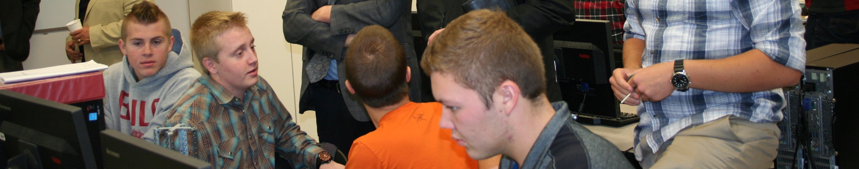
Secondary CTE
718 programs
59,575 students enrolled in CTE courses
7,783 CTE concentrators (taking a sequence of CTE courses)
10,132 students enrolled in career & technical high schools
66% went on to college compared to 49% of all Idaho students
96% of CTE high school graduates found a job or moved into postsecondary education
Notes:
As I mentioned we have secondary CTE programs in almost all of our high schools across the state. Almost 60,000 high school students took a CTE course and almost 8,000 are CTE concentrators who take a series of CTE courses within a program of study.
Over 10,000 of those students are attending one of or 17 Career Technical High Schools.
I think it is important to note that CTE concentrators have a 66% go-to-college rate compared to an average 49% of Idaho high school students.
And 96% of CTE high school concentrators found a job or went to college.

Slide 10
ICTE FY18 Budget Overview
Postsecondary CTE | $53.69 Million
Secondary CTE* | $16.53 Million
Statewide Initiatives | $1.35 Million
Division Support (4.2%) | $3.18 Million
Total: | $74.75 Million
NOTE:
* Secondary CTE Teacher salaries from General Education Budget – $40 million
Notes:
This is a summary of our overall State CTE budget. For FY2018 we had a budget of just under $75 Million.
You will note the difference between our Postsecondary and Secondary budgets.
The reason for that difference is that our budget doesn’t include the salaries and facilities for secondary CTE teachers, while we do pay for salaries of our Postsecondary faculty. The dollars for secondary CTE teacher salaries come through Public Education Budget that is distributed through the State Department of Education. The CTE secondary budget helps cover the additional costs of implementing a quality CTE program that takes lots of additional equipment and supplies. If you add the public education dollars for CTE secondary teacher salaries you would could identify an additional $40 million that supports our CTE secondary programs. (885 CTE Teachers X $45,117 (avg. teacher salary) = $39,928,545) .
We have a number of statewide Initiatives includes:
Teacher Training
Help with CTE teacher training including grants to U of I and ISU Colleges of Education As well as our new InSpire Teacher Training program to help on-board CTE occupationally licensed teachers coming from the private sector into the teaching profession.
We also have our alignment initiative to assure CTE credit transfers to our technical colleges as non-elective credit
CTE Digital partnership with Idaho Digital Learning Academy to expand online CTE courses.
This also supports our annual professional development Conference. We are very pleased that participation in this conference from 500 three years ago to almost 1000 CTE faculty, teachers and administrators attending last year.
Our Division Support category that is for our staff salaries is only 4.2% of our overall budget.

Slide 11
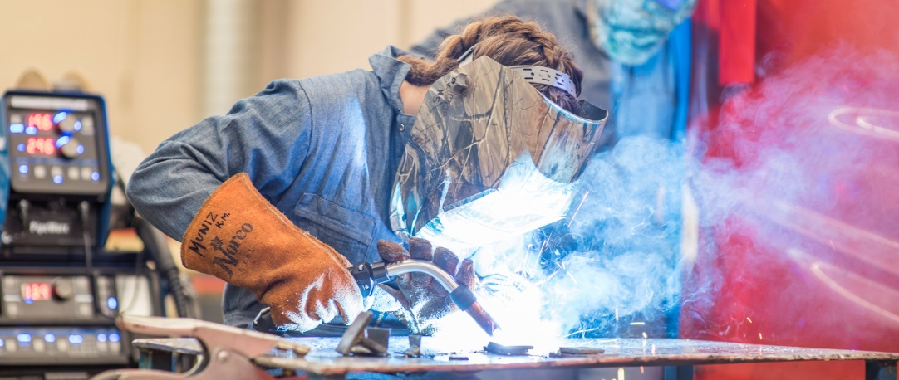
FY18 Secondary Budget: $16.53 Million
Ag Incentive
$325,000
Program Quality
$300,000
Federal Perkins
$3.2 Million
Added Cost $7.9 million
CT Schools $4.8 million
Budget Line-Item Requests
Dwight Johnson, ICTE State Administrator
Notes:
So, looking a little more deeply at our Secondary Budget
We have 4 Secondary CTE Funding Streams:
Added Cost funding provides additional resources to defray the expense of delivering a quality CTE program. The school district and the state provide the funds for a CTE teacher and a classroom facility, and the added cost funding provides additional resources to pay for equipment such as welding tools, auto-body equipment, mannequins for health classes or ovens for culinary programs as examples.
We also have 17 CT High Schools across the state, who by code can qualify for additional state CTE funding if they have students attending from multiple high schools or school districts and if they meet higher program quality requirements.
Three years ago the legislature provided $325,000 in ongoing incentive funding for high quality Agriculture CTE programs. So, we annually award 30 - $10,000 incentive grants and one $25,000 grant to start a new Ag program.
We appreciate your unanimous passage of SB1222, which will establish our Program Quality Initiative and allow us to provide high quality to the other 5 CTE program areas and provide technical assistance grants to all of our CTE programs.
We also distribute over $3 million in Federal Perkins funds. Those funds are targeted at enhancing the quality of CTE programs throughout the state.

Slide 12
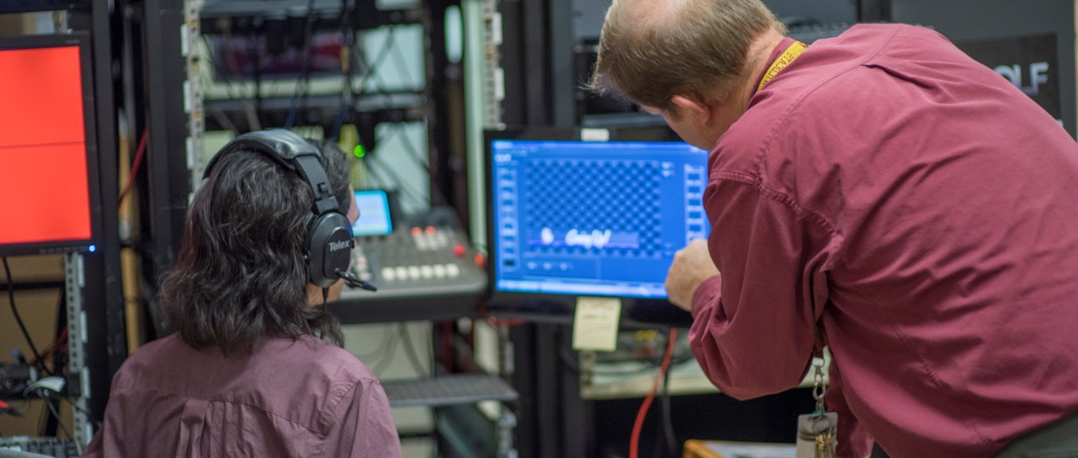
FY18 Postsecondary Budget: $53.69 Million
Centers
for New Directions
$1.14 million
Workforce Training Centers
$483,100
CTE For Tech Degrees
$45.9 million
Adult
Education
$3.44 Million
Federal Perkins
$2.6 Million
Budget Line-Item Requests
Dwight Johnson, ICTE State Administrator
Notes:
We have a number of CTE funding streams at the Postsecondary level as well:
Our most significant is our CTE programs of technical degrees and certificates
We also provide funding for Adult Education to help adult student obtain GEDs and build skills to help them be successful in obtaining postsecondary education.
Our Centers for New Directions are particularly focused single mothers with significant barriers to employment to assist them to increase skills as they re-enter the workforce.
Our 6 Workforce Training Centers are largely self funded by local businesses who pay for customized training but we currently provide $80,500 to help defray their administrative expenses.
We also distribute over $2.6 million in Federal Perkins funds. Those funds are targeted at enhancing the quality of CTE programs throughout the state.

Slide 13
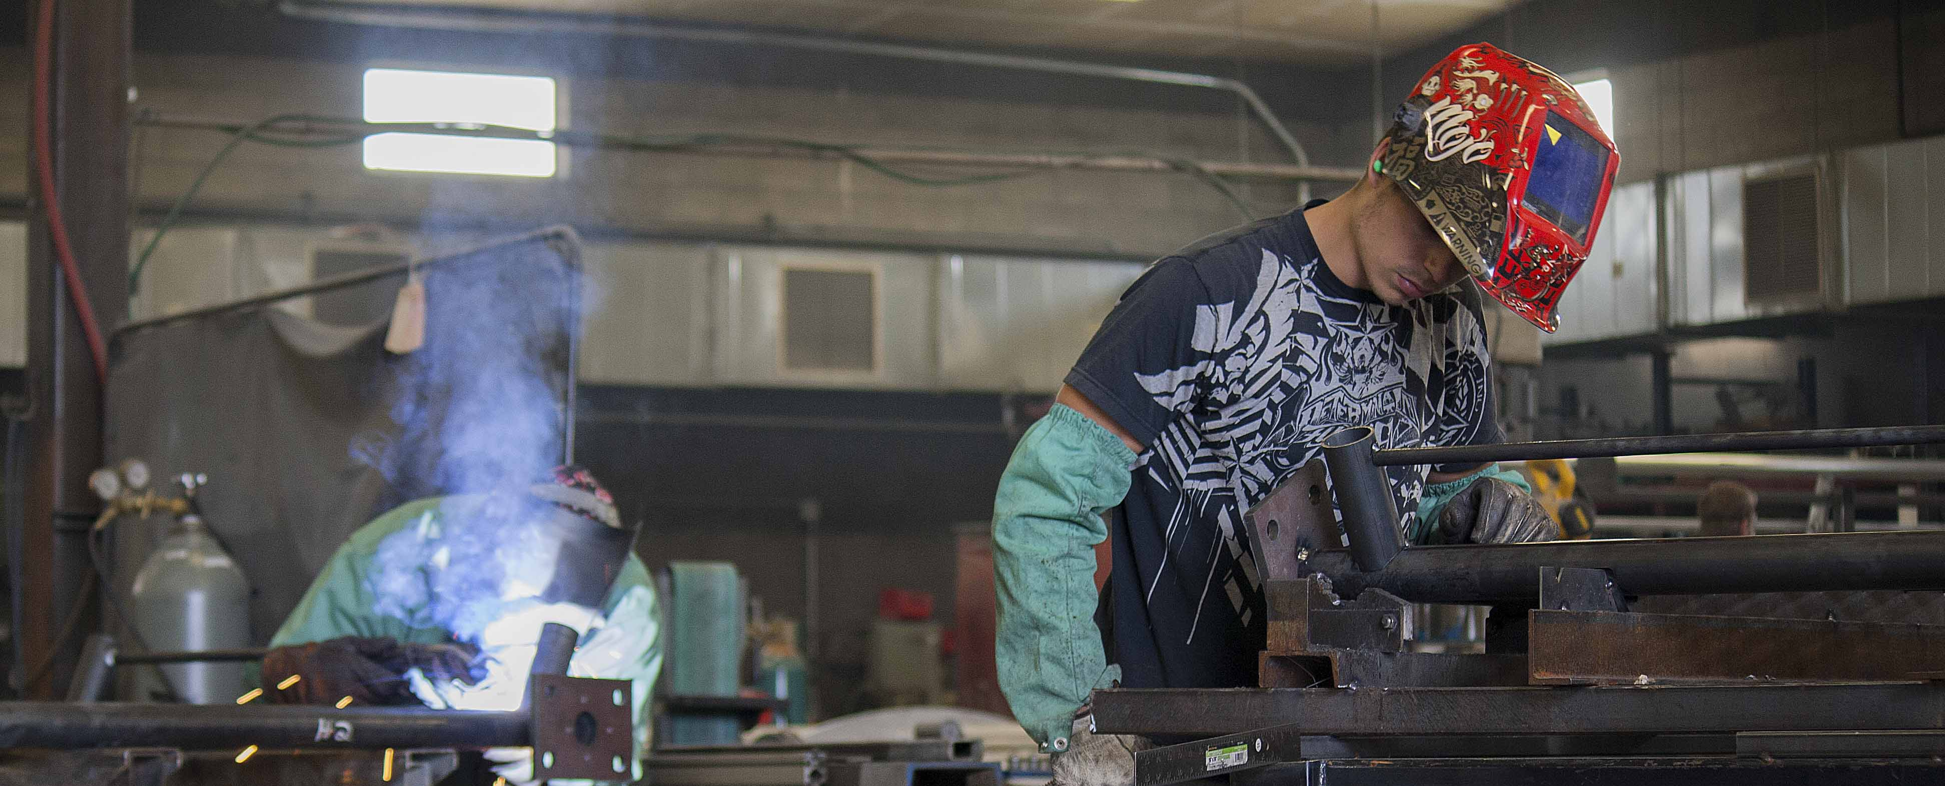
“Meeting the employer demand for more skilled workers is among our most serious challenges.”
Governor C.L. Otter (2018 State of the State Address)
Dwight Johnson, ICTE State Administrator
Notes:
We very much appreciate Governor’s Otter’s support for Career Technical Education.
In his state of the state address, identified workforce development as one of the two top public priorities that Idaho faces today.
To help address those challenges the Governor appointed an industry-led Workforce Development Task Force, which made its report July 1st of last year.

Slide 14

Governor’s Workforce Development Task Force
Recommendations Regarding:
Workforce Development Council and Industry Partnerships
Workforce Development Training Fund
Public Engagement
Connecting Education to Careers
Workforce Training Centers and Adult Training Support
Strengthen Career Advising
Workforce Readiness
Apprenticeships
Expand Career and Technical Education Programs
Notes:
The Task Force articulated the urgency of addressing this challenge by noting that the availability of skilled labor has become one of the critical factor in business siting and expansion decisions. A direct quotes from the Report states: If an adequate workforce is not available, businesses will go elsewhere to create new, high-quality jobs, damaging every local economy.
And we are pleased that the Task Force identified CTE as a major component of meeting this challenge and increased support for CTE programs was not only directly recommendation but also figured prominently in their other recommendations of expanding support for our Workforce Training Centers and strengthening Career Advising, Workforce Readiness, and Apprenticeships.
And we are pleased to be working with the Governor’s office, the State Board of Education and other Executive Agencies to effectively implement these recommendations.

Slide 15
Workforce Development System
Governor’s Office
Industry Representatives / Legislators
Workforce Development Council
Government & Education Agencies
Role of Workforce Development Council:
Advise Governor and State Board on Workforce Strategy & Policies
Oversee Workforce Development Training Fund
Oversee federal WIOA funds
State Board of Education
  State Department of Education
  Colleges & Universities
  Career & Technical Education
  Division of Voc-Rehabilitation
Department of Labor
Department of Commerce
Department of Health and Welfare
STEM Action Center
Notes:
One of the recommendations that the Governor is acting on is to change the Workforce Development Council to an office within the Governor. He has redone the Executive Order establishing the WDC assure that it is a majority of private sector members as well as expanding membership to include Legislative representation (Sen. Michelle Stennett and Rep. __________ have been appointed).
I believe goal of the Taskforce was assure that some single entity had ownership of the recommendations to help assure they would be accountability to get them implemented.
And one of the significant roles the WDC plays is to take those recommendations in developing a statewide strategic plan for workforce development with industry input and advise the Educational Institutions within the State Board of Education and other executive agencies to coordinate all of our resources to assure they are complementary and supportive of youth and adults in achieving their career goals throughout their lives.

Slide 16
Talent Pipeline for Business
Career Pipeline for Students
Expand Capacity
Continuous Improvement
Attract Students
Notes:
As we have reviewed Task Force Report and recommendations we have identified 3 strategic topics that we believe CTE can productively contribute to their accomplishment. If you imagine what we do as a talent pipeline for business and a career pipeline for students then that means that:
First we need to attract more students into that pipeline both at the secondary and postsecondary level. That includes better career advising, enhancing our image, communicating more effectively with parents and students the opportunity available through CTE, and better utilizing and engaging our connections with employers and other stakeholders to deliver that message.
Second, if we are successful in attracting more students then we must expand our capacity to teach and train those additional students. Nothing would be worse than to create hope and vision for students and their families then not be able to deliver on that promise. That means securing the resources to increase the number and size of our programs at the secondary and postsecondary level, increasing materials & equipment, and it includes addressing CTE teachers shortages.
Finally, it means we must continuously improve our program quality and be able to demonstrate to policy makers and funders that our CTE students are obtaining the technical and workplace readiness skills necessary to be successful in their chosen careers.

Slide 17
CTE Image
Continue to increase visibility, enhance perceptions, and inform students & families of the opportunities available through CTE high schools and Idaho’s technical college programs
Attract Students
New Postsecondary CTE Facilities
LCSC, NIC, CEI, ISU, CWI
Expand CTE to Middle Schools for Career Exploration
Legislation proposed to allow ICTE to begin funding CTE programs starting in seventh grade. Develop program curriculum and implementation budget to expand career exploration program for middle schools.
Notes:
So, we’ve divided our legislative initiatives into these three strategic areas of focus.
One of their recommendations of the Governor’s Workforce Development Taskforce was to better “Connect Education to Careers” and that Idaho’s K-through-Career education system should value and support all pathways for students to achieve education, training and workforce skills that align to their career aspirations.
The task force recognized that the “Go – to – College” message that we have pushed for many years has often been wrongly interpreted as meaning only a 4-year degree. We need more bachelor degrees and graduate degrees. But there are many post high school opportunities and we need to increase the visibility of postsecondary technical degrees, industry certifications, and apprenticeships to help students and parents understand an celebrate the full range of options that can lead to great careers.
And we need to communicate that technical and academic education are not mutually exclusive but rather complimentary. If a student comes out of H.S. with a skill that can command a higher wage then they can better afford greater educational attainment and many times employers will pay for that greater educational attainment. We believe that the applied learning embedded in CTE programs provides a competitive advantage for all students whatever their career aspiration.
I believe we are making tremendous strides in changing that image and that changing image is reflected in the recent expansion of CTE facilities around the state.
NIC new CTE facility
LCSC with permanent building funds & Lewiston HS Bond
CEI – 71%
ISU Ames Building
CWI – FY19 Permanent Bldg. Fund recommendation for a Health & Science Bldg.
To further respond to this recommendation we are proposing the recreation of a CTE Middle School Career Exploration program
There is a great need in Idaho for students and their families to have greater exposure to career opportunities.
Currently, CTE programs in Idaho start in 9th grade and help prepare students for high-skill, in demand careers. So we are proposing legislation this session that would allow CTE programs to begin in 7th grade.
This new CTE Middle School program would focus on career exploration opportunities for students, helping ensure that Idaho 8th graders will have greater context and content for developing their required 8th grade career plan.
The goal will be to make this career exploration a more meaningful experience for students and their parents and help ensure that the 8th grade plan will not be a one-time event, but an on-going process that will involve their families as they explore career opportunities.
Where appropriate, this proposal would also allow CTE programs of study to start earlier, leading to greater skill development and career preparation for postsecondary credits, industry certifications, and apprenticeship programs.
This line-item would provide 2 FTEs in our office a Program Manager and Support staff, who will research best practices and promising practices and thoughtfully help us develop and implement a program statewide starting in FY2020.

Slide 18
Secondary CTE Capacity Expansion - $300,000
Increase funding for Program Quality Incentive grants for high quality CTE programs and to improve low performing programs
Expand Workforce Training Center Capacity - $750,000
To respond to business training needs. 44,801 Idahoans received short-term occupational training in 2017 with 90% completion rate.
Postsecondary CTE Capacity Expansion - $978,000
Expand 7 programs in business, health care, information technology, manufacturing, and transportation for high-wage, high-demand careers.
Expand Capacity
Notes:
It was very gratifying to have the Task Force strongly endorse the expansion of Career & Technical Education programs and recommend increased funding for CTE programs.
Secondary Capacity Expansion
As I mentioned SB 1222 will help tie expansion of secondary CTE capacity to performance outcomes.
The governor has recommended an increase in our budget to expand support for the 6 Workforce Training Centers
Last year almost 45,000 Idahoans received training at our Training Centers. The Task Force recognized the great value these Centers provide and recommend increased funding for these centers. They have over a 90% student completion rate for the training they provide.
They Training Centers are largely supported directly by businesses who pay for the training provided. However, our Division provides $80,500 to each Training Center to help defray administrative costs. ($483,000 – Total)
The Governor is recommending an increase in our funding by $750,000 that would increase staff capacity at the Training Centers so they could work more effectively with businesses in their regions, aiding particularly in their ability to do outreach to small businesses in rural areas.
Continue to Expand Postsecondary CTE programs
This is the third year of making specific requests for expanding targeted postsecondary CTE programs. We have selected those programs by identifying those programs which have 100% placement rate of their graduates in high wage jobs and where there student waiting lists to get into the programs.
Over the past two years (FY17 and FY18) the legislature has appropriated $5.6 million in targeted CTE postsecondary programs. We have had anticipated 527 additional enrollments. Actual enrollment results were 690 additional students in these targeted programs. So we believe that tis has been an excellent investment. This capacity expansion has dramatically reduced the number of students waiting to get into these programs.
NOTES on secondary CTE Expansion
We want to thank the legislature for appropriating $300,000 for this CTE Secondary Quality Improvement Program last year.
We are in the middle of launching this initiative, which we believe will have significant positive impact on increasing capacity and quality of CTE programs by tying funding to performance metrics.
These funds can be used for both program incentive grants based on high performance or program improvement grants to help struggling programs.
I this initial year of the program we have focused on improvement grants.
As part of our agency’s implementation strategy, CTE staff conducted a total of 15 regional training sessions this fall with lead CTE teachers and administrators statewide.
We had nearly 450 people attend these sessions from across the state where they learned about their programs’ performance on three key CTE performance measures:
1) How their students performed on Technical Skills Assessments,
2) How their students performed on Workplace Readiness Assessments, and
3) What was their participation rate in Career Technical Student Organizations where students can apply what they learn in the classroom.
Programs and districts that fall below the statewide average on any one of those measures will be eligible to apply for a technical assistance grant as part of the initiative.
The grant applications will clearly specific how these additional funds will lead to program improvement and must also explicitly state how and where the funds will be spent within their CTE program that will positively impact these key metrics.
Invitations to apply for the improvements grant will be sent to districts by the end of January, with grant awards anticipated no later than the end of March 2018.
We are very excited about launching this new initiative that ties spending to performance metrics.
The Governor is recommending an additional $300,000 for FY2019. This will provide a total of $600,000 for both incentive grants and program incentive grants.

Slide 19
Postsecondary Capacity Expansion
7 Programs | Business, Health Care, Information Technology, Manufacturing, and Transportation
High Demand | 793 annual job openings
Current Graduates | 161 (253 on waitlist)
High Wages | Median Hourly Wage: $26.85
Request | $978,900
Projected Results | 107 additional graduates
Notes:
For FY 2019 the Governor is recommending $978,000 to expand the capacity of 7 more targeted programs.
With the Department of Labor we have identified there were 793 annual job openings in these occupations for which we graduate only 161 students to meet that demand in jobs that pay a median hourly wage of $26.85.
We also identified there were over 253 students on waiting lists to get into these programs.
The recommended funding increase would result in an additional 107 students in these programs that will help meet the talent pipeline demand for employers and provide excellent career opportunities for students.

Slide 20
Learn & Earn Models of Education
Continue to expand apprenticeships, School-To-Registered-Apprenticeship Programs (STRAP), internships, Co-ops, Career Technical Student Organizations.
Career Ready Incentives:
ICTE is working with the Governor’s office and Idaho Business for Education to develop a program to incentivize school districts who graduate career ready students
Continuous Improvement
Notes:
Finally we are focused on continual improvement of our program quality.
The Task Force recognized the importance of expanding Apprenticeships and other “Learn & Earn” models such as Internships, Co-ops, and School to Registered Apprenticeship programs as well as our Career Student Organizations where students get to apply what they are learning as well as have outstanding leadership opportunities.
In the past, traditional apprenticeship have been limited to occupational trades but the Division has partnered with the Idaho Department of Labor this last year in securing a $1.4 million federal grant to help businesses develop new apprenticeship programs in non traditional areas such as Advanced Manufacturing, Healthcare and IT.
We are also very excited about expanding the opportunities in the secondary schools with the School To Registered Apprenticeship Model (STRAP). This approach allows students to start an apprenticeship at age 16 instead of waiting until they are 18.
We are very excited about a new STRAP program in the Boise School District. Beginning this year, they are going have an Sophomore exploratory program in Electrical, HVAC, and Plumbing and then students can participate in a STRAP program during their Junior and Senior years and graduate with the first year of their apprenticeship completed.
Also this past year the Minico and Burley School Districts have partnered with 3 business in the Food Processing industry in the Magic Valley to launch a Machine Operator School to Registered Apprenticeship this last November. We will be working hard to replicate these models to other schools and industries across the state.
Workforce Readiness Incentives
Another recommendation from the Workforce Development Taskforce was to Incentivize Idaho school districts to incorporate workforce readiness skills through secondary curriculum. So, we are proposing legislation that would establish a framework for creating Workforce Readiness Incentive program that was also included as part of SB1222.

Slide 21
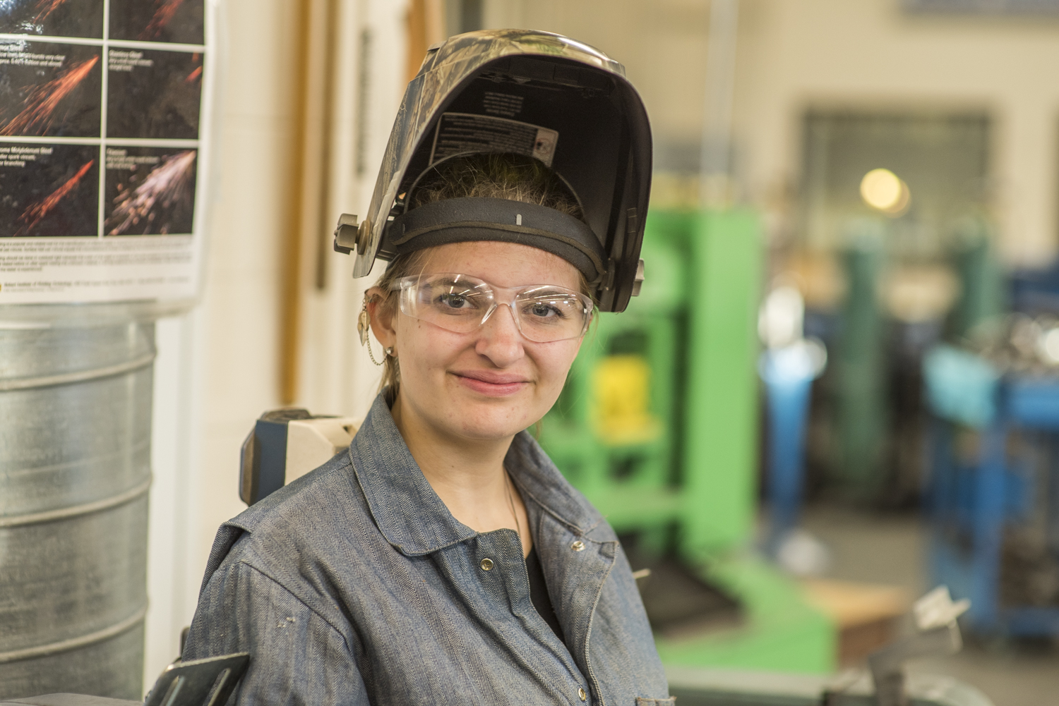

Thank you!
Notes:
Mr. Chairman that was a lot of information in a short amount of time. But I want again express my sincere appreciation for your support in helping assure our vision of preparing Idaho’s youth and adults for high-skill, in-demand careers CTE at reality.
Happy to respond to any questions you may have.
Thank you!

