Slide 1

Improving Transparency in the
Credentialing Marketplace
October 2016
#BetterCreds
Follow us on Twitter and Facebook

Slide 2

Today’s Credentialing Marketplace

Slide 3



Slide 4




Pilot Project Leadership
Pilot led by:
With support from:
Strategic direction from:
American Association of Community Colleges (AACC)
American Council on Education (ACE)
Business Roundtable
Committee for Economic Development of the Conference Board
The Manufacturing Institute
University Professional and Continuing Education Association (UPCEA)
U.S. Chamber of Commerce Foundation

Slide 5
Project Goals
*Develop common terms (Credential Transparency Description Language - CTDL) for describing key features of:
Credentials
*Create and populate a voluntary, web-based credential registry with credential issuers and QA bodies
*Bring the registry to scale under non-profit governance
Quality assurance (QA) bodies
*Develop and evaluate a directory search app to facilitate use of the registry by stakeholders
*Foster a competitive app marketplace**
Credentialing organizations
*The credential registry, descriptors, and applications will all be open-source.

Slide 6




Registry Vs. Directory Search App:
How Do They Differ?
Registry
Cloud-based metadata repository uses a common language, CTDL Version 1.0
Machine readable
Human readable
Directory Search App
Uses metadata from the Registry to provide user-friendly info

Slide 7
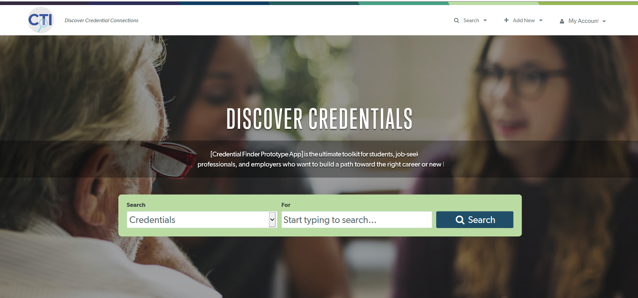

Slide 8
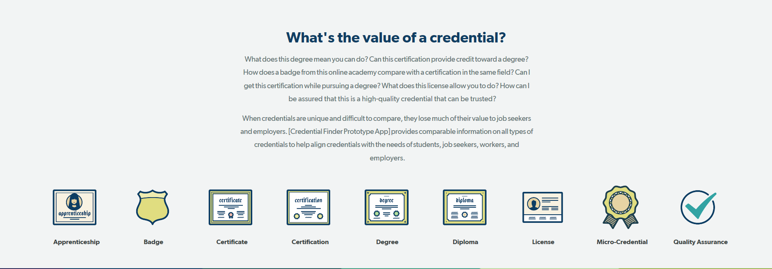
The Registry Will Include All Kinds of Credentials

Slide 9
A Common Language - the CTDL - Enables Comparability
Credential Descriptors:
Declaring Name, Purpose and Type of Credential and Credentialing Organization Credentialing Organization Identification Credential Organization Type Credential Identification Credential Type Purpose of the Credential Where Credentialing Is Offered | Declaring What Is Inside the Credential Credentialing Eligibility Requirements Competencies/Learning Outcomes Required to Attain the Credential Assessments Required to Attain the Credential Education and Training for the Credential Time Required to Attain the Credential Credentialing Costs Maintaining the Credential Credential Removal Credential Holder Authentication Version Management Employer Engagement | Declaring Other Key Characteristics and Connections Primary Scope of Application: Subject/Discipline Area Primary Scope of Application: Career Preparation and Advancement Role of Occupational Regulation and Licensing Geographic Portability of Credential Use Connections to Other Credentials Career Pathway Connections External Quality Assurances Employer Recognition Number and Characteristics of Credential Holders Employment and Earnings of Credential Holders

Slide 10
A Common Language - the CTDL - Enables Comparability
QA Descriptors:
Purpose & Scope of the QA Body Type of QA body Main purpose Missions/Objectives What is accredited, endorsed, approved, recognized? How is the QA used? Primary geographic scope Maximum period of the approval, recognition, endorsement, accreditation? Year body began operating | QA Process Activities used to assess a credential in the QA process Process used to validate the quality criteria? Quality criteria/standards/requirements used in the QA process Outcomes reviewed as part of the QA process Stakeholders involved in developing the quality criteria Criteria for selecting and evaluating assessors/reviewers? | Public Information about QA Decisions Types of decisions made and how they are defined Directory of accredited/approved/recognized/endorsed providers and their current status Information about the QA body made public with request Information about the QA body made public without request | Additional Info General Info Policies and procedures for managing conflicts of interest, complaints, appeals External recognition

Slide 11
Project Work Plan:
Transitioning to Scale
July 2016 – December 2016
Pilot, add more partners, evaluate results & fine-tune prototype Registry & Credential Directory App, begin scale up effort
Jan 1 2017 - June 2017
Scale-up with registry partners, with assistance as needed
July 2017 - forward
Operated by new nonprofit board & advisory groups; maintain/scale up
Work with 2-3 state partners to demonstrate state applications

Slide 12
Project Successes
Creation of the Credential Transparency Description Language (CTDL)
Development of the infrastructure for the Credential Registry, with pilot partners (Credential Issuers and QA Bodies) populating the information
Development of the prototype search application
Demoed prototype app to more than 400 in-person and web participants at Sept. 19 event
Announcement of a non-profit, Credential Engine, to take project to scale

Slide 13
Takeaways from September 19 Event
Need to further examine ways to validate the self-reported data from credential issuers and QA bodies
Focus on refining and explaining descriptors related to outcomes (quality and market value), competencies/competency frameworks and how they are assessed, and how credentials are connected
Use a more systems approach (state/regional networks) to increasing the number and type of credentials to accelerate the population of the registry
Populate the registry with a large number of diverse credentials and demonstrate the value to specific stakeholders – this will encourage stakeholders and app developers to make use of the tools
Need to align and understand connections to other similar projects, frameworks, and data
Important to focus on the above priorities before scaling too quickly

Slide 14
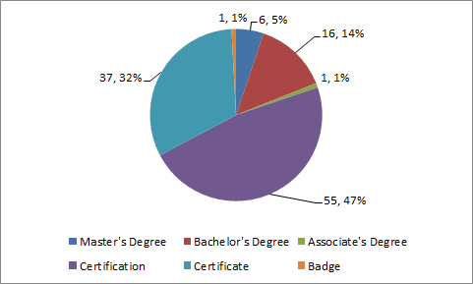
Profile of Current Pilot-Site Partners
Number of Credentialing Organizations as of September 2016
62 credential partner organizations
116 credentials total
Credentials* as of August 2016 = 116
Number of Quality Assurance Organizations Identified by Credential Partners
15 Accreditation Organizations
4 Regulatory Organizations
* Some credentials have additional credentials embedded within those selected for project. These quantities don’t (yet) include embedded credentials.

Slide 15
Benefits of Participating as a Registry Partner
Be at the forefront of a groundbreaking technology effort driving the new credentialing ecosystem
  Gain greater visibility to a vast market of students, employers and others
Demonstrate a commitment to credential and QA transparency
Receive a suite of services beneficial to short- and long- term technology planning
**To learn more about becoming a registry partner,
email credtransparency@workcred.org**
15

Slide 16
Participating as a Pilot Partner
Conversion of credential or QA information to machine and human readable/comparable formats
How Partners Participate
Provide access to technical and credential staff
Provide ongoing feedback
Provide early access to credential or QA information
Participate in evaluation
Credential or QA information published to the Pilot Credential Registry
Personalized “Roadmap” document showing steps that can be taken to enable the W3C vision for Linked Data
Partners Receive Services
**To learn more about becoming a registry partner,
email credtransparency@workcred.org**

Slide 17
Getting Involved with Credential Engine
Credential Engine will have 4 Advisory Groups and is accepting nominations for each through October 15:
  Higher Education
  Business
  Certification & Licensure
  Quality Assurance
  To learn more and submit a nomination visit: https://www.credentialtransparencyinitiative.org/

Slide 18
Questions?

Slide 19
For more information
www.credentialtransparencyinitiative.org
#CTIcred
Follow CTI:
Twitter: twitter.com/CTI_credential
Facebook: facebook.com/credtransparency
Steve Crawford
Research Professor, GWIPP crawford@gwu.edu
Bob Sheets
Research Professor, GWIPP rsheets@gwu.edu
Roy Swift
Executive Director, Workcred rswift@workcred.org
Roberts T. Jones
Former Assistant Secretary,
U.S. Department of Labor bob.jones@mtctrains.com
Jeanne Kitchens
Associate Director, SIU Center for Workforce Development kitchens@siuccwd.com

