Slide 1

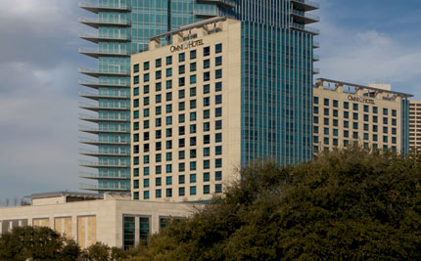
Tools for Curriculum Development: Linking Clusters to Courses and Programs
Tuesday, June 16, 2009, 2:20-3:20 p.m.
Robin Nickel, Ph.D.
Worldwide Instructional Design System
A Division of Wisconsin Technical College System Foundation, Inc.
A 501 (c) 3 non-profit organization
Presented at the Seventh Annual Career Clusters Institute in Ft. Worth Texas

Slide 2
Presenter
Robin Nickel, Ph.D.
Associate Director
Worldwide Instructional Design System
A Division of Wisconsin Technical College System Foundation
nickelr@wids.org (608) 849-2411
Notes:
Explain WIDS as part of WTCS Foundation, location, mission.

Slide 3

Today’s Session:
Explore a process to infuse career clusters into curriculum
View the software tool for creating course and program documents

Slide 4

Your Challenges:
Integrate career clusters and other external standards into curriculum; document connections
Build courses and programs
Adapt common process; determine content overlap/gaps to make decisions about dual enrollment
Design assessments that target outcomes

Slide 5
Continuous Challenges:
Time
Money
Time
Money
Time
Money
Time
Money

Slide 6

Your Solution Should
Bring efficiency to the curriculum development process
Allow for easy update and publication
Create consistency

Slide 7
Basic Assumptions
We want to achieve clarity about learning outcomes
Student learning is the organizing principle of our organization
We coordinate teaching and assessment to promote student learning
Roth, Gromko, McGury, Wissmann. “Making Student Learning Central: Principles and Practices for Implementation” in A Collection of Papers on Self-Study and Institutional Improvement. The Higher Learning Commission, NCA. 2001.
Doherty, Riordan, Roth. “Student Learning: A Central Focus for Institutions of Higher Education.” Alverno College Institute, Milwaukee, WI.
Notes:
Underlying assumptions.

Slide 8

Learning Organizations
Focus on learners
Document learning results
Strive for learning and teaching excellence
Continually improve effectiveness
Based on the teachings of Terry O’Banion

Slide 9
What Can You Create With WIDS?
Program Documentation
Official Course Documentation
  Syllabi
  Assessments (rubrics and checklists)
  Learning Plans/Teaching Plans
Reporting Matrices
Note: Print to HTML or MS Word

Slide 10

Who is using WIDS?
Over 150 licenses worldwide
  (33 states and 5 foreign countries)
Technical colleges
Community colleges
Universities
High schools
Businesses

Slide 11

Some of Our Users
16 Wisconsin Technical Colleges
7 Michigan Colleges
9 Minnesota Colleges
6 Kansas Colleges and Kansas Board of Regents
Southwest College of Naturopathic Medicine, AZ
Iowa State University
Brevard Community College, FL
9 Canadian Colleges
Learning Resources, Cape Town, South Africa
Anne Arundel Community College, MD
GE Medical
Bethel University, MN
National American University, SD

Slide 12

Why do we have to do this?
What are the drivers?
Notes:
Robin

Slide 13


Curriculum and Accreditation
Comprehensive Standards
  3.3.1 “institution identifies expected outcomes … assesses whether it achieves the outcomes; and provides evidence of improvement based on analysis of those results.”
  3.4.1 “establish and evaluate program and learning outcomes
Notes:
Robin

Slide 14
Curriculum and Accreditation
“Assessment of student learning is a participatory, iterative process that:
  Provides data/information you need on your students’ learning
  Engages you and others in analyzing and using this data/information to confirm and improve teaching and learning
  Produces evidence that students are learning the outcomes you intended … .”
From “Student Learning, Assessment and Accreditation: Criteria and Contexts”, presented at Making a Difference in Student Learning: Assessment as a Core Strategy, a workshop from the Higher Learning Commission, July 26-28, 2006.

Slide 15
Carl Perkins IV
Who: Secondary and postsecondary
What: Develop a process for measuring technical skills that lead to an industry-recognized credential, state-recognized credential, or locally-developed credential
Why: Provide as a separate measure of accountability, the extent of skill development in Career and Technical Education (CTE) programs
How: Develop valid and reliable assessments

Slide 16

Agree to use a common process
Why?
  Simplify articulation
  Provide a general road map of all courses and programs
  Ensure skills are being addressed
  Increase efficiency
  Avoid chaos

Slide 17
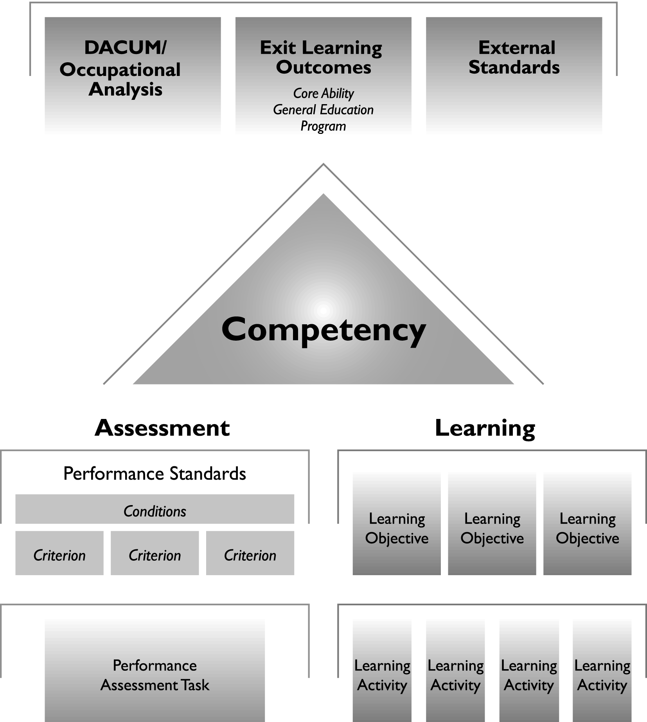
Institutionally-defined
Instructor-defined
Notes:
From this point, “below the line” curriculum is developed. Each organization will have set policies for how and when this happens, but the starting point is the same. Quality outcomes – and in this case, driven by industry standards.
Placement of “line” is determined institutionally.

Slide 18
State, national, professional standards (Career Clusters, NLN, NATEF)
Notes:
Example of Process – Describe what drives the competency and how external standards fit into the overall process.

Slide 19
Major skill, knowledge or attitude that is measurable and observable; field or discipline specific outcome addressed at the learning plan (lesson) level.
What will the learner be able to do as a result of this course?
Notes:
From there, the clusters were linked to courses or competencies.

Slide 20
Architecture and Construction
Cluster:
Use basic math functions to complete jobsite/workplace tasks.
Carpenter Competency:
Cut floor joists to proper length.
Notes:
Example with content from Gateway.

Slide 21
Exit Learning Outcomes
Macro skills that go beyond the context of a specific course. Not all courses include these outcomes.
Program Outcomes Field specific skills to be mastered by end of program
Gen Ed Outcomes Academic foundation skills
Core Abilities Transferable skills to be mastered by end of degree or certificate
Carpentry: Apply construction measurement principles to building applications.
Use mathematical concepts to comprehend, interpret, and communicate quantitative information
Think critically;
Value diversity
Notes:
Other initiatives at college are also important and need to be addressed. This process allows you the flexibility to build these in.

Slide 22
Institutionally-defined
Instructor-defined
Notes:
From this point, “below the line” curriculum is developed. Each organization will have set policies for how and when this happens, but the starting point is the same. Quality outcomes – and in this case, driven by industry standards.
Placement of “line” is determined institutionally.

Slide 23
Assessment Task
Evaluators: Instructor, Self
Competency: Develop a marketing plan
Scoring Guide
You must achieve a “2” on each item.
Rating Scale:
3 Exceeded criterion
2 Met criterion adequately
1 Did not meet criterion
Criteria: Rating
Plan includes an analysis of the market 1 2 3
Plan includes an action plan 1 2 3
Plan aligns with mission statement 1 2 3
Plan includes evaluation, etc. … 1 2 3
        Total Points______
        Comments:
Rubrics

Slide 24
Learning Plan
Introduction: (Why this skill is important)
Competency: Develop a marketing plan
How you will show you have achieved the competency:
Performance Standards - Conditions:
in the development of a marketing plan
using word processing software
When your performance will be acceptable:
Performance Standards - Criteria:
Plan includes an analysis of the market
Plan includes an action plan
Plan aligns with mission statement
Plan includes evaluation, etc. …
Learning Activities:
__1. THINK about the products you purchase…
__2. STUDY the terms….
__3. PARTICIPATE in a discussion… etc.
Assessment Activities:
__1. SELF-ASSESS your plan using the scoring guide
__2. SUBMIT your marketing plan to your instructor
Frontline Learning Modules
Notes:
Examples of activity statements include: “Submit your final product to the instructor” or “Post the podcast of your introductory speech.”

Slide 25
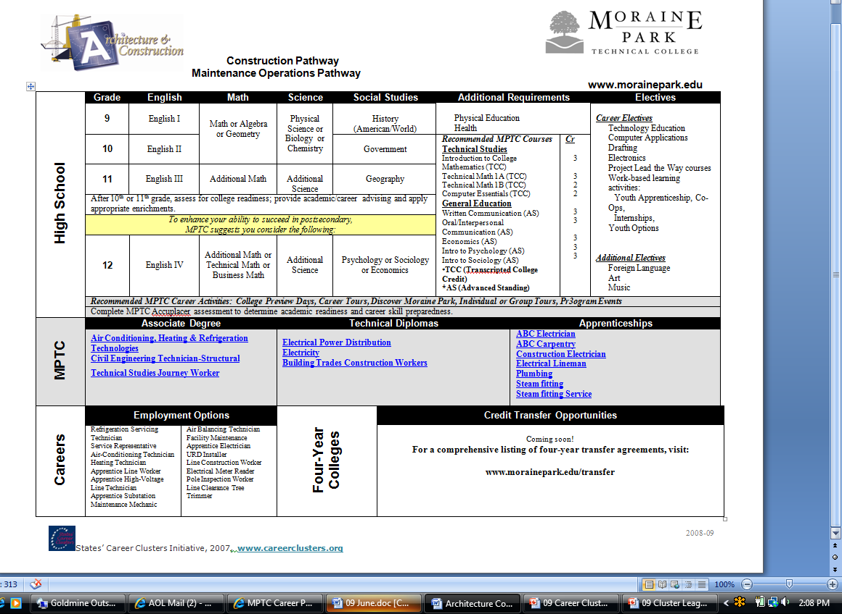
Carpentry At Moraine Park

Slide 26
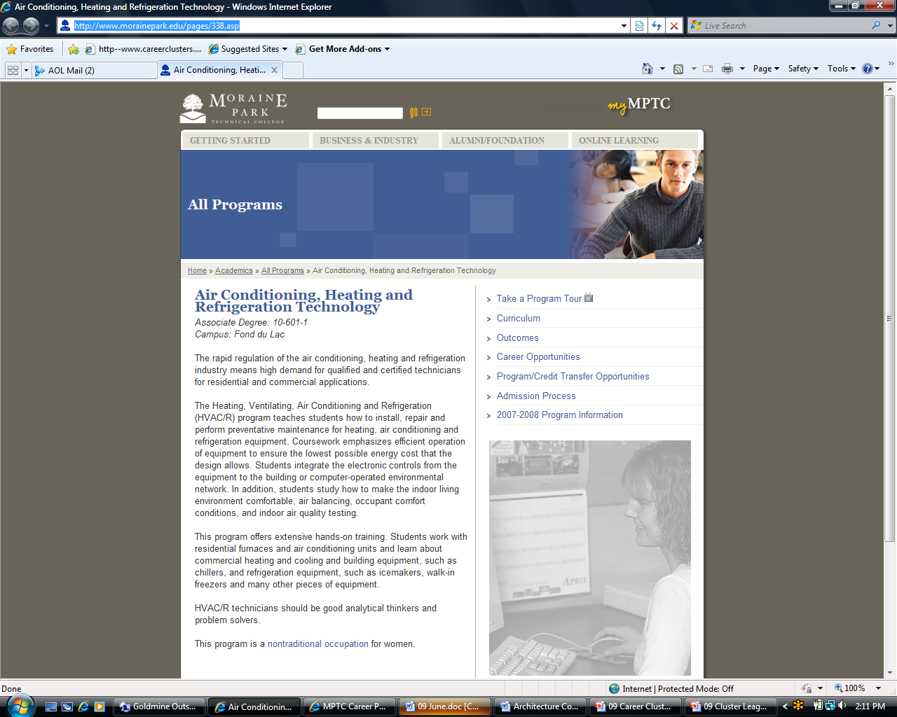

Slide 27
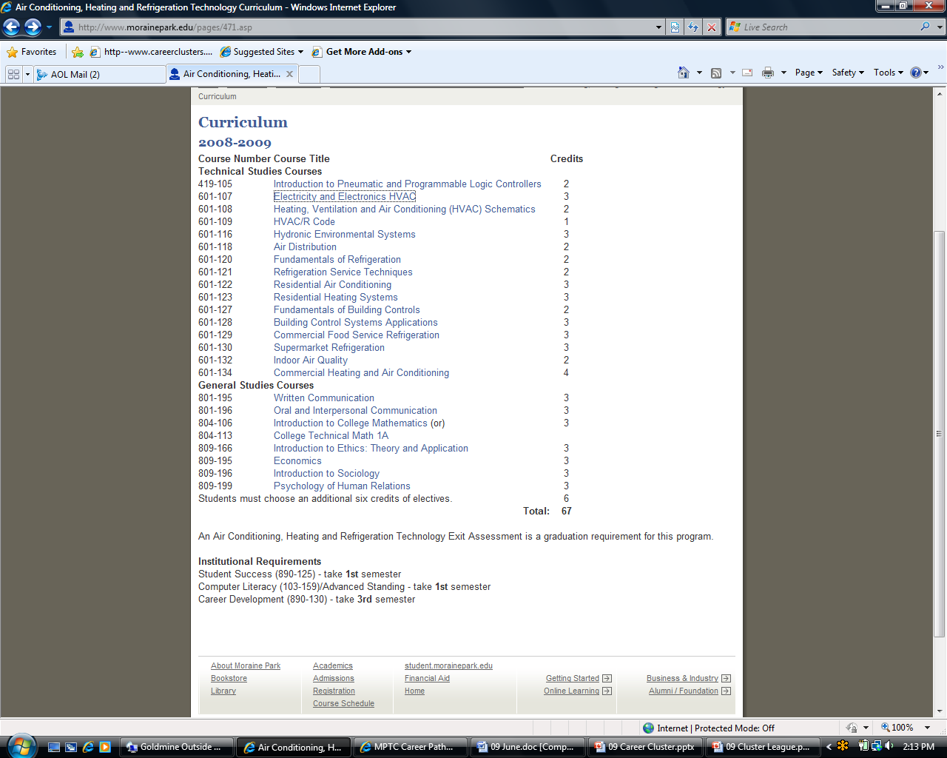

Slide 28
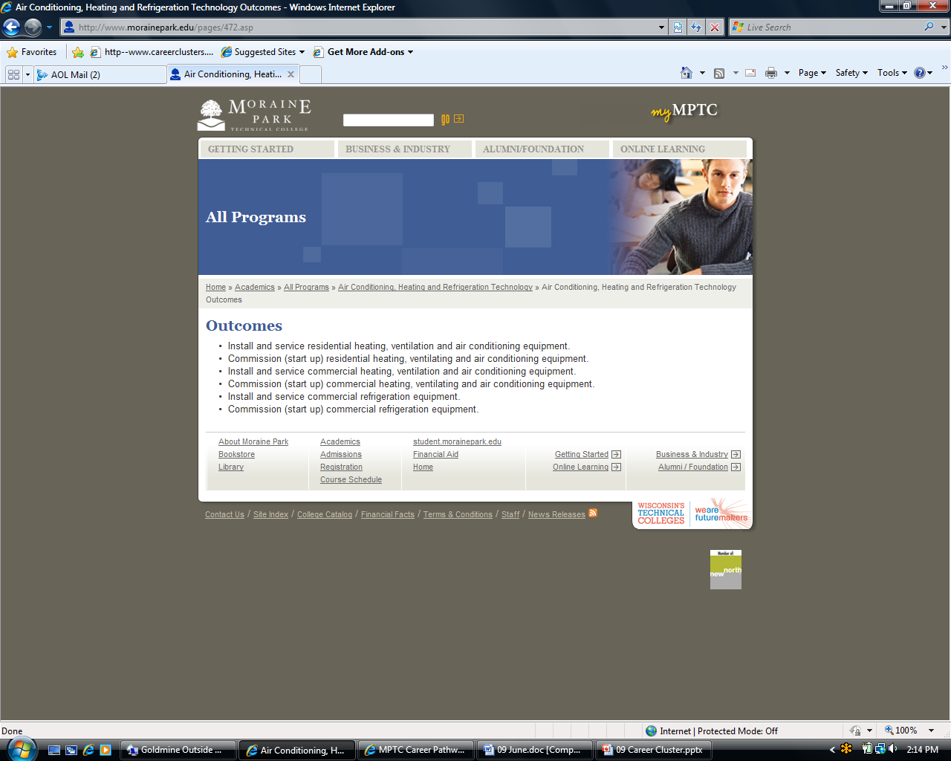

Slide 29
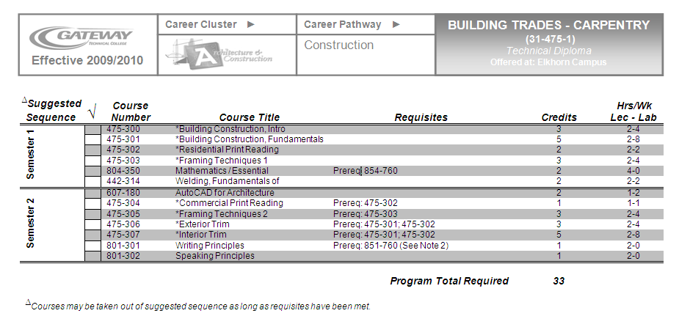
Carpentry

Slide 30

Career Cluster
Architecture and Construction Cluster
Building Trades-Carpentry Program Design Summary External Standards
ACC01.01 Perform math operations such as estimating and distributing materials and supplies to complete jobsite/workplace tasks.
ACC01.01.01 Use basic math functions to complete jobsite/workplace tasks.
ACC01.01.02 Use geometric formulas to determine areas and volumes of various structures.
ACC01.02.02 Identify the physical properties present when using common construction materials in order to use the materials safely, effectively and efficiently.
Notes:
Nancy

Slide 31
Program Design
Notes:
Generate complete document in demo.

Slide 32
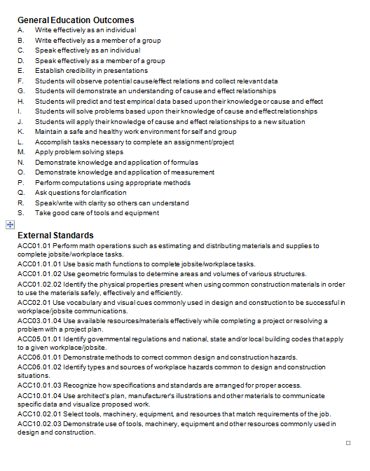
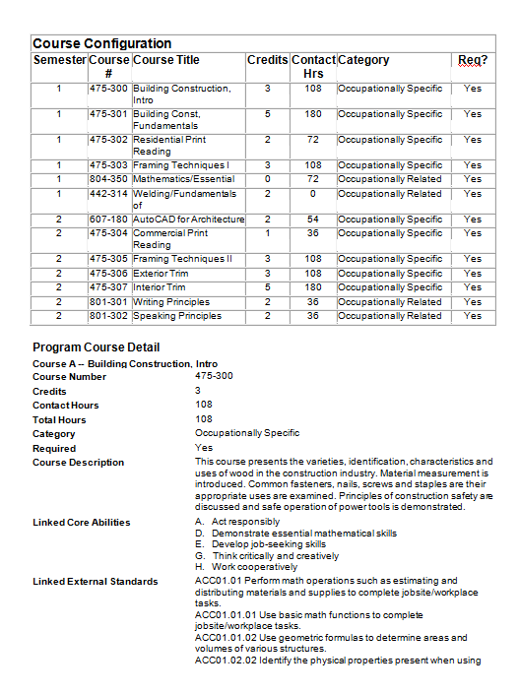
Program Design
Notes:
Provide full sample of Program Design

Slide 33
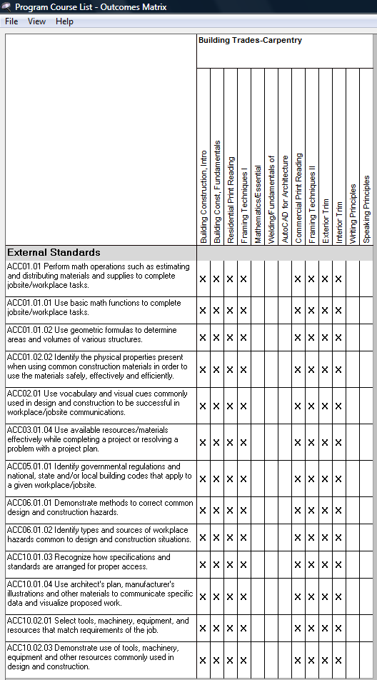
Program
Career Clusters
Documents where Clusters are addressed

Slide 34
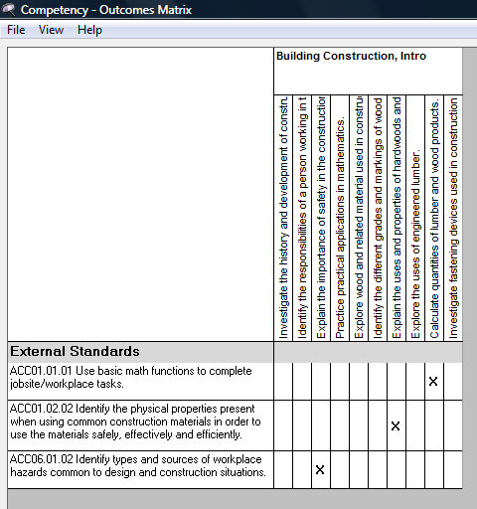
Course Competencies
Career Clusters
Documents where Clusters are addressed

Slide 35
Courses
Summative Assessments
Soft Skills
Notes:
Core Ability assessment, show development of Core Ability -- PAT in demo.

Slide 36
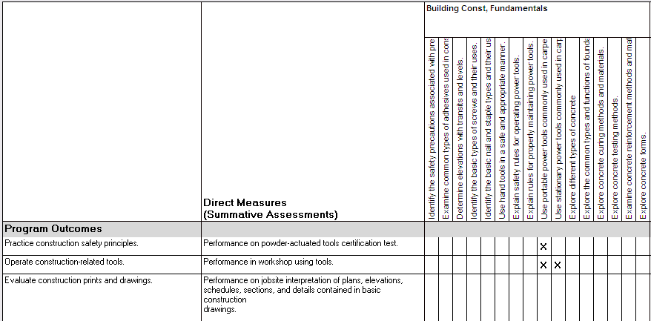
Competencies
Program Outcomes
Summative Assessments

Slide 37
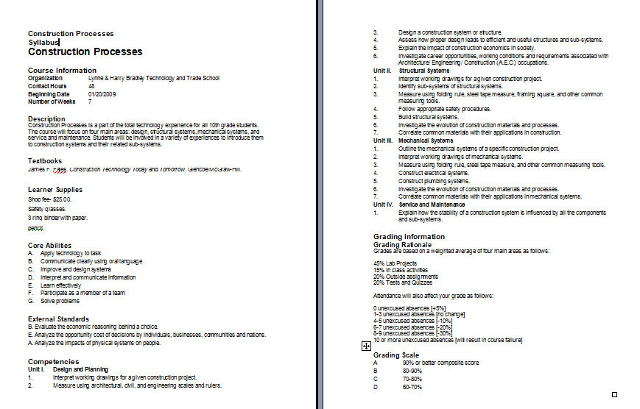
Syllabus

Slide 38
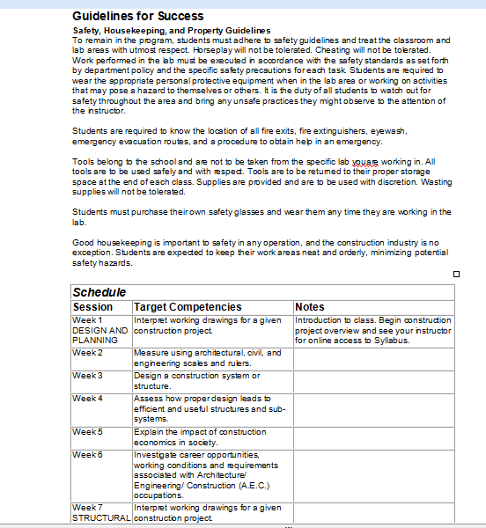

Slide 39
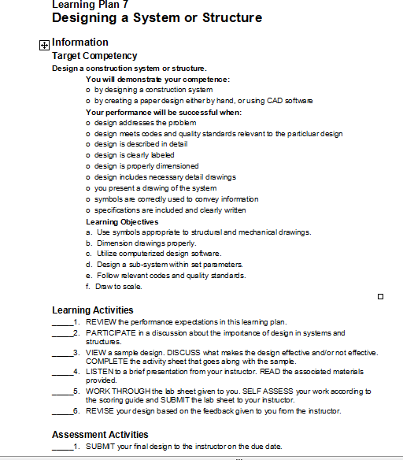
Learning Plans
Notes:
Printed WIDS learning plans plus your handouts provide a study guide that steps your students through the process of learning and the requirements of assessment.

Slide 40
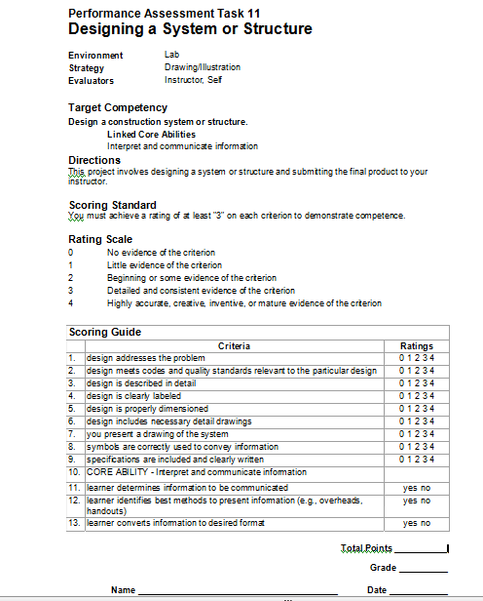
Assessment Tasks

Slide 41

What is WIDS?
Organizing framework
Software for curriculum development
Design expertise, professional development, and facilitation services
Helps you establish and communicate intended learning outcomes
Notes:
Robin

