Slide 1


www.pwc.com/us/catalyst
https://pwc-spark.com/groups/catalyst-us
The art of rapidly designing solutions together
Catalyst Introduction
FY15

Slide 2
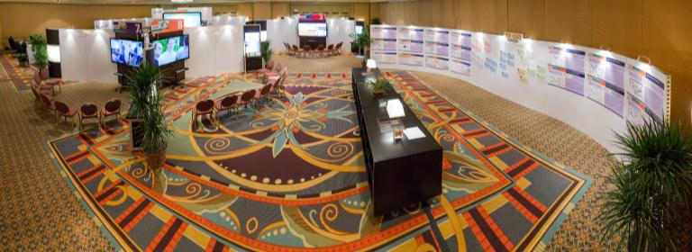
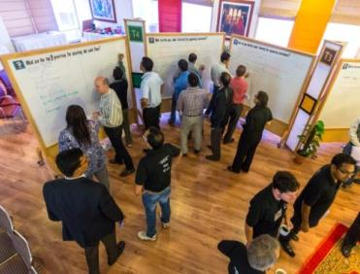
Catalyst delivers Speed.
The visibility to see the landscape,
the flexibility to recombine capabilities and
the velocity to leverage opportunities in real time.

Slide 3
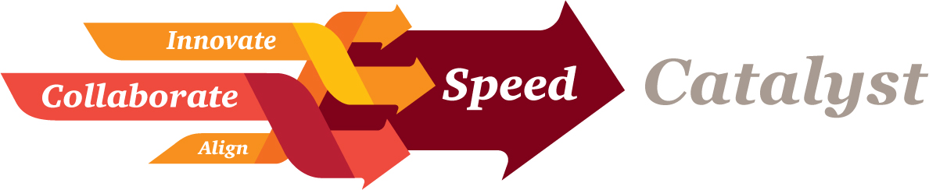
Catalyst delivers Speed
Today’s business markets are unlike any other.
Organizations must navigate a constantly changing landscape and make more complex decisions more rapidly, creatively and flexibly than ever before.
Speed is the key to competitive advantage in this environment.
Catalyst delivers the tools, methods, ideas and capabilities to enable people and organizations to thrive in an always on, real time, anywhere environment.

Slide 4


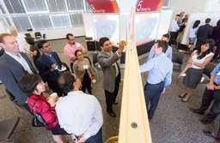
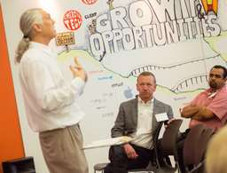
From strategy to execution
Leverage Catalyst to overcome the challenges of business transformation.
“From strategy to execution, Catalyst is a creative and engaging methodology for solving the complex.”
From creating a vision and strategy to developing a new product, re-engineering business processes, generating business requirements or designing an IT architecture.
Catalyst is an instant way to create ownership and a room full of change-enablers and drive lasting change.
Catalyst collapses Months into days.

Slide 5
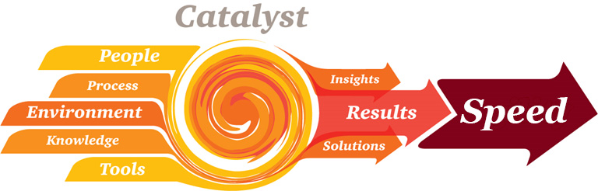
Creating results by design
Apply Catalyst from strategy through execution to increase acceleration and alignment around innovative solutions.
Engage diverse stakeholders from your organization with the right experience, analytics and research from PwC.
Develop innovative solutions to critical challenges using the Catalyst methodology.
Adopt that methodology to build the agility of your organization to address future challenges.

Slide 6
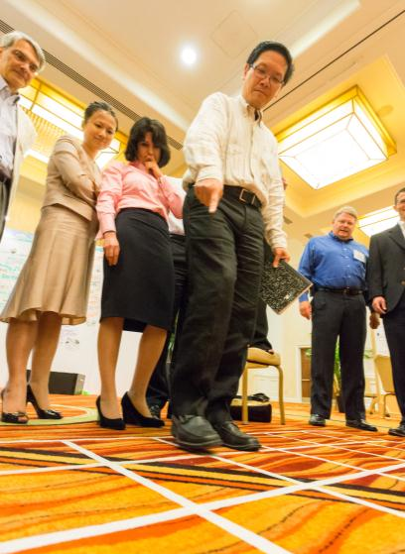



Designed collaboration creates acceleration
Catalyst uncovers the ability to crystalize your vision and bring it swiftly into reality. Catalyst creates a breakthrough where previous efforts have failed or an issue is too urgent, complex or political to apply traditional methods.
Catalyst Empowers Organizations
We begin with the ideal combination of your thought leaders and knowledge. Then we augment and extend their value with our own expertise. We converge all of this into a collaborative environment with the right tools and processes to achieve success. We explore ideas and rapidly simulate solutions to capitalize on opportunities in unique and powerful ways.
Facilitated to fast-track idea generation and decision-making, we compress months of effort into days – gaining fresh insights and inspiring better business outcomes.
Learn about Catalyst by experiencing it.

Slide 7

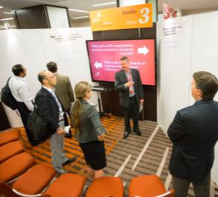
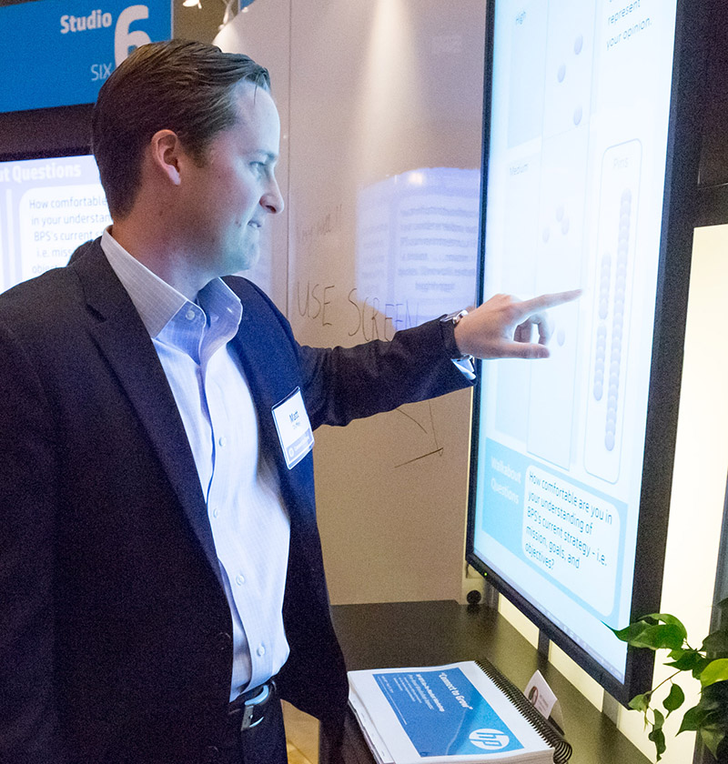

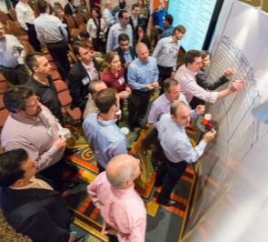
Catalyst - The art of the possible
Accelerate
Engage large groups of people in complex design and development of solutions. Invest days for what would typically take months.
Collaborate
Bring together and actively involve 10-100+ participants in the development of the solution to achieve alignment and ownership.
Change
Creative and engaging approach to solving complex problems creates excitement and interest due to it’s unique approach. An instant way to create a room full of change-enablers.
Align
People own what they help create. Catalyst enables buy-in when people champion their ideas and approaches that they help author.
Adapt
Used for anything from creating a vision and strategy to developing a new product, re-engineering business processes, generating business requirements or designing an IT architecture.
Catalyst is a large group collaborative design process operating in a customized working environment enabled by a unique set of facilitation techniques to create value from strategy through execution.

Slide 8

For a sense of the Catalyst experience
www.pwc.com/us/catalyst
Catalyst Methodology in 60 seconds
http://www.youtube.com/watch?v=0pOBG82Gti8
The Catalyst Environment
http://www.youtube.com/watch?v=m2hnaODt3-0
Catalyst Tools & Technology
http://www.youtube.com/watch?v=MXD2-dbFB5g
Catalyst Experience
https://www.youtube.com/watch?v=LDsl2yiImvM&feature=youtu.be
Catalyst Collaboration Consulting
http://www.youtube.com/watch?v=rpl6Q6SiNSE
For more info please contact:
Ben Hormell
Catalyst Director
Ben.hormell@us.pwc.com
(215) 300-3352 USA (eastern time)
© 2014 PricewaterhouseCoopers LLP, a Delaware limited liability partnership. All rights reserved. PwC refers to the US member firm, and may sometimes refer to the PwC network. Each member firm is a separate legal entity. Please see www.pwc.com/structure for further details. This content is for general information purposes only, and should not be used as a substitute for consultation with professional advisors.

