Slide 1
CTE in STATE
Name, Organization

Slide 2
Our Vision for CTE
Career Technical Education is an educational option that provides learners with the knowledge and skills they need to be prepared for college, careers and lifelong learning. CTE gives purpose to learning by emphasizing real-world skills and practical knowledge within a selected career focus.
Our vision is to transform and expand CTE so that each learner – of any background, age and zip code – is prepared for career and college success.
Our strategic priorities:
All CTE programs are held to the highest standards of excellence.
All learners are empowered to choose a meaningful education and career.
All learning is personalized and flexible.
All learning is facilitated by knowledgeable experts.
All systems work together to put learner success first.

Slide 3
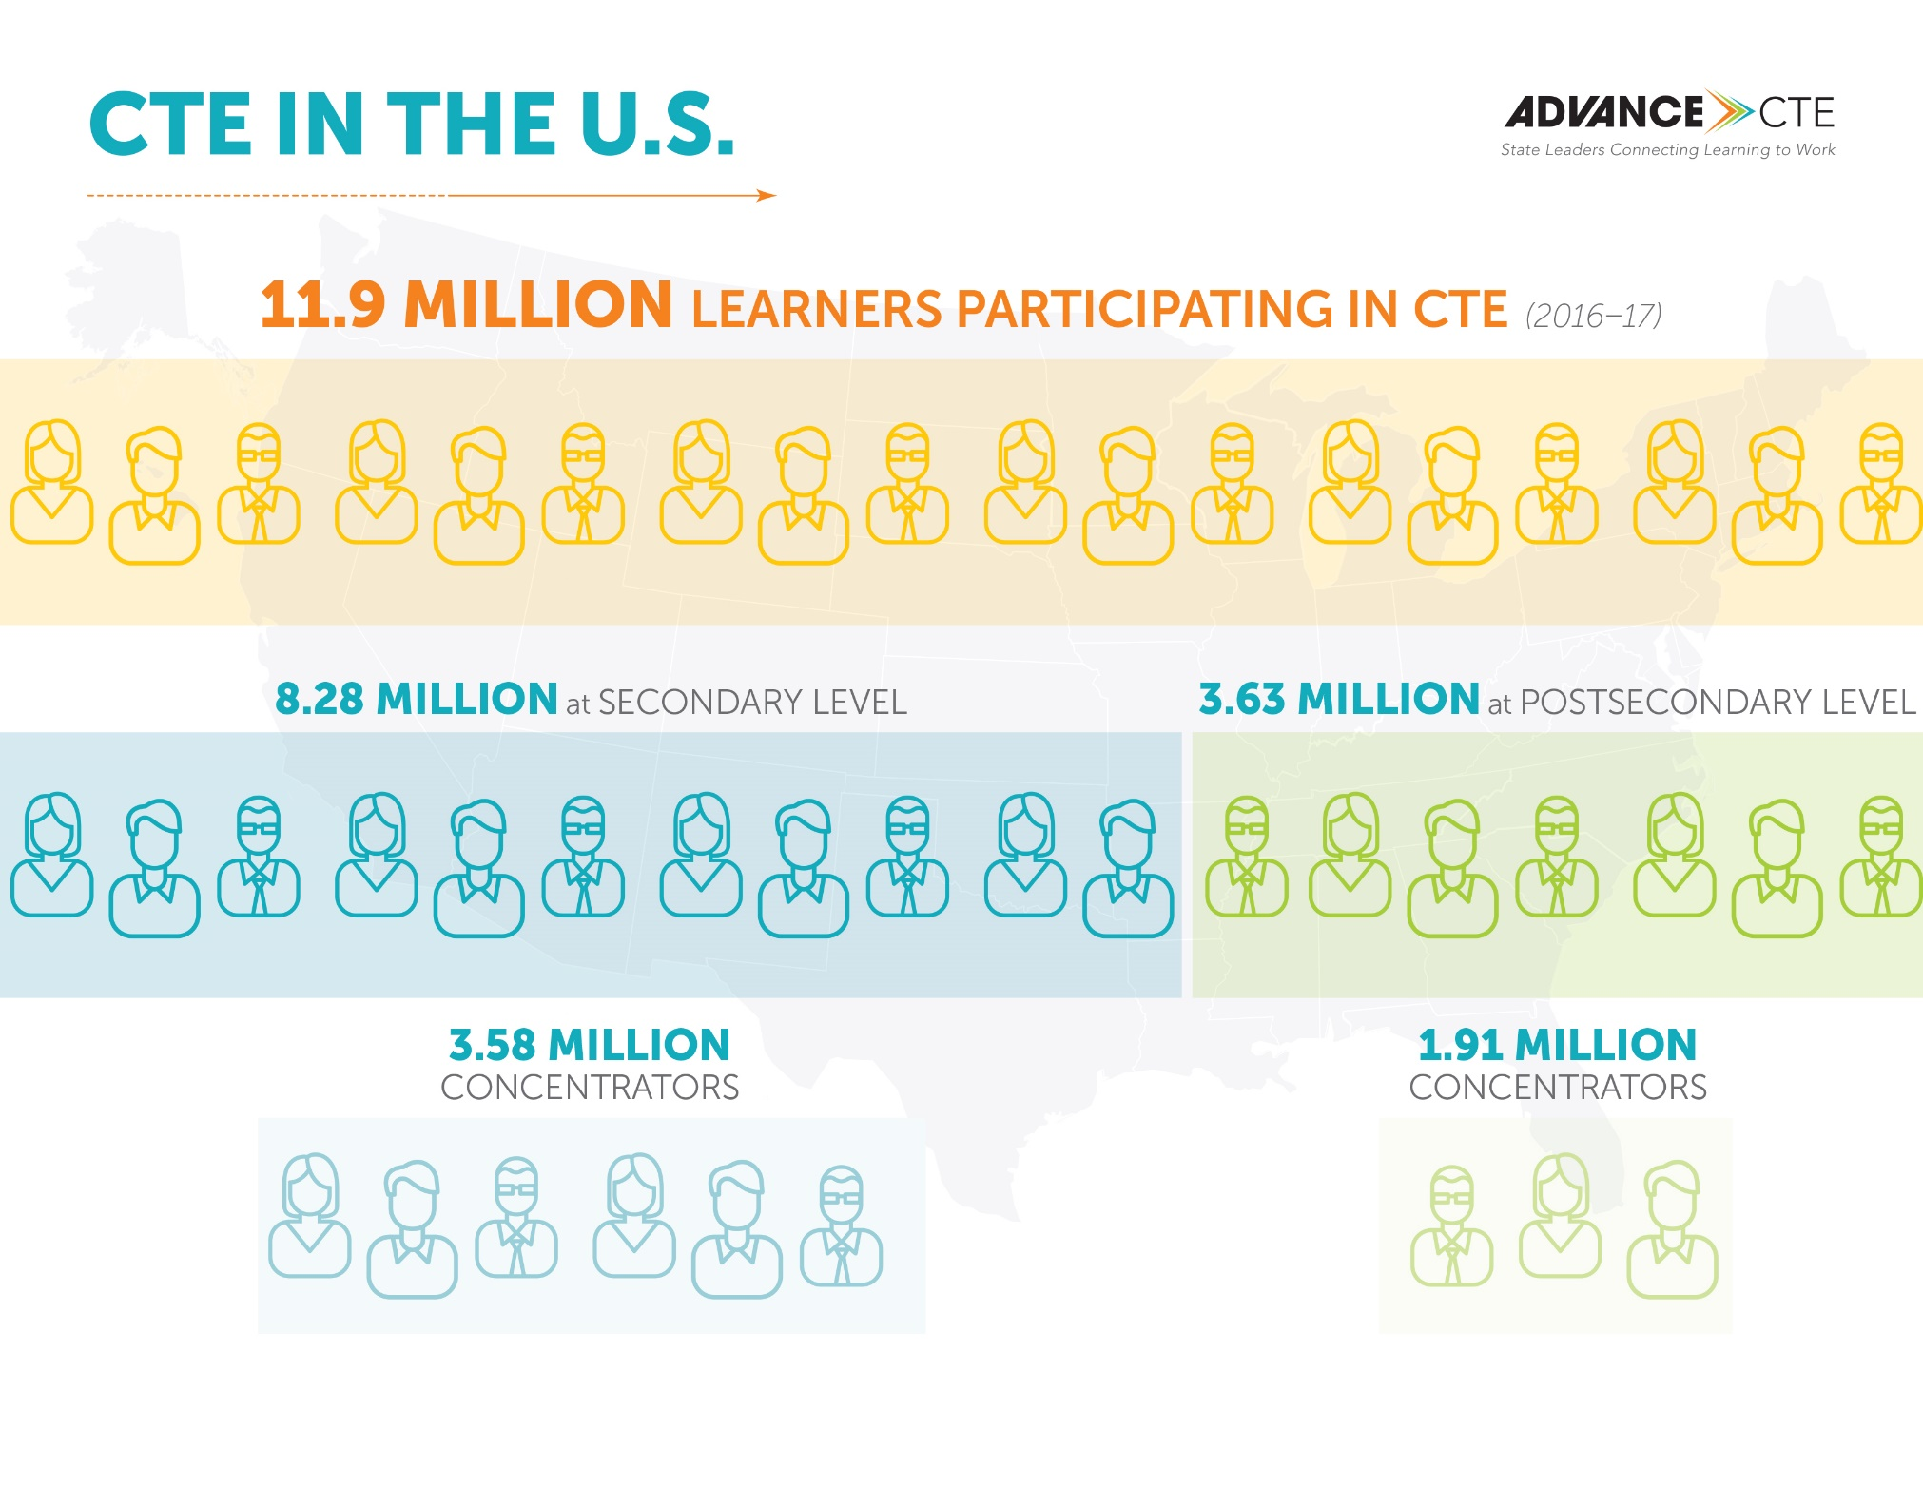
Who We Serve
Notes:
Key tip: Update with state data

Slide 4
Who We Serve – Secondary
Notes:
Key tip: Update with state data

Slide 5
Who We Serve – Secondary
Notes:
Key tip: Update with state data

Slide 6
Who We Serve – Postsecondary
Notes:
Key tip: Update with state data

Slide 7
Who We Serve – Postsecondary
Notes:
Key tip: Update with state data

Slide 8
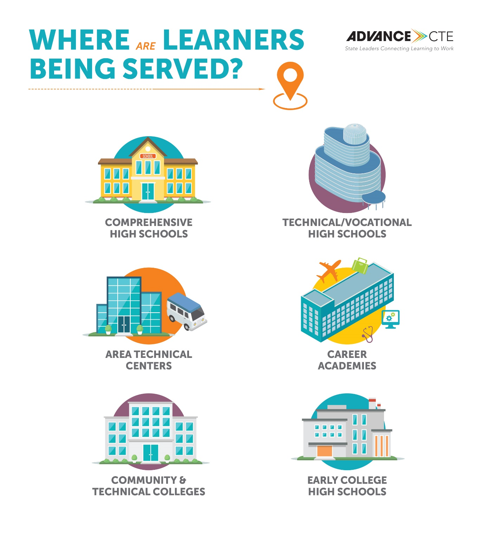

Slide 9





CTE Delivers
Secondary Outcomes for CTE Concentrators
97% Graduated High School | 97% Enrolled in Postsecondary Education/ Workforce | 39% Earned Postsecondary Credit | 100% Participated in Work-Based Learning |  | 22% Earned an Industry-Recognized Credential
Postsecondary Outcomes for CTE Concentrators
75% Completed | 80% Entered Workforce/ Continued Education/ Training | 80% Earned an Industry-Recognized Credential |  | 75% Participated in Work-Based Learning
Notes:
Key tip: Update with state data

Slide 10
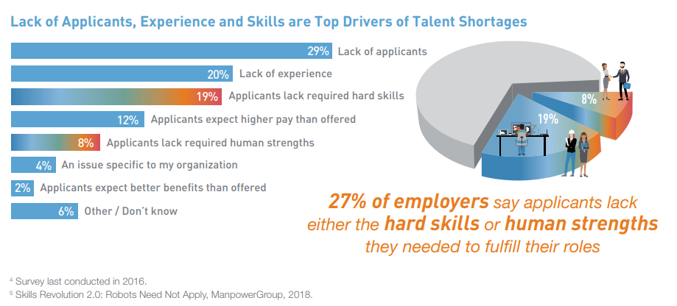
CTE Fills a Critical Need: The Skills Gap
Unemployment rate is 4 percent while there are 6.7 million open jobs in the U.S.
Companies fighting over talent – we need a stronger pipeline
Hardest to fill jobs are in manufacturing, IT and health care – all leading Career Clusters in the state
Notes:
https://go.manpowergroup.com/talent-shortage-2018

Slide 11
CTE Fills a Critical Need & Pays for Itself
Fastest growing jobs increasingly require additional education/ training and skills
CTE is aligned with high-wage, high-skill and in-demand careers
Oklahoma’s economy reaps a net benefit of $3.5 billion annually from graduates of the CareerTech System.
Notes:
https://www.acteonline.org/wp-content/uploads/2018/03/ROI_of_CTE_January2018.pdf

Slide 12
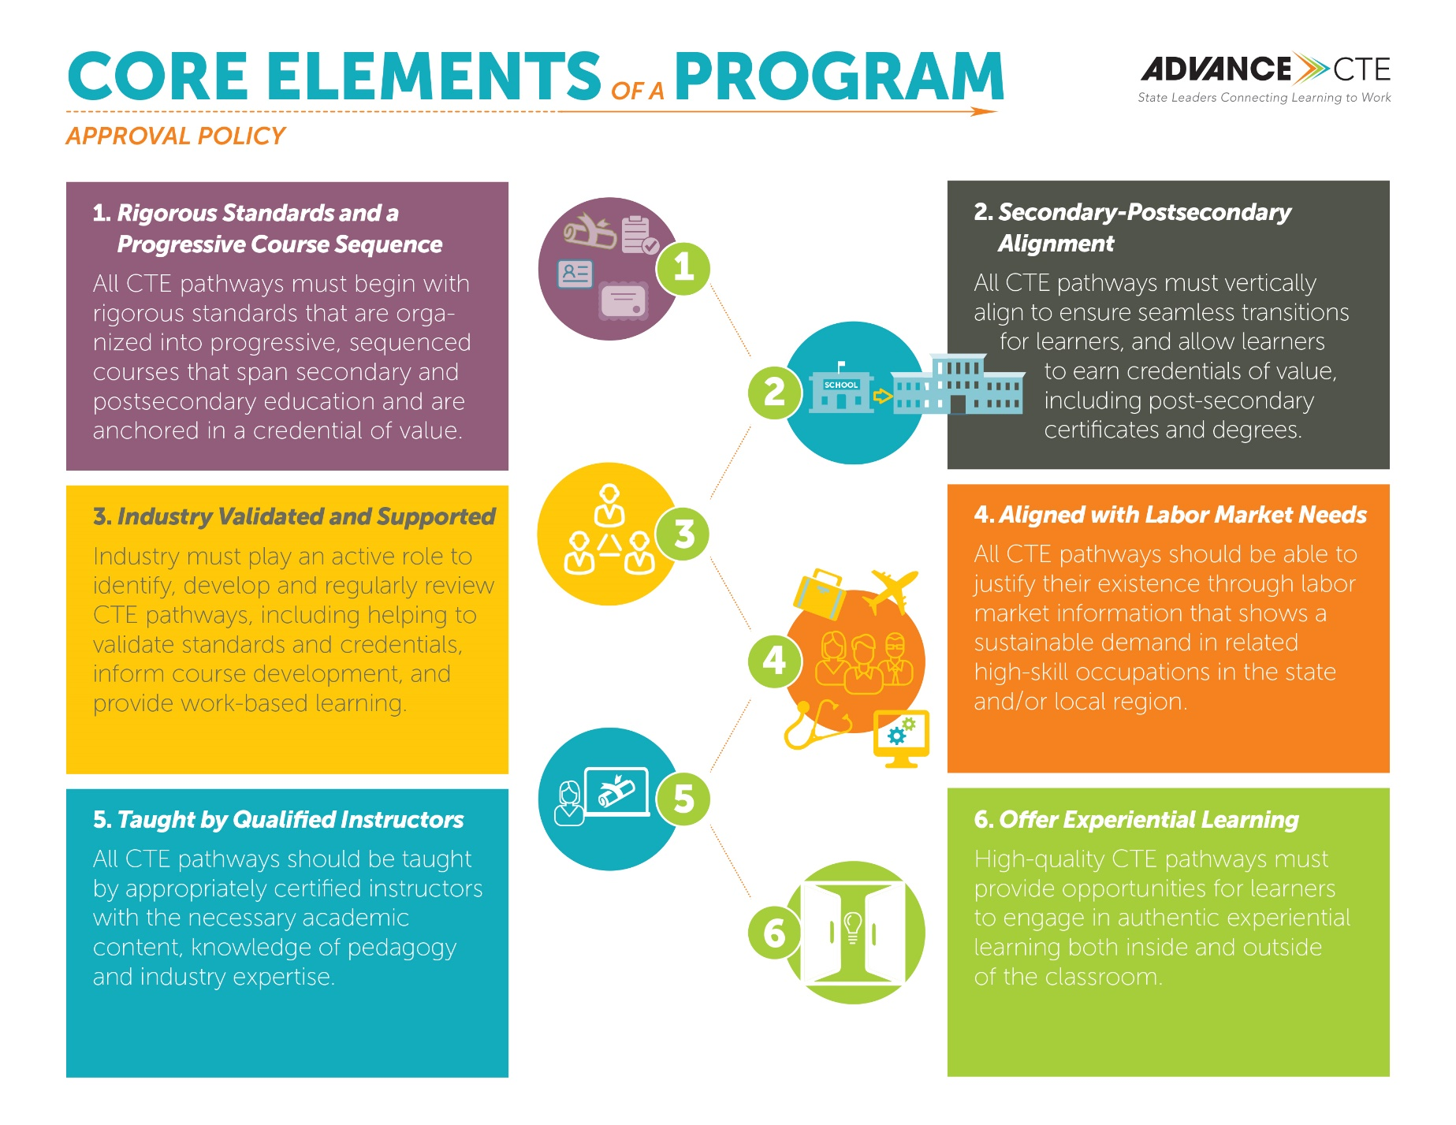
What Does Quality CTE Look Like?

Slide 13
What Does CTE Look Like?
Program Example
History of program
Certifications offered
Partnerships
Data

Slide 14
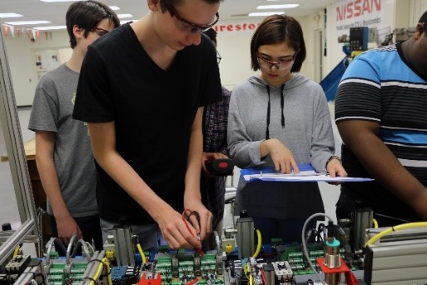
What Does CTE Look Like?
Mechatronics at Oakland
High School
Developed collaboratively by Manufacturing Leadership Council, Rutherford County School District, Motlow State Community College (MSCC) and Middle Tennessee State University (MTSU).
Built on Siemens’ training model, students can earn Siemens 1 certification in high school, Siemens 2 certification at MSCC, Siemens 3 certification at MTSU.
All juniors and seniors are fully dual enrolled in high school and at MSCC, earning at least 16 college credits.
100 percent of students graduate high school, 100 percent earned postsecondary credit, 94 percent earned an industry-recognized credential and 94 percent enrolled in postsecondary upon graduation.

Slide 15
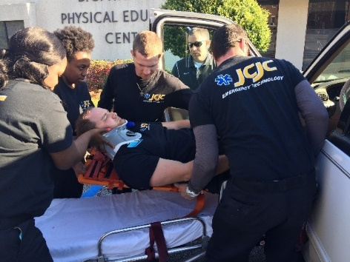
What Does CTE Look Like?
Emergency Medical Technology
Education, Jones County Junior College
Three-year program of study in a rural community with rigorous and integrated academic and technical coursework, and a required 500-plus hours of clinical internships in the field
Strong pipeline by partnering with local school districts, even engaging with elementary school students, and offering dual enrollment with high schools
Key partners include Camp Shelby Army Base, EMSERV Ambulance Services, South Central Regional Medical Center, University of Mississippi Medical Center
90 percent of students pass professional qualifying exam on first attempt (compared to statewide pass rate of 50 percent) and 100 percent of graduates are placed into jobs.

Slide 16
How Do We Pay for CTE?
Source | Funds | Description
Federal funds (Carl D. Perkins Career and Technical Education Act Basic State Grant) | $XX,XXX | Annual allocation to support state and local administration of CTE programs
General Education Budget
State Incentive Fund

Slide 17
Major CTE Initiatives
Initiative name
Overview and theory of action
  Examples of accomplishments to date
Next steps

Slide 18
Major CTE Initiatives
EXAMPLE: Strengthening CTE program quality
Raising rigor and quality of CTE programs by revising program approval and review policies
  Aligned state and federal (Perkins) funding to only support CTE programs that meet quality criteria
  Adopted more rigorous and aligned CTE standards
  Require evidence of labor market alignment annually
  Require evidence of industry validation
Impact of efforts:
  Opened XX new CTE programs

Slide 19
Major CTE Initiatives
EXAMPLE: Expanding Work-based Learning
Increasingly access to work-based learning at all levels
  Created work-based learning standards/guidance so students can earn high school credit for work-based learning experiences
  Included work-based learning in accountability system through the Every Student Succeeds Act
  Expanded apprenticeship into new sectors
  Etc.
Impact of efforts:
  % more students participating in work-based learning in high school
  % increase in apprenticeship participants
  # of employers providing work-based learning

Slide 20
Major CTE Initiatives
EXAMPLE: New Skills for Youth
Receiving $2 million from JPMorgan Chase &Co. (through Council of Chief State School Officers, Advance CTE, Education Strategy Group) over January 2016-December 2019
Goals:
  Strengthen high-quality career pathways
  Increase access by expanding career advisement and work-based learning
  Ensure employers are fully engaged and anchoring our pathway work

Slide 21
Who We Work With
Name of committee or partner
  Their role
  Who is on the committee/coalition/partnership
State Education Agency/Postsecondary System
  Partner to develop seamless pathways leveraging dual enrollment
  Co-located CTE programs in rural communities
State Workforce Development Board
  Collaborate on sector strategies, sharing labor market data and identifying credentials of value
STEM Council
  Meet annually to support collaboration and alignment between CTE and STEM

Slide 22
Who We Work With
Key Industry Partners
State Chamber of Commerce
Major corporations on state advisory council, etc.
Notes:
Include logos, specific CEO names

Slide 23
Looking Ahead
Major Priorities
Examples:
  Teacher pipeline
  Meaningful employer engagement
  Expanding access in rural communities

Slide 24
Looking Ahead
Initiative
Explanation of initiative
  Next steps
  Resources needed
  Timeline

Slide 25
Looking Ahead
Implementation of Perkins V
Strengthening Career and Technical Education Act for the 21st Century (Perkins V) was signed into law in July 2018.
Will be developing a new four-year state plan that focuses on expanding access in high-quality CTE programs across K-12 and postsecondary
Notes:
Add any major milestones/planned activities

Slide 26
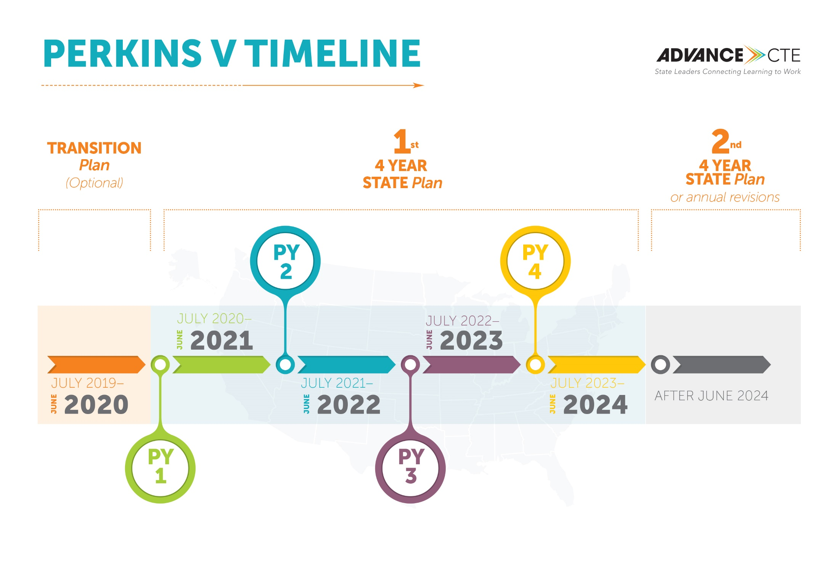

Slide 27
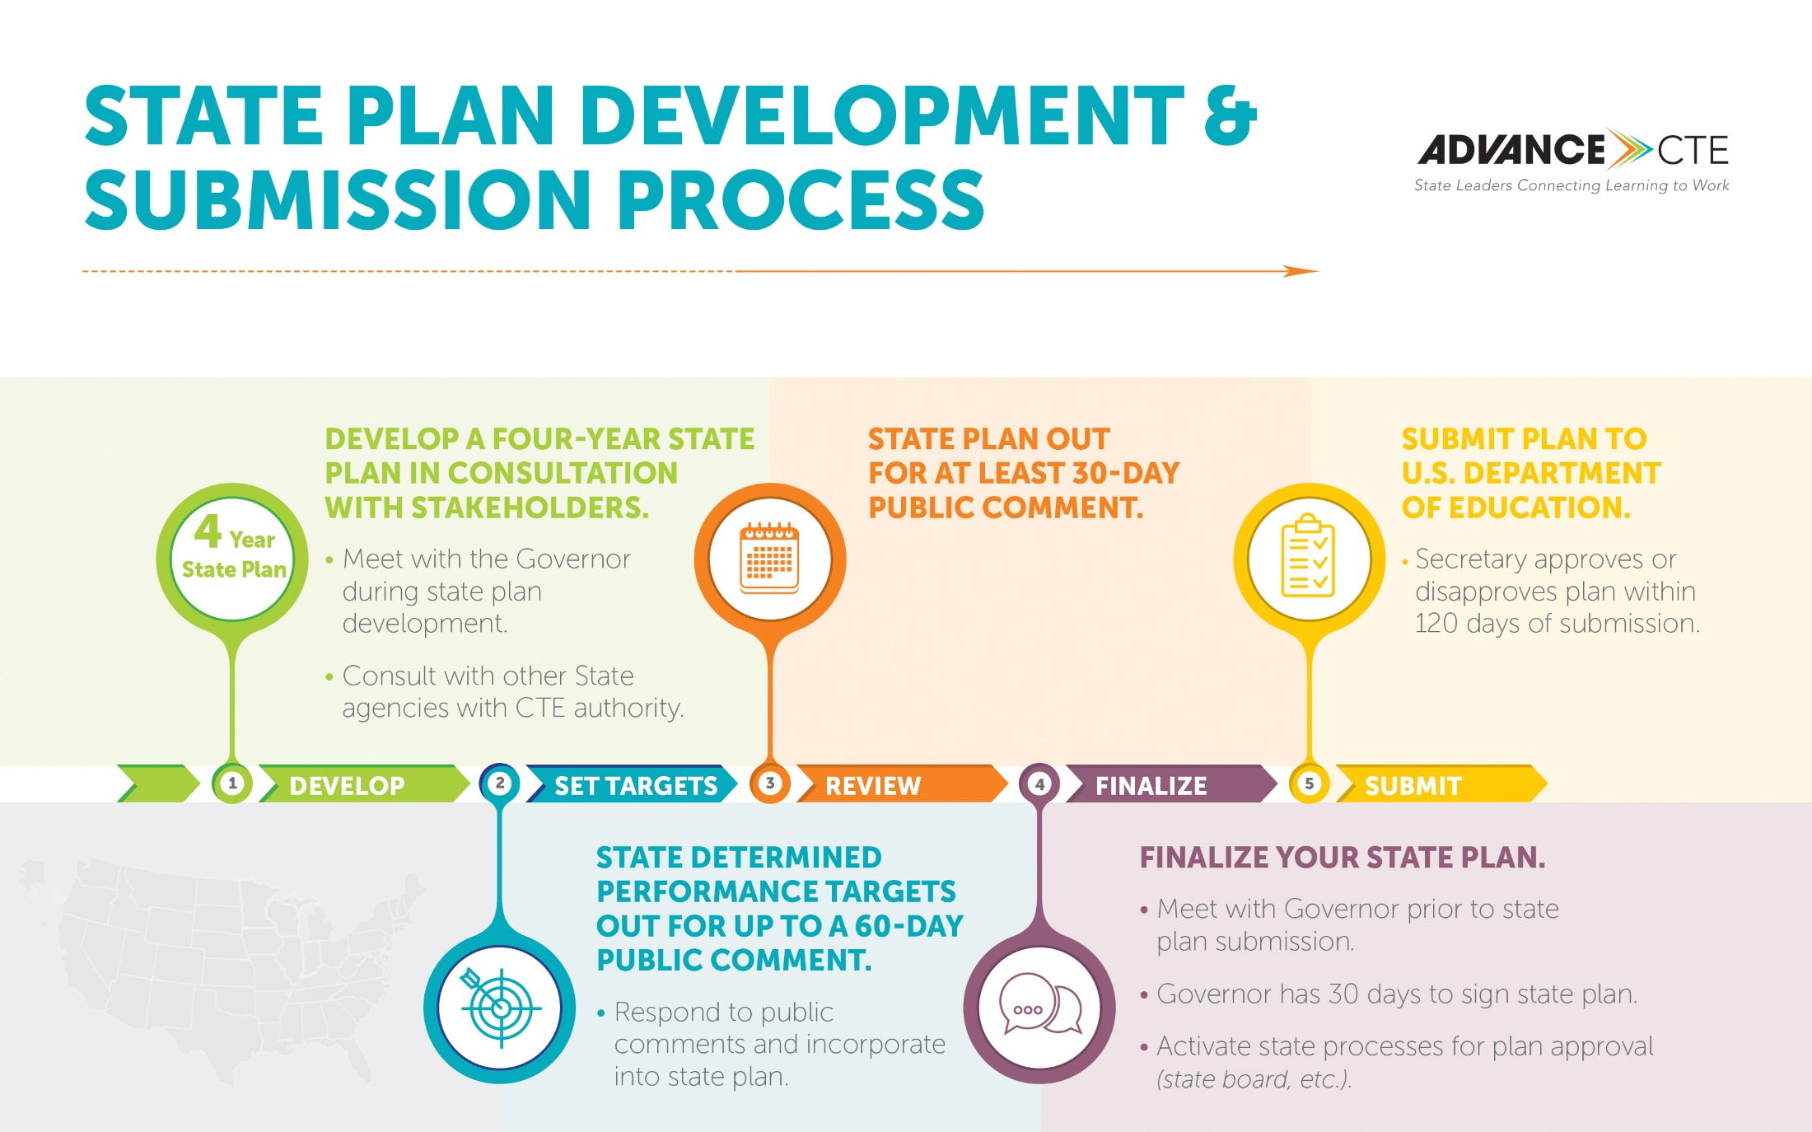

Slide 28
Follow Up Information
Where to find more information (including your contact info)
Next steps

