Slide 1
Presenter Name | Organization Name
Date

Slide 2
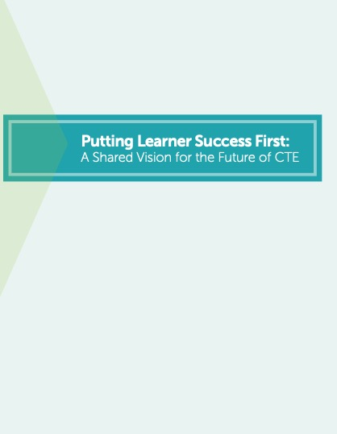
Putting Learner Success First
Published in 2016 with 11 national partners
Affected priorities in Perkins V
Inspired 40 states to build career readiness into K-12 accountability

Slide 3




Slide 4

Without Limits: A Shared Vision for the Future of Career Technical Education
Worked with partner organizations and members to synthesize and prioritize the ideas, strategies and goals generated during the Summit
Published March 2021

Slide 5

CTE Without Limits
Each learner must have access to and the means to be successful in the career of their choice
Will require:
  All systems working in concert
  A commitment to tearing down the barriers that limit opportunity
  CTE to serve as the catalyst to make this vision a reality

Slide 6





































A Shared Vision

Slide 7
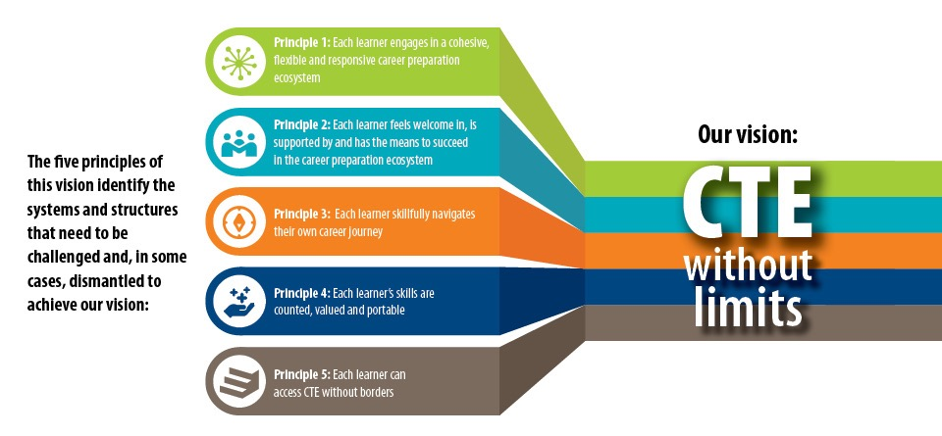
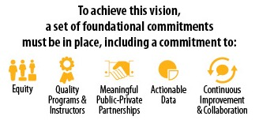

Slide 8





Foundational Commitments to Achieve the Vision
Equity
Quality programs and instructors
Meaningful public-private partnerships
Actionable data
Continuous improvement and collaborative leadership

Slide 9





Five Principles
Call on the CTE field to remove the limitations of:
Siloed systems and funding and accountability models that drive the wrong outcomes
Racist and discriminatory systems, policies and practices
Barriers that prevent learners from navigating their career progression seamlessly
Seat time and degrees so we can value all learning and all skills wherever they occur
Geography through cross-state collaboration and open access

Slide 10

Each learner engages in a cohesive, flexible and responsive career preparation ecosystem

Slide 11

Principle 1
To accomplish this, we must:
Establish shared statewide goals for a cohesive career preparation ecosystem
Ensure all CTE programs of study are flexible and responsive
Expand data and accountability models that value collaboration, equity and innovation
Design equitable funding models that direct funding to where it is most needed

Slide 12

2
PRINCIPLE
Each learner feels welcome in, is supported by and has the means to succeed in the career preparation ecosystem

Slide 13
Principle 2
To accomplish this, we must:
Fully diagnose and understand the scope of institutional barriers and systemic racism
Recruit, retain and support a diverse and culturally competent workforce
Design CTE programs and interventions on the margin while maintaining a commitment to quality
Providing meaningful and ongoing mechanisms for elevating the learner voice

Slide 14

3
PRINCIPLE
Each learner skillfully navigates their own career journey

Slide 15
Principle 3
To accomplish this, we must:
Offer integrated PreK-20W advisement systems
Provide transparent and accessible cross-state data on CTE options and outcomes
Invest the necessary resources to support integrated advisement systems

Slide 16

4
PRINCIPLE
Each learner’s skills are counted, valued and portable

Slide 17
Principle 4
To accomplish this, we must:
Capture and value all learning that occurs, wherever and whenever it happens
Build and leverage trusted systems to translate competencies and credentials into portable credit
Expand skills-based hiring practices that value competencies

Slide 18

5
PRINCIPLE
Each learner can access CTE without borders

Slide 19
Principle 5
To accomplish this, we must:
Leverage a national framework for connecting education and the workforce
Develop inter-state compacts that support collaboration and remove barriers
Invest in research and development to ensure that virtual opportunities are quality, equitable and meaningful

Slide 20

Call to Action
For this vision to be successful, we must:
Draw on the capacity of each existing system and leverage their greatest assets
Push for new models of collaboration, learner-centric design, and funding and accountability models that create the right incentives and supports
Come together to push beyond the status quo and take collective, collaborative and bold action

Slide 21

Find Out More
Read the full vision, access additional resources and sign up to stay engaged:
www.careertech.org/without-limits
Thank you!

