Slide 1
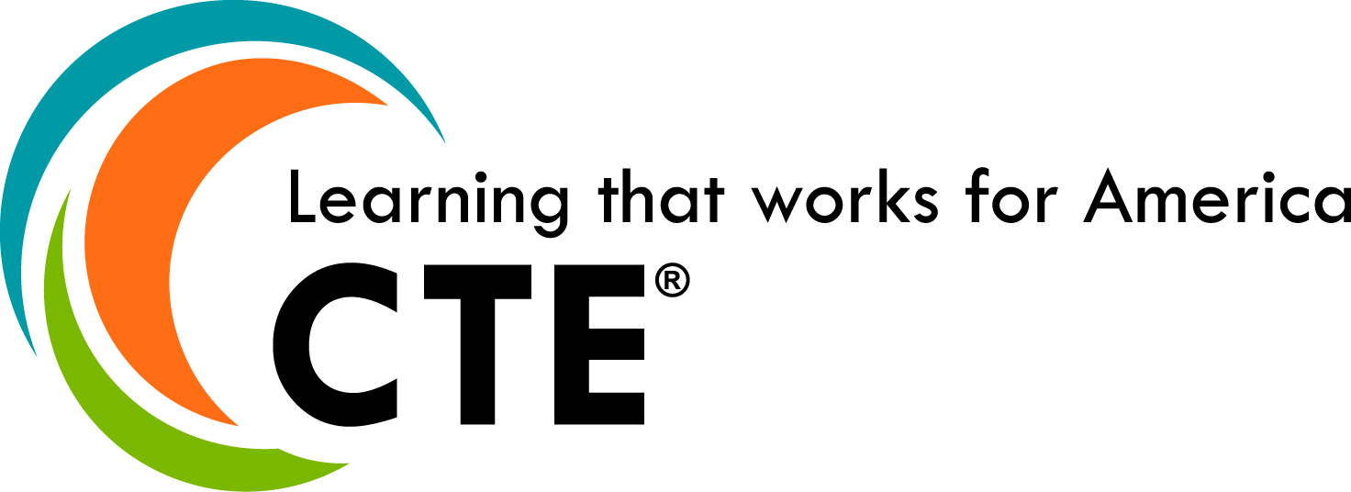
CTE Works for Learners in Green School District, West Dakota
Name, Organization
Date
Notes:
This presentation was created for a K-12 practitioner audience. You can update the slides with data for your district/state. If your audience is postsecondary practitioners, consider focusing on regional data.

Slide 2
What Is Career Technical Education (CTE)?
Provides learners with the knowledge and skills they need to be prepared for college, careers and lifelong learning
Gives purpose to learning by emphasizing real-world skills and practical knowledge within a selected career focus
Notes:
Fill in your own hashtag and website address.

Slide 3
CTE in Our District
Available in grades 5-12
Many learners participate
Some learner groups are under-represented

Slide 4
Today’s Agenda
Review data on who participates in and completes CTE programs in our district
Identify under-represented groups so we can begin to think about ways to increase their participation in CTE
Notes:
This presentation provides a brief overview of CTE in this fictional school district. You may be able to provide more detailed data about not only participation but also potential barriers.

Slide 5

Who Participates in CTE in Our District?

Slide 6
Many Learners in Our District Concentrate in CTE
CTE concentrator: Learner who has completed at least two courses in a single CTE program
of high school seniors in our district were CTE concentrators in 2018-19
49%
Notes:
Charts in this presentation were created in PowerPoint so you can update them with your own data. Starting with top-level data helps set the stage. This presentation focuses on CTE concentrators. Depending on the data you have available, you may choose a different group of CTE learners to focus on.

Slide 7
But Some Learner Groups Are Under-Represented
Data is from the 2018-19 school year.
Notes:
Then you can dig deeper into disaggregated data to highlight gaps.

Slide 8
Under-Representation Starts Early
Too few middle school learners participate in career exploration activities (career fairs, job shadowing, etc.)
Raising awareness about career opportunities and CTE in middle school helps learners and their families/caregivers make informed choices in high school
of middle school learners in our district participated in career exploration in 2018-19
26%

Slide 9
Concentration Is Also Not Proportional Across Career Clusters®
 | All CTE | Human Services | Busines Management & Administration | Agriculture, Food & Natural Resources | Hospitality & Tourism | Arts, A/V Technology & Communications
Total CTE concentrators | 24,336 | 9,661 | 8,198 | 4,099 | 3,513 | 2,635
Black | 26% | 32% | 14% | 22% | 30% | 17%
Latinx | 3% | 5% | 3% | 2% | 5% | 2%
White | 66% | 62% | 69% | 68% | 52% | 75%
Learners from low-income families | 45% | 50% | 32% | 57% | 62% | 32%
Learners with disabilities | 4% | 8% | 2% | 6% | 8% | 2%
Male | 67% | 55% | 65% | 78% | 60% | 55%
Female | 33% | 45% | 35% | 22% | 40% | 45%
Number of related CTE programs in the district | N/A | 634 | 432 | 119 | 124 | 233
Data is from the 2018-19 school year. It reflects duplicate numbers as some learners can achieve concentrator status in more than one career field.
Under- or over-representation of 10 percentage points or more
Notes:
This table shows the top 5 Career Clusters in this district. It is helpful to provide additional levels of disaggregation to uncover gaps and areas of over- or under-representation. If you have priority industries in your district/region, that might be another area where it would be helpful to provide disaggregated data.

Slide 10
Too Few Learners Complete a
CTE Program
38%
of high school seniors in our district completed a CTE program in 2018-19
Notes:
It is often helpful to know not just who is participating in CTE but also who is completing their programs so you can identify and remove barriers.

Slide 11
Completion Rates Are Even Lower in Some Learner Groups
Data is from the 2018-19 school year.

Slide 12
Why Focus on Increasing CTE Participation in Our District?

Slide 13
CTE Concentrators Get an Early Start on Their Careers
of CTE concentrators in our district earned credentials of value while still in high school
82%
Data is from the 2018-19 school year.

Slide 14
But Not All Learner Groups Get This Benefit
Data is from the 2018-19 school year.

Slide 15
Graduation Rates Are Higher for CTE Concentrators
87%
CTE concentrators in the district
72%
District
76%
State
Data is from the 2018-19 school year using the adjusted cohort graduation rate.

Slide 16
Graduation Rates Stay High Across Learner Groups
Data is from the 2018-19 school year using the adjusted cohort graduation rate.

Slide 17
CTE Concentrators Go on To Succeed After High School
Data is from the 2018-19 school year.

Slide 18
Next Steps
Identify barriers that are preventing learners from participating
Lack of awareness about CTE opportunities?
Misperceptions about CTE?
Lack of access to CTE programs?
Notes:
In this slide, insert your next steps – now that you know which learner groups are under-represented, the next step is to figure out why and what barriers are preventing participation.

