Slide 1
The Common Career Technical Core: The Development Process

Slide 2
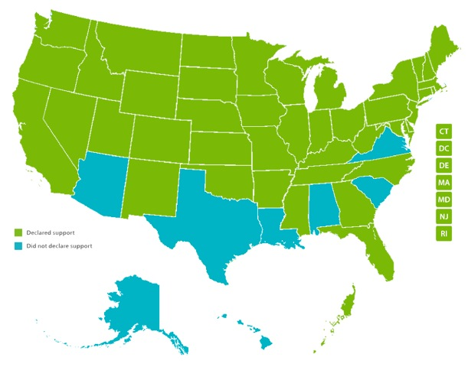
The Common Career Technical Core
The Common Career Technical Core are benchmark standards that define what a student should know and be able to do at the end of a program of study.
Notes:
The CCTC (or CCTC) were released after a two-year development process that directly engaged 42 states, DC, Palau
The CCTC are benchmark standards that define what a student should know/be able to do after completing a program of study

Slide 3
Components of CCTC
Standards for each of the 16 Career Clusters® and their 79 Career Pathways
Overarching set of Career Ready Practices, which address the knowledge, skills and dispositions that are important to becoming career ready.
Notes:
There are two major compoents…

Slide 4
The Development Process
Revision of Career Cluster® Knowledge & Skills State-ments
State-led Working Groups
Public Comment
Working Group Validation
Final Release
Notes:
As the CCTC are standards developed for states, by states, their development process was inclusive, opten
There were four major components ot the development process,

Slide 5
Knowledge & Skills Revision Process
Engaged Subject Matter Experts
Web-based review
Identified benchmark standards
Writing Teams
Analyzed input
Proposed revisions
Conducted online industry validation
Set baseline for CCTC

Slide 6
Working Groups
Identify consensus among states on CTE standards to frame program of study
320+ business and industry, state leaders, postsecondary, master teachers were involved
Review Knowledge & Skill Statements
Drafted CCTC

Slide 7
Public Comment & Validation
Two-week public comment period
Rating each statement on clarity, appropriateness, specificity, within reach
About 1,000 respondents
Back to working groups to review, validate CCTC based on feedback from public comments

Slide 8
Final Release
June 2012: National Career Clusters® Institute
In total, CCTC development incorporated input at various stages from approximately 3,500 individuals representing K-12 education, business and industry and higher education from across the nation.
Notes:
The CCTC were released in June 2012
In total, CCTC development process engaged over 3,500 individuals representing K-12 education, business and industry and higher education from across the nation

Slide 9
CCTC Resources
Download the CCTC
More info on development, including the CCTC technical report
www.careertech.org/CCTC
Notes:
And here is where you can find more resources on the CCTC on our website including the standards themselves, background info on their development and materials to support the use of the CCTC in your states and communities
Thank you

