Slide 1




The Federal Budget and Appropriations Process: What’s the Difference?
Brought to you by the National Association of State Directors of Career Technical Education Consortium at www.careertech.org

Slide 2

Main Actors
The President
Congressional Budget Committees
Congressional Appropriations Committees
    Labor-HHS-Education Subcommittee(s)

Slide 3


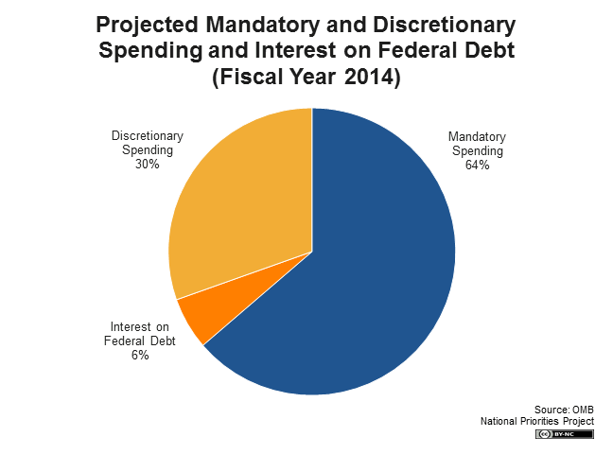
Budget Basics

Slide 4
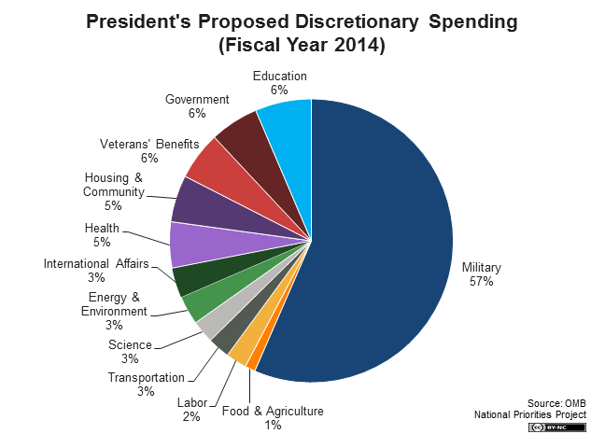
Discretionary Spending

Slide 5
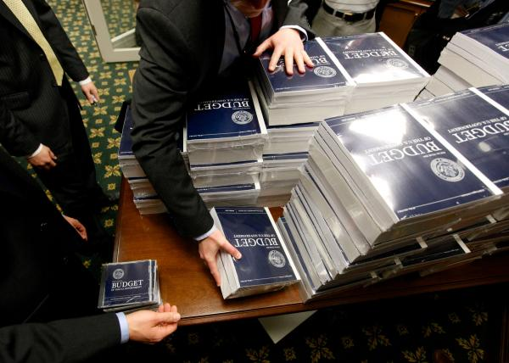
President’s Budget Request
First week in February
OMB prepares request
Highly detailed
Spending priorities
Budget is a tool for policymaking

Slide 6
Congressional Budget Process
President’s budget request sets Congressional action in motion
Congress develops a budget resolution:
      Non-Binding resolution
      For a specified amount of time
      Framework of federal budget & a topline discretionary number
      Composed of 20 budget functions

Slide 7
Congressional Budget Process (Cont.)
Information gathering: Views & Estimates and Member Requests
Congressional Budget Office
Bicameral conference:
      Concurrent resolution
      Negotiations to resolve differences
Establishes 302(a) allocation

Slide 8
Congressional Appropriations Process
Getting from 302(a) to 302(b)
From 20 budget functions to 12 appropriations bills
Reconciling legislative differences
With or without a budget resolution

Slide 9
Congressional Appropriations Process (Cont.)
Types of appropriations:
      Regular appropriations & Omnibus
      Supplemental appropriations
      Continuing Resolutions

Slide 10
Additional Resources
Stay current on legislative news by following the NASDCTEc blog. Subscribe today!
Access the latest Perkins information on the NASDCTEc Policy & Legislation webpages.

