Slide 1
FY 19 State Membership
Final Guidance

Slide 2
On Today’s Webinar
Overview of state membership policy and guidance
  Brief Q&A
Walk through the process to affirm/change state members
  Brief Q&A
Timeline/Next Steps

Slide 3
State Membership Structure
“Beginning Fiscal Year 2018 (July 1, 2017), each state membership will cover up to five individuals, including and selected by the State CTE Director.”
State Director is the only required member
Only State Director may add or change individuals
All memberships are valid from July 1 to June 30
No impact on state dues
May add more than five for cost of relevant membership type
  All state memberships must be paid for by agency that employs the State CTE Director

Slide 4
Role of the State Director
This does not change who/how State Director is identified
State Director retains the vote on behalf of the state for all Advance CTE membership votes
This does not change the governance of Advance CTE or who can serve on the Board
Participation in expanded state membership is voluntary

Slide 5
Who Is Eligible?
Any state member must qualify as an Advance CTE Associate, State or Associate, Non-state member
Associate, State member ($75): Employees who work in state government such as state agencies, governor’s office, higher education systems, etc.; must live in a state with an active Advance CTE membership.
Associate, Non-state member ($100): An individual who is directly employed by the educational delivery system but is not a state employee, including local administrators, teachers, and faculty; must live in a state with an active Advance CTE membership.

Slide 6
Who Is Not Eligible?
Advance CTE organizational members:
  Representatives of any organization, including non-profit and for-profit organizations, national or state associations, consulting firms, other businesses and corporations.
Non-members who work for entities that meet the “organizational member” criteria (including such as state chambers of commerce, business organizations, etc.)
Vendors
Contractors or consultants even if they are employed by a state agency

Slide 7
Exceptions
State ACTE Executive Directors
State CTSO Advisors
Individuals who may not be employed by a state but are appointed or elected to a governing body that has authority or influence over CTE; and
Executive Directors of the state’s CTE administrator organization

Slide 8
Can A Person Become Ineligible?
Individuals may become ineligible if they leave their positions
Responsibility of State Director to notify Advance CTE of change

Slide 9

Hawaii’s State Membership
Bernadette Howard, State CTE Director, University of Hawaii System
State Members
  Dominic Estrella, University of Hawaii
  Warren Kawano, University of Hawaii
  Stacey Takanishi, Hawaii Department of Education
  Allicyn Tasaka, Hawaii ACTE

Slide 10
Questions?
Unmute your phones or type a question into the chat box

Slide 11
Submitting Your State Members
Two-step process
  Annual dues intent form
  “Renew State Membership” form at careertech.org
High-level Timeline:
  2/23 – Receive dues intent form, FAQ and resources from Advance CTE
  2/23-3/30 – Complete and submit dues intent form and online “State Membership” form
  No later than 5/15 – Advance CTE sends state dues invoices to State Directors

Slide 12
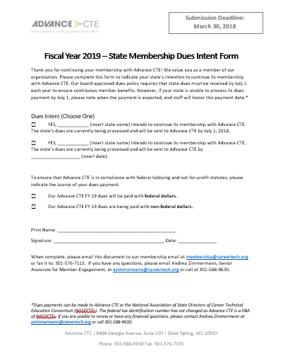
Dues Intent Form
Indicate:
  When dues will be received
  To be paid with federal or non-federal funding
Written signature required
Email it back to Advance CTE
Deadline to submit: March 30

Slide 13
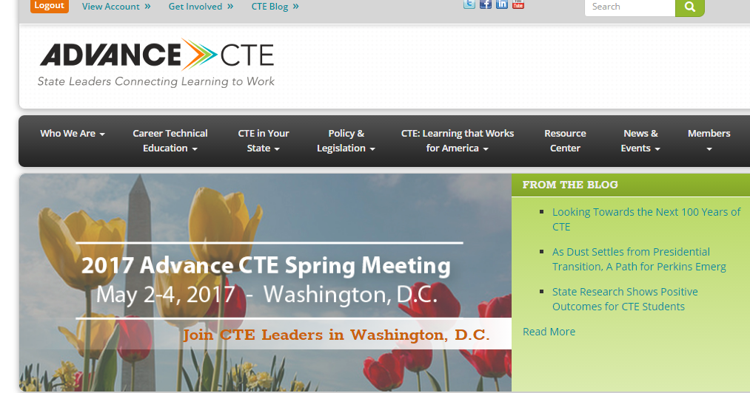
State Membership Portal
One-stop shop for state membership resources and forms: careertech.org/state-membership

Slide 14
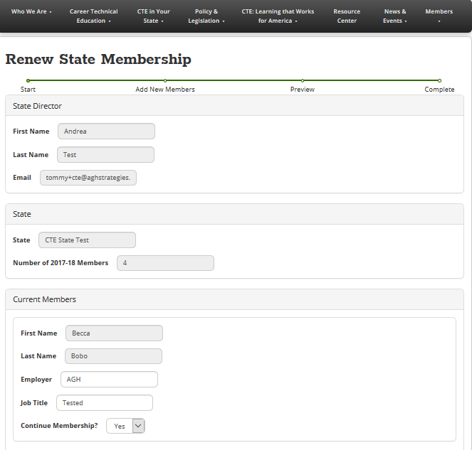
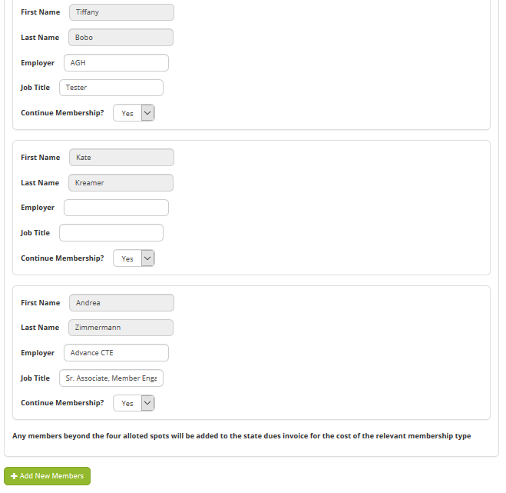
Online State Member Form
Submit your state members using this form
You must be logged in to access this form
Only State Directors can see and access this form
Deadline to submit: March 30
Will receive confirmation email after submitting

Slide 15
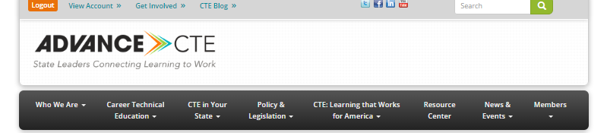
You must be logged in
If logged in, your name and state will appear here
Verify or remove existing state members by selecting Yes or No
Ready to add your new members? Click the green button

Slide 16
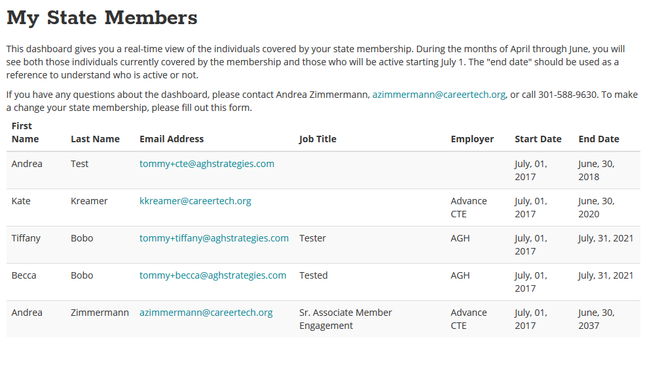
State Member Dashboard
Only State Directors can see and access this dashboard
Link found on State Membership webpage
Shows all active state members
After July 1, State Directors may initiate add/change requests through this dashboard

Slide 17
Questions?
Unmute your phones or type a question into the chat box

Slide 18
Timeline and Next Steps
Timeline
  2/23 – Receive by email -- Dues Intent Form, FAQ and resources from Advance CTE
  2/23-3/30 – Complete and submit Dues Intent Form and online “State Membership” form
  No later than 5/15 – Advance CTE sends state dues invoices to State Directors
  7/1 – All state members receive an email from Advance CTE about how to maximize their membership

Slide 19
Thank You!
For any questions, contact Andrea Zimmermann, azimmermann@careertech.org or 301-588-9630

